Slide 1

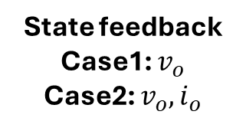
Circuit Model
Circuit Input
Gate signal
Buck Converter
State feedback
Case1: $v_{o}$
Case2: $v_{o}, i_{o}$
Reference
$$V_{ref}$$
Controller

Slide 2
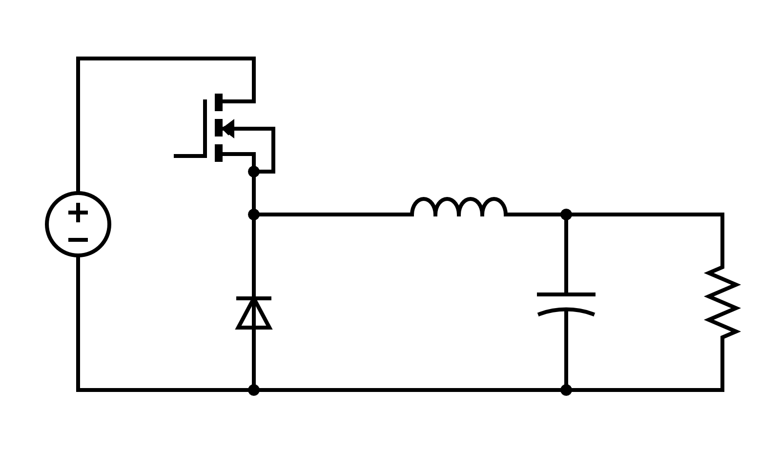







$$Gate$$
+
$$I_{o}$$
$$V_{g}$$
+
$$L$$
-
$$C_{o}$$
$$R_{o}$$
$$V_{o}$$
-

