Slide 1
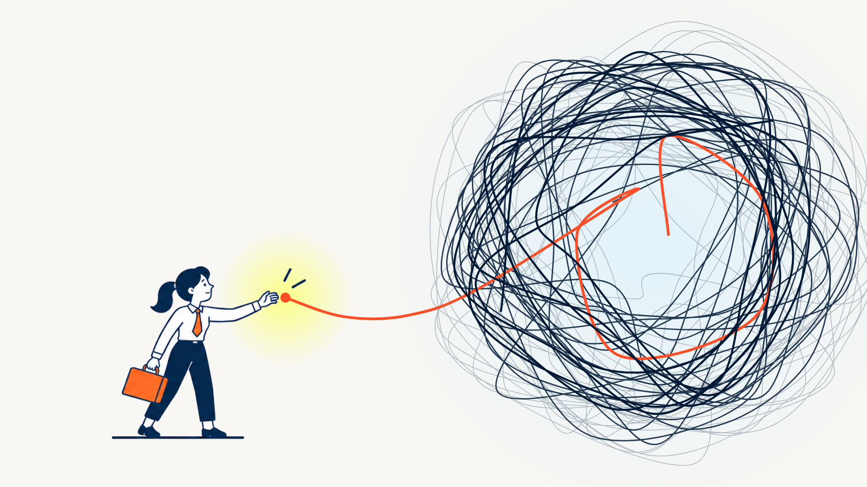
01 FIRST STEP
No matter how
hard it looks,
there is always
a beginning.
INFUSE Academy 01 / 03
Notes:
Tools: character generated in Magnific (slide 1); visuals built in code (HTML, SVG, Canvas) with Claude (Anthropic); typography Asap; INFUSE Academy palette. Animated version: see the live link.

Slide 2
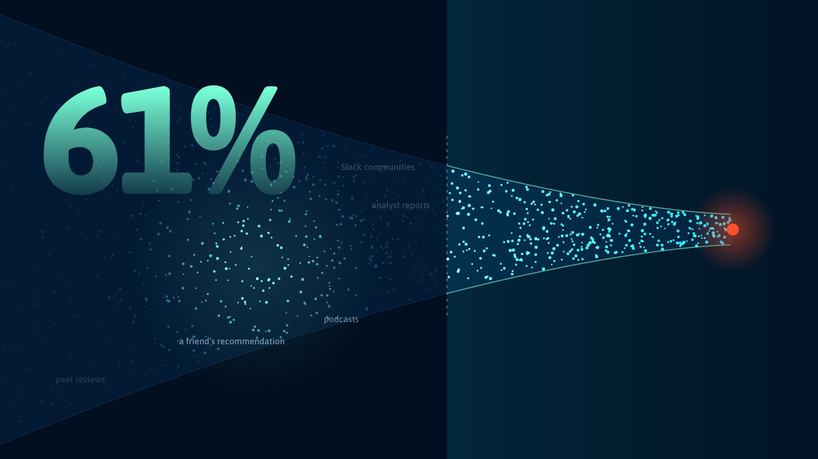
02 THE DARK FUNNEL
39%
is all your dashboard ever shows
PRICING PAGE · DEMO REQUEST · FORM FILL
of the buyer’s journey happens
where you cannot see.
They finally
raise their hand.
YOU START SEEING THEM HERE
INFUSE Academy 02 / 03
Notes:
Tools: character generated in Magnific (slide 1); visuals built in code (HTML, SVG, Canvas) with Claude (Anthropic); typography Asap; INFUSE Academy palette. Animated version: see the live link.

Slide 3
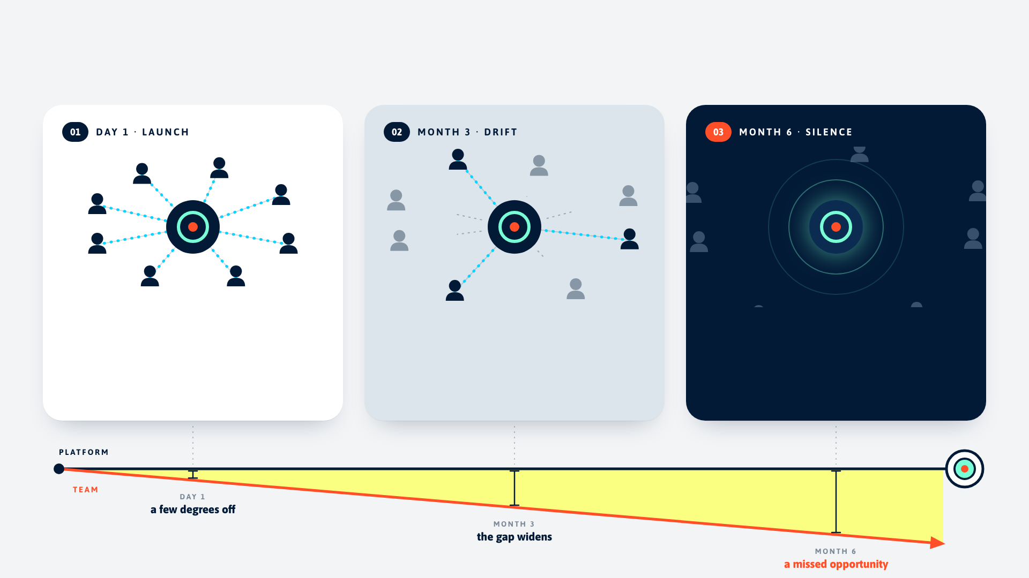
03 THE SCRIPT
INFUSE Academy 03 / 03
A small gap at the start. A missed opportunity at scale.
100% team adoption
38% team adoption
0% team adoption
The tool is capable. The logic is sound. The goal is compelling.
Old habits creep back. Nobody raises a flag.
Nobody is using it. The gap was there on day one.
Notes:
Tools: character generated in Magnific (slide 1); visuals built in code (HTML, SVG, Canvas) with Claude (Anthropic); typography Asap; INFUSE Academy palette. Animated version: see the live link.

Slide 4
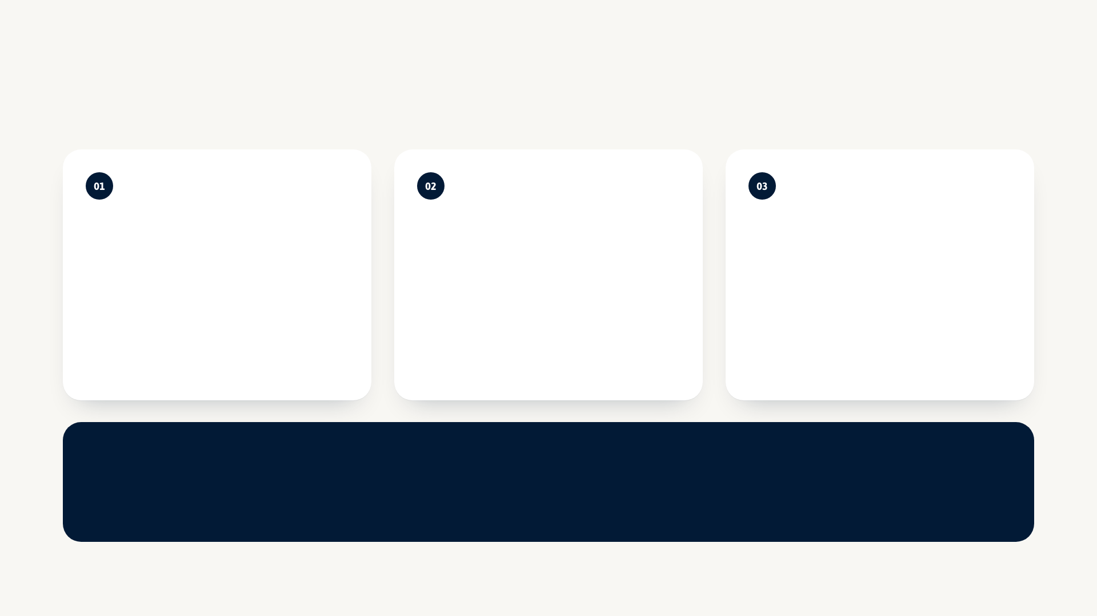
04 PROCESS
Tools & thinking
A beginning
The dark funnel
The script
TOOL
TOOL
TOOL
Magnific (character) + Claude → code
Claude (Anthropic) → HTML Canvas
Claude (Anthropic) → HTML + SVG
The character was generated with AI; the world around her is code. The knot is built from hundreds of random loops so “hard” looks genuinely overwhelming. One orange thread escapes the chaos and ends right at her fingertips: the beginning is always within reach.
A statistic is easy to read and easy to forget, so the 61% becomes physical: buyers flow through a funnel and most of their journey happens in the dark. In the live version your cursor is a flashlight, so you literally have to go looking for them.
The story is about a gap too small to notice. Each panel shows the team drifting away from the platform while one line underneath shows why: a few degrees off on day one becomes a missed opportunity by month six. The panels darken as the story does.
WHY AI
I generated the character in Magnific, using the INFUSE character sheet as the reference, because a human figure is where AI illustration shines and a flat, limited-palette prompt keeps it on brand. Everything around her — knot, thread, funnel, storyboard — is built in code with Claude, so it stays crisp, animates, and follows the palette exactly.
Notes:
Process slide: tools used per visual and why AI.

