Slide 1
XML Solutions
Kasson Davis, Tucker Sparkman, Ellis Nielsen

Slide 2
Solutions
We have three main solutions
Struct / Class Approach
XML Xpath Approach
Hybrid Approach

Slide 3
Class Struct Approach
Users use a agreed upon method on XMLDoc
The method returns a class instance from the XML
This instance is a ptr of the abstraction of the data element, i.e. Metrics, MassBalance, etc.

Slide 4
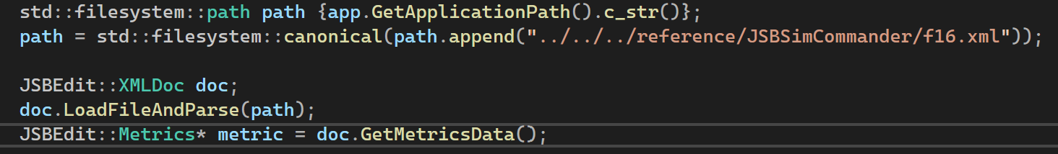
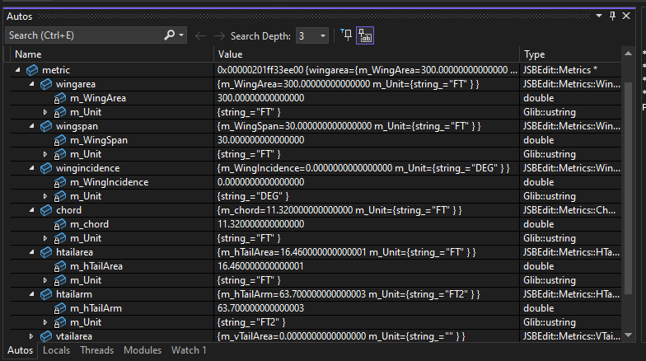
Example

Slide 5
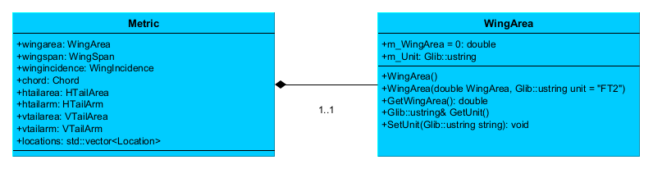
UML Diagram

Slide 6
Class Struct Approach
Pros:
Easy access
Less error prone
Cons:
XML group will have to do more work
Not very flexible

Slide 7
Xpath Solution
Xpath is a query language for XML
Similar to a file path ”home/documents/CSE3310”
Has operations for selecting a single element, or getting multiple

Slide 8
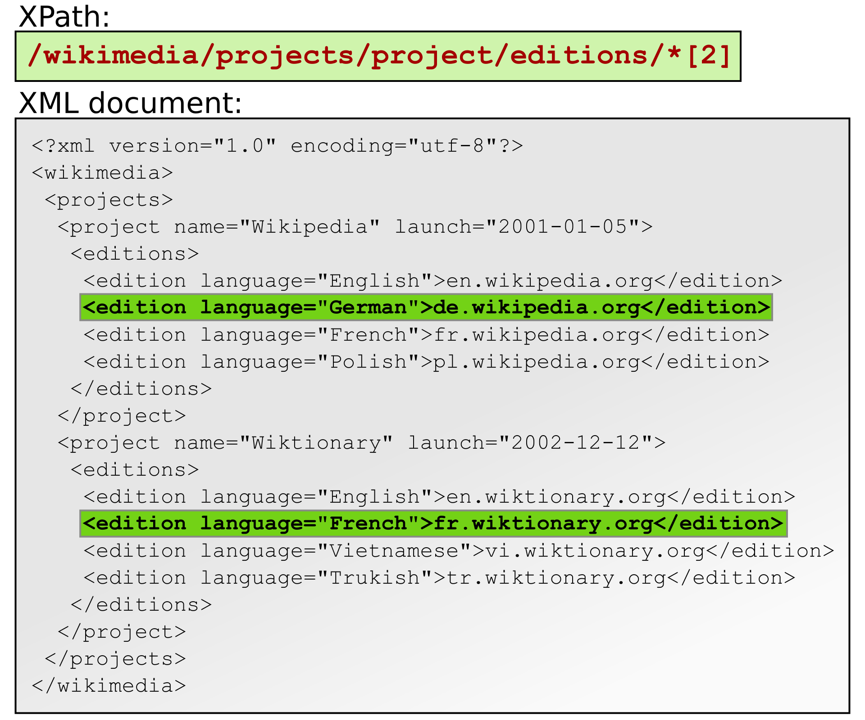
Example

Slide 9
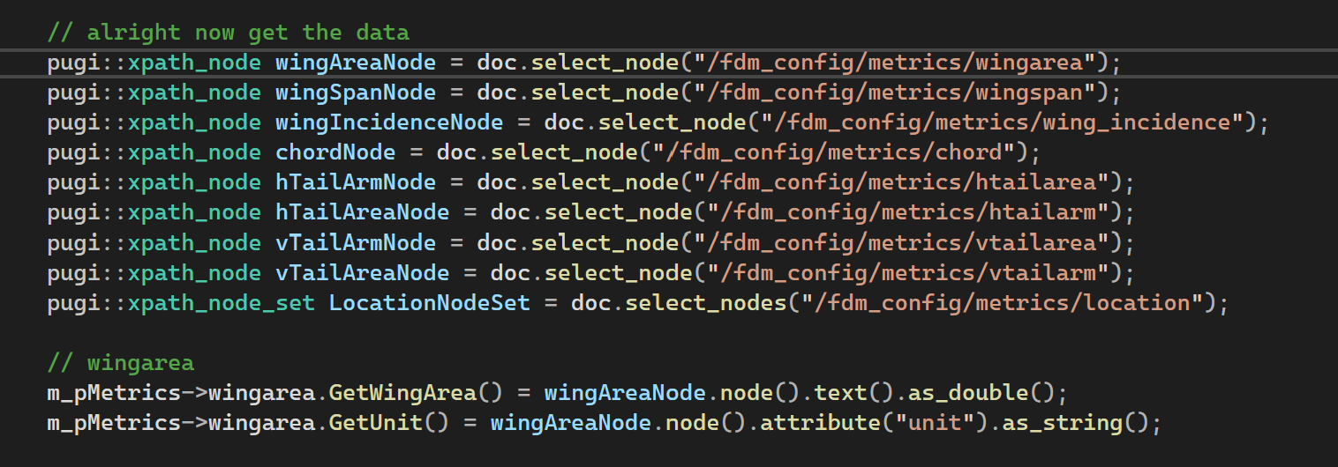
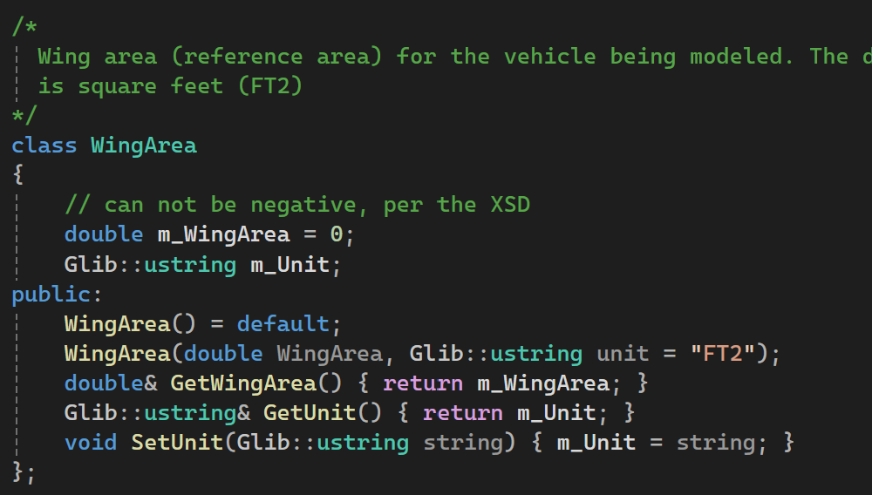
Example Cont.

Slide 10
Hybrid Approach
Best of both worlds
Classes can be written and used
Xpath can be used for individual use cases

Slide 11
Solution 4
The Best solution
We did not ask for permission from Professor Davis.

Slide 12
Best Solution
Have 1106 students create a solution.
Or have 1106 students do the project for us.

Slide 13
Solution 4
What is one more lab for 1106?

Slide 14
Solution
PROs
Freshman write the code
We will not have to do the project anymore
We aren’t freshman
CONs
Freshman write the code
1106 Students might hate 1106 more
We have to convience Professor Davis to allow it

