Slide 1

Neural Networks and Deep Learning
Zach Blanks
MIT 15.S60
(adapted from 2017 Eli Gutin)

Slide 2
Overview
Why deep learning?
So what is a neural network?
TensorFlow/Keras
Image Recognition
Sentiment Analysis

Slide 3
Goals
De-mystify neural networks
Introduce common applications
Highlight additional resources for further exploration

Slide 4
Why Deep Learning?

Slide 5
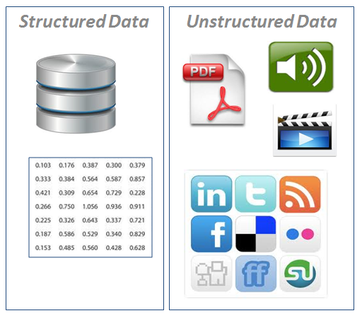
Why deep learning?
Unstructured data

Slide 6
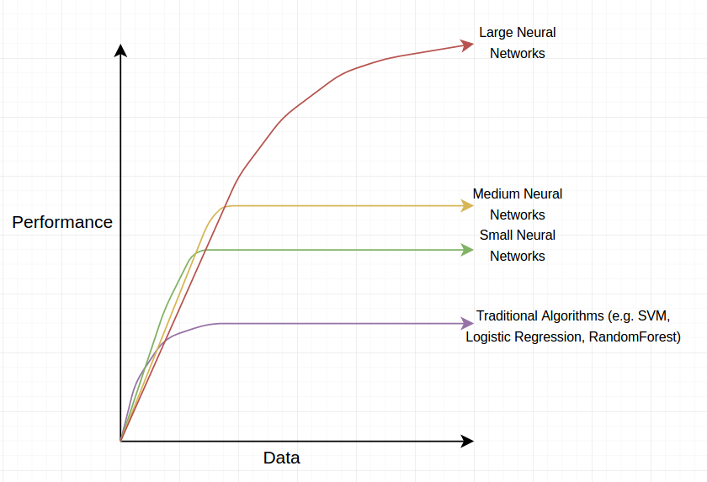
Why deep learning?

Slide 7
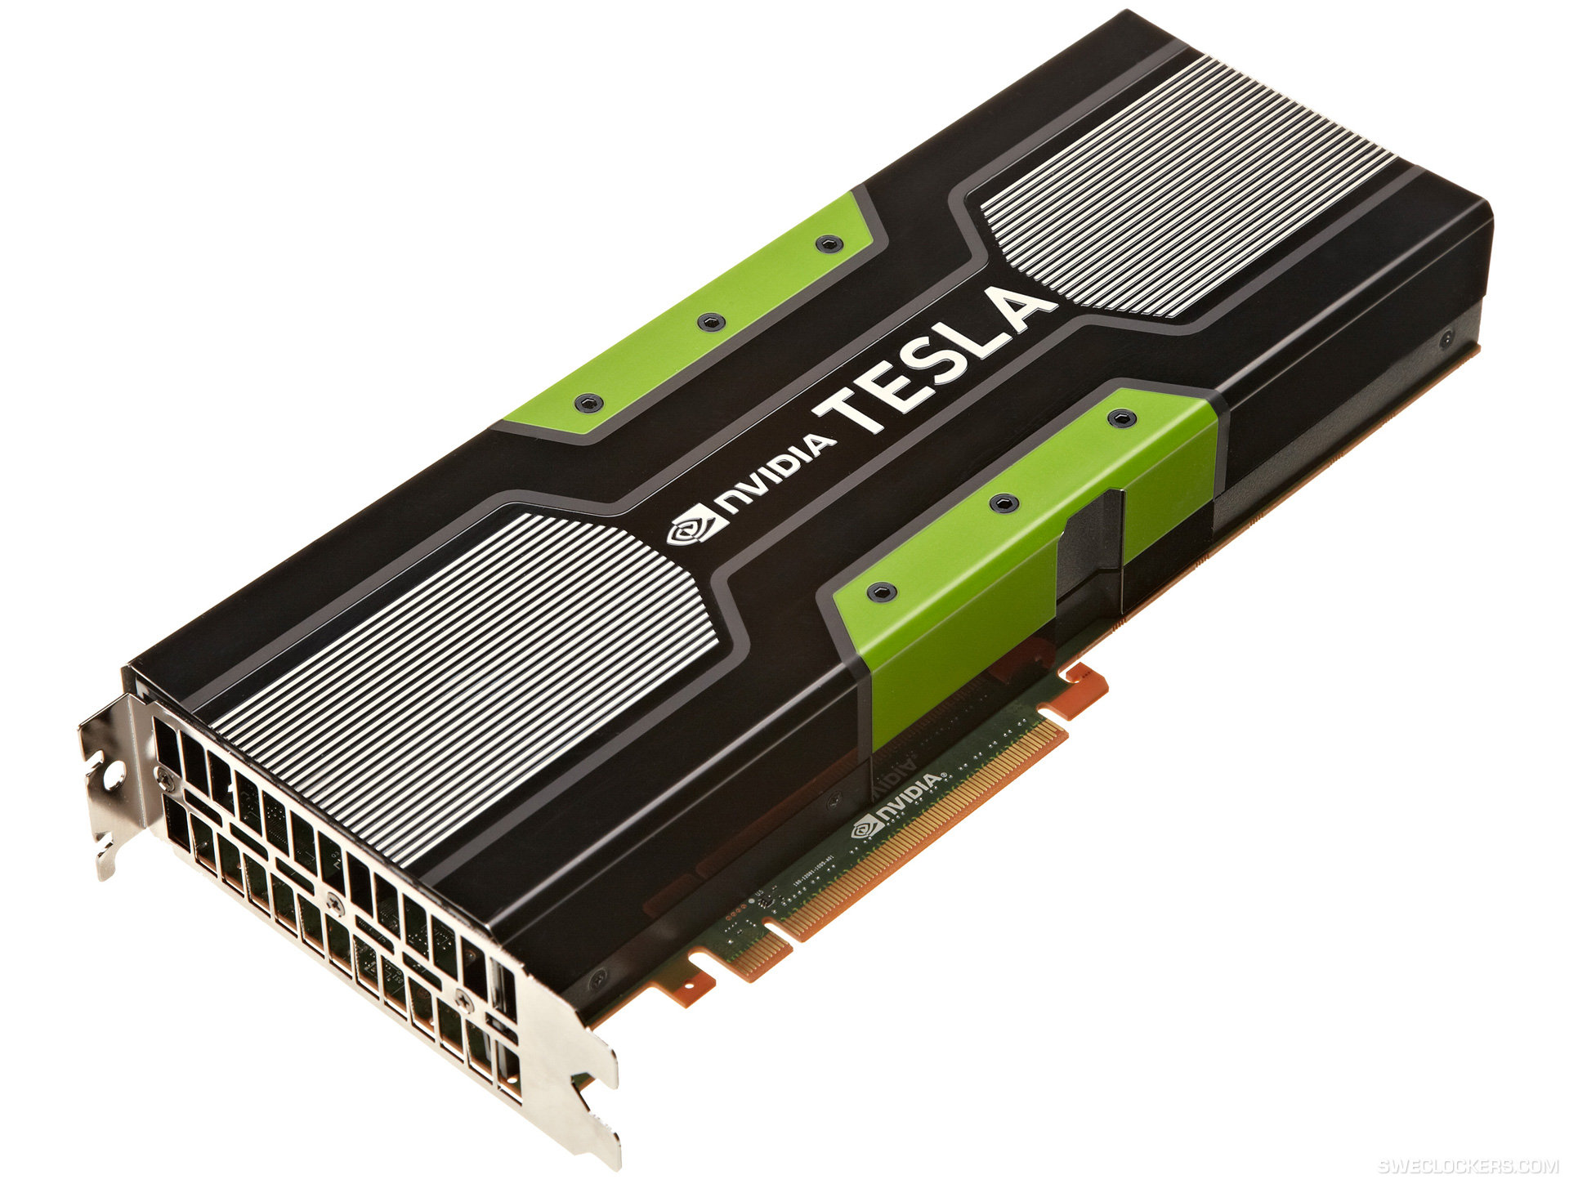
Why deep learning?

Slide 8
Intro to Neural Networks

Slide 9
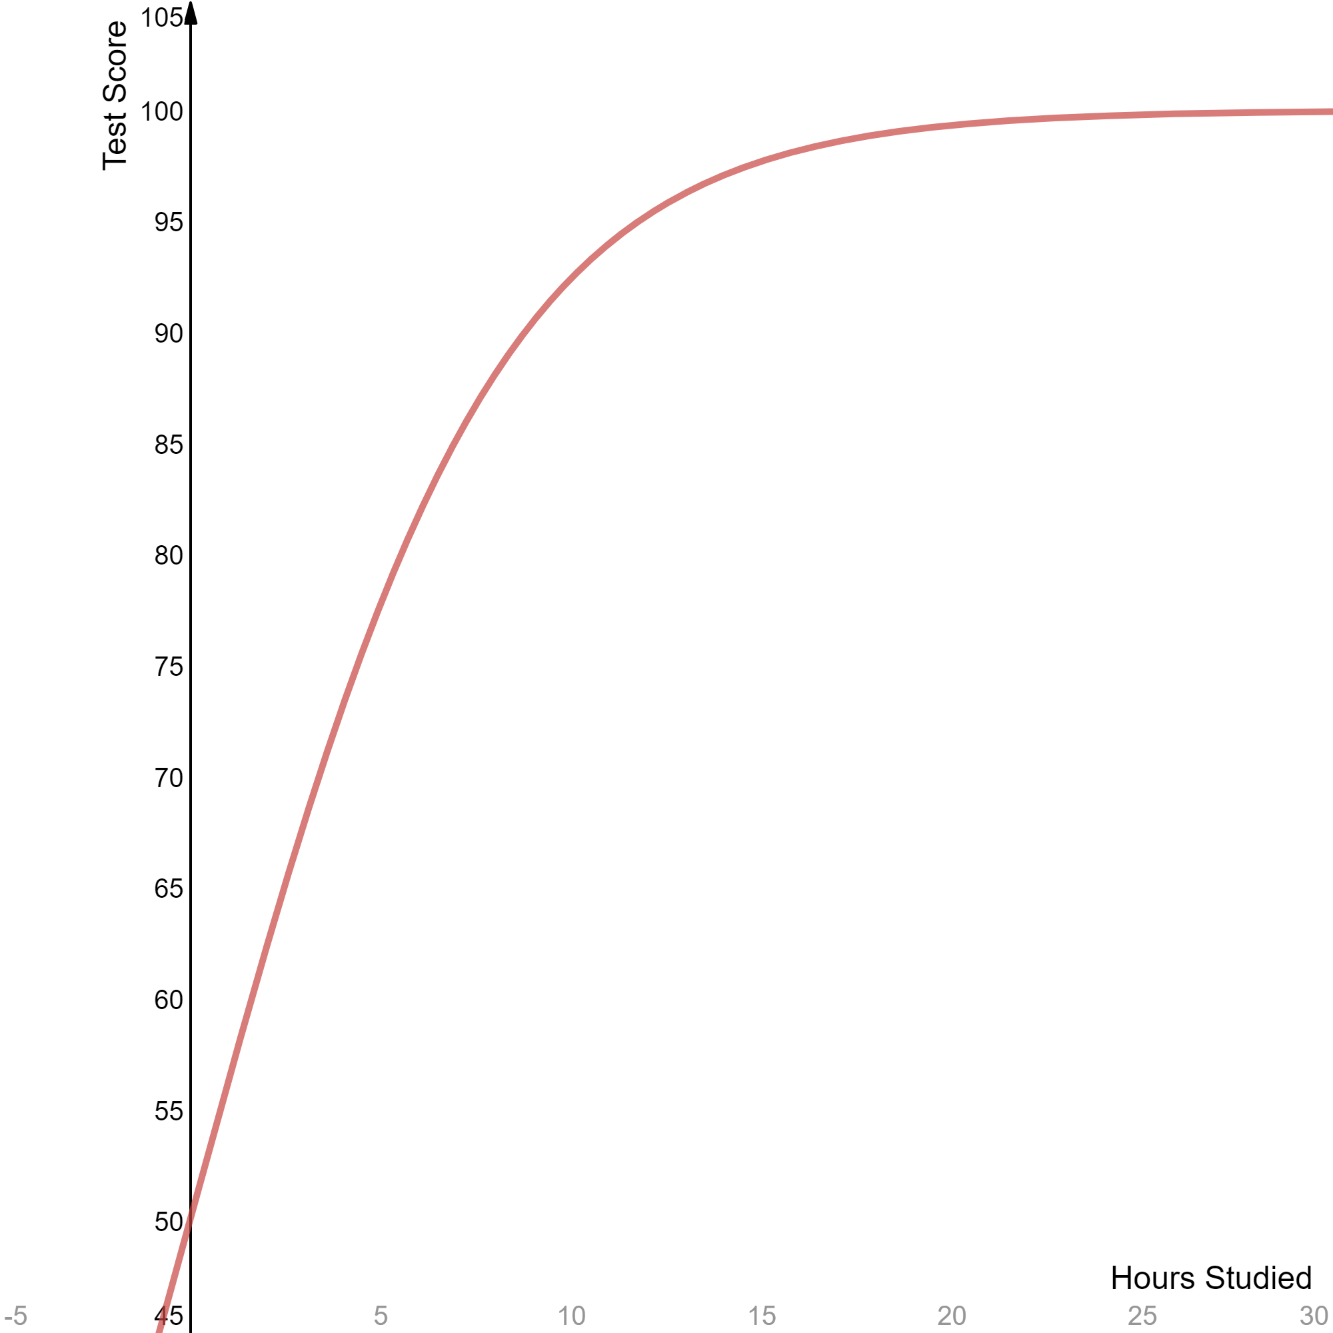
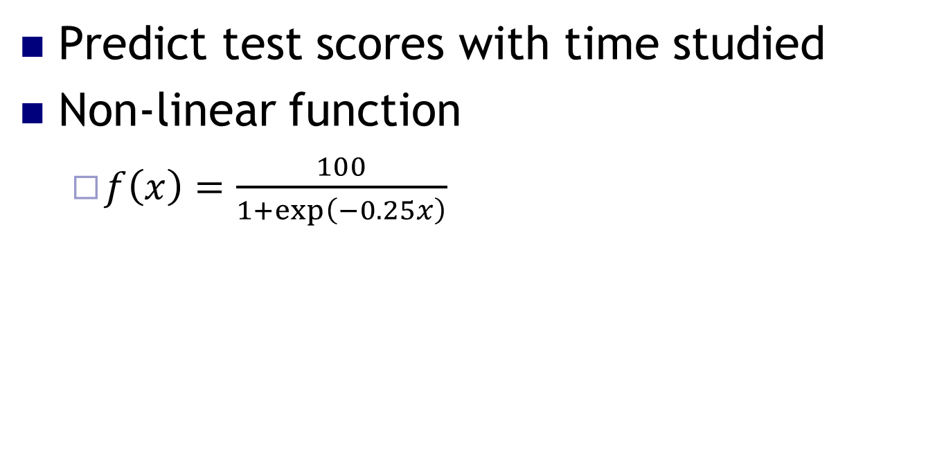
Supervised Learning
Predict test scores with time studied
Non-linear function
$f\left(x\right)=\frac{100}{1+\exp\left(−0.25x\right)}$

Slide 10
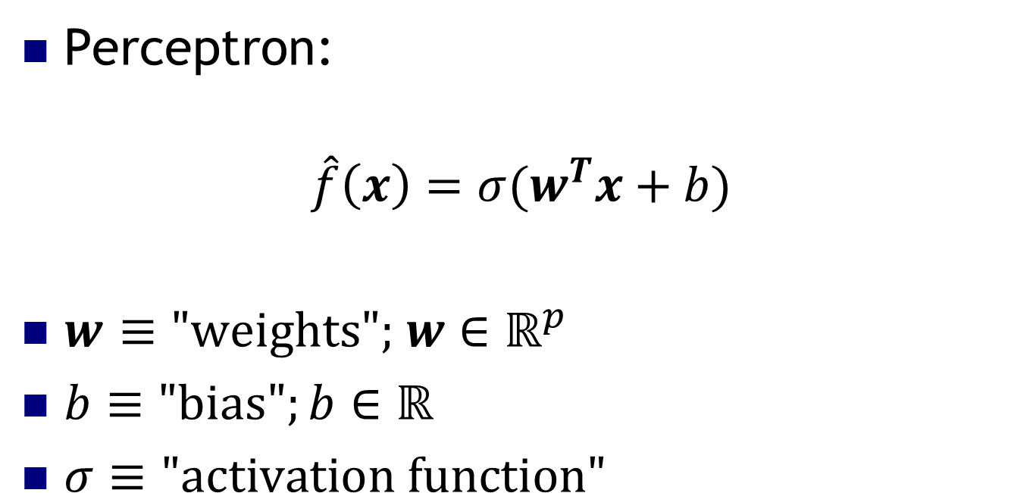
Perceptron
Perceptron:
$$\hat{f}\left(x\right)=σ(w^{T}x+b)$$
$w$ $≡\text{"}\text{weights}\text{"; }w∈ℝ^{p}$
$b≡\text{"}\text{bias}";b∈ℝ$
$σ≡\text{"}\text{activation} \text{function}"$

Slide 11
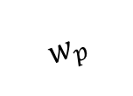
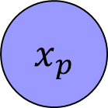
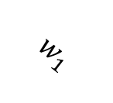
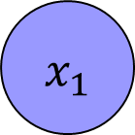
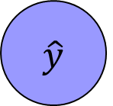


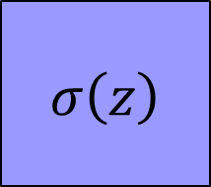

Perceptron
$$x_{1}$$
$$w_{1}$$
$$⋮$$
$$σ\left(z\right)$$
$$\hat{y}$$
$$w_{p}$$
$$x_{p}$$
$$b$$
$$1$$

Slide 12
Project 1: Predict Test Scores
Goal: Understand intuitively how neural networks operate
Introduce TensorFlow/Keras

Slide 13
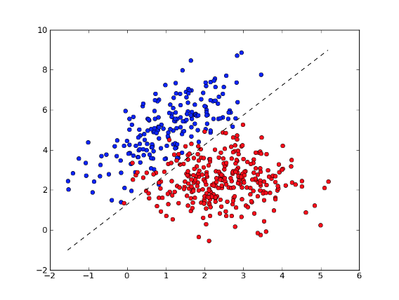
Perceptron

Slide 14
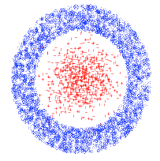
Main Issue with Perceptrons
What if the data is not linearly separable?

Slide 15

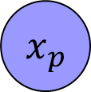

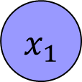
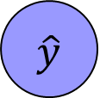



Multi-Layer Perceptrons
$$x_{1}$$
$$w_{1A}$$
A
$$⋮$$
$$w_{AC}$$
C
$$\hat{y}$$
$$x_{p}$$
B
$$w_{BC}$$
$$1$$

Slide 16
Activation Functions
STEP FUNCTION
Used in good old-fashioned perceptron

Slide 17
Activation Functions
LINEAR
like linear regression
(only used for final layer)
LOGISTIC / SIGMOIDAL / TANH
Smooth, differentiable, saturating functions
RECTIFIED LINEAR (ReLU)
Cheap to compute, popular lately

Slide 18
MLP Generalization
Output can be multi-dimensional

Slide 19
MLP Theorem
Theorem: 2-layer NNs with sigmoid activation functions can approximate any other function
(Kurt Hornik: Approximation Capabilities of MultiLayer FeedForward Networks, 1991)

Slide 20
Project 2 - MNIST
Goal: Identify hand-written digits from an image
Live coding in R with TensorFlow/Keras packages
Play with extending the code

Slide 21
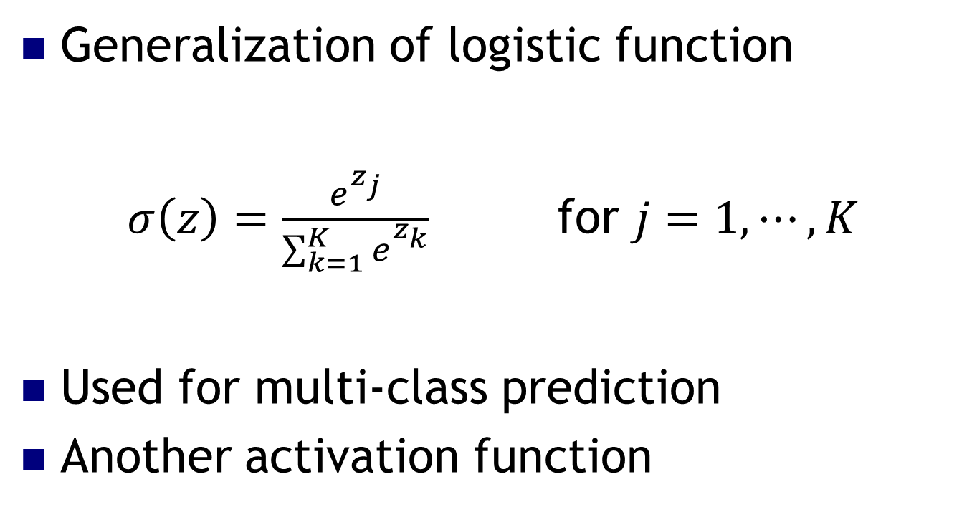
Project 1: Softmax Layer
Generalization of logistic function
$σ\left(z\right)=\frac{e^{z_{j}}}{\sum_{k=1}^{K}{e_{}^{z_{k}}}}$ for $j=1,⋯, K$
Used for multi-class prediction
Another activation function

Slide 22
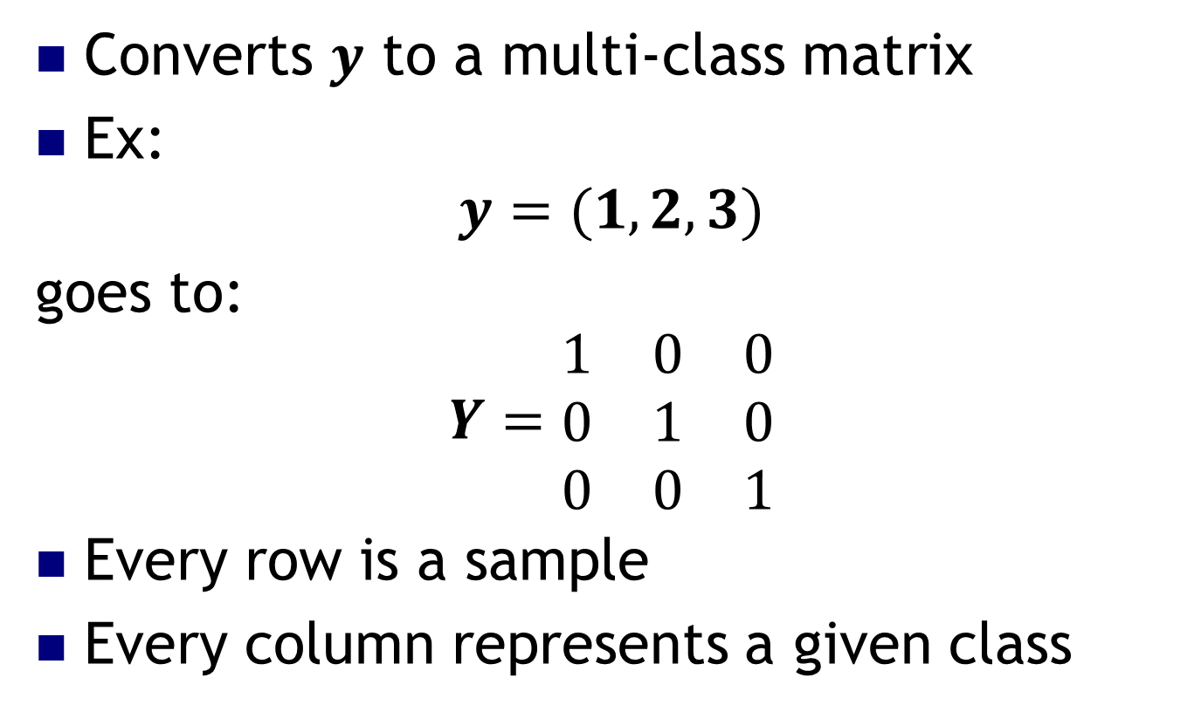
Project 1: One-Hot Encoding
Converts $y$ to a multi-class matrix
Ex:
$$y=(1,2,3)$$
goes to:
$$Y=\begin{matrix}1 & 0 & 0 \\ 0 & 1 & 0 \\ 0 & 0 & 1\end{matrix}$$
Every row is a sample
Every column represents a given class

Slide 23
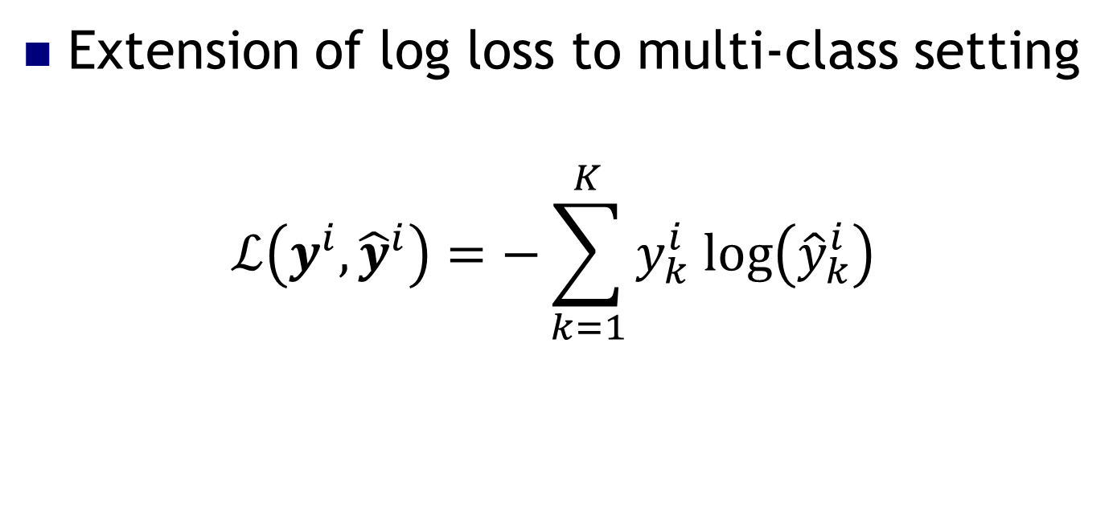
Project 1: Cross-Entropy Loss
Extension of log loss to multi-class setting
$$ℒ\left(y^{i}, {\hat{y}}^{i}\right)=−\sum_{k=1}^{K}{y_{k}^{i} log\left({\hat{y}}_{k}^{i}\right)}$$

Slide 24
Project 2: Extensions
Try changing…
The number of hidden neurons
The input layer activation function
Learning rate
The optimization algorithm
etc.

Slide 25
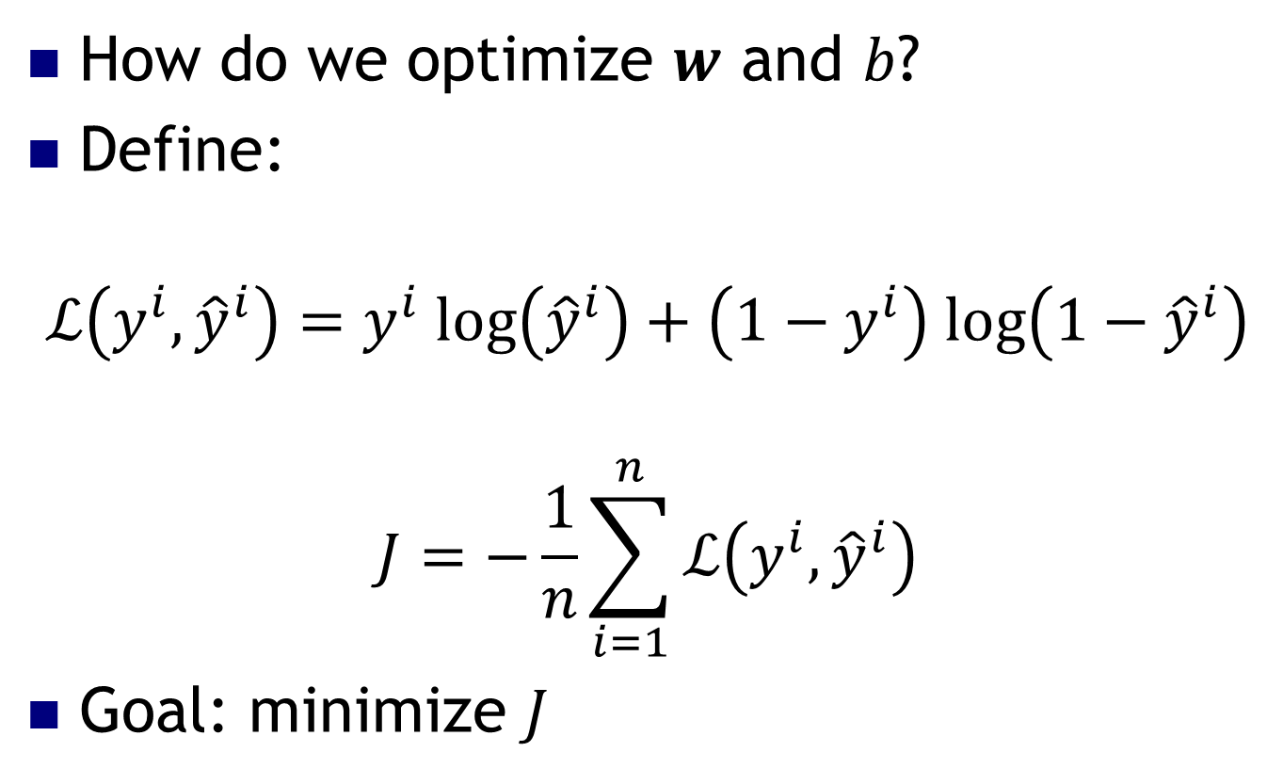
Optimizing MLPs
How do we optimize $w$ and $b$?
Define:
$$ℒ\left(y^{i},{\hat{y}}^{i}\right)=y^{i} log\left({\hat{y}}^{i}\right)+\left(1−y^{i}\right) log\left(1−{\hat{y}}^{i}\right)$$
$$J=−\frac{1}{n}\sum_{i=1}^{n}{ℒ\left(y^{i},{\hat{y}}^{i}\right)}$$
Goal: minimize $J$

Slide 26
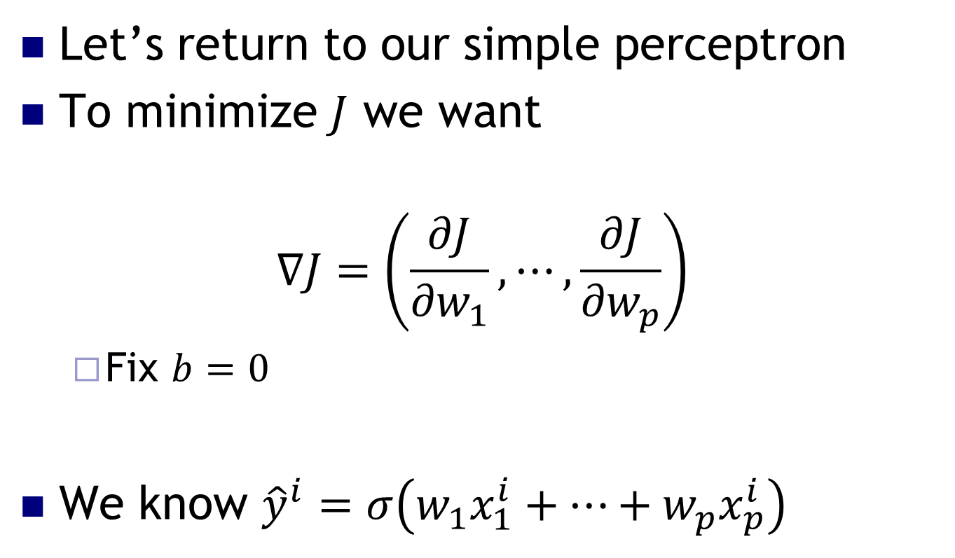
Neural Network Basics
Let’s return to our simple perceptron
To minimize $J$ we want
$$∇J=\left(\frac{∂J}{{∂w}_{1}}, ⋯,\frac{∂J}{{∂w}_{p}}\right)$$
Fix $b=0$
We know ${\hat{y}}^{i}=σ\left(w_{1}x_{1}^{i}+⋯+w_{p}x_{p}^{i}\right)$

Slide 27
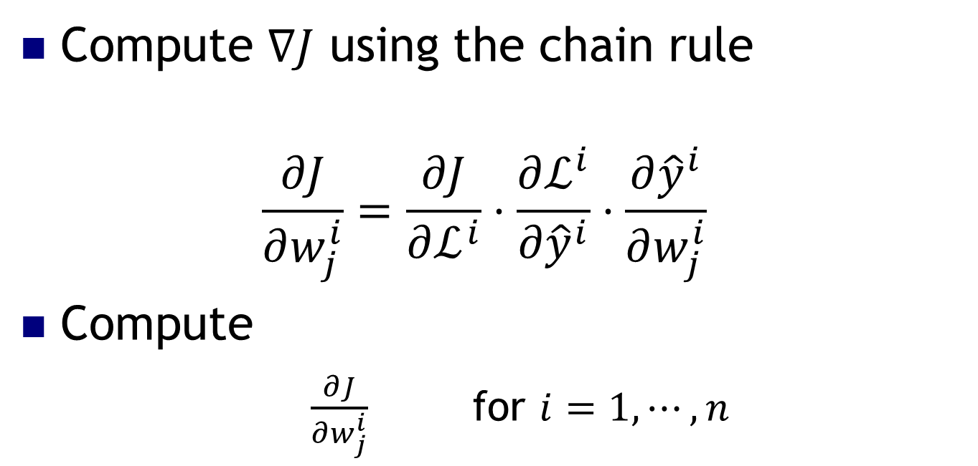
Backpropagation Algorithm
Compute $∇J$ using the chain rule
$$\frac{∂J}{∂w_{j}^{i}}=\frac{∂J}{∂ℒ^{i}}⋅\frac{∂ℒ^{i}}{∂{\hat{y}}^{i}}⋅\frac{∂{\hat{y}}^{i}}{∂w_{j}^{i}}$$
Compute
$\frac{∂J}{∂w_{j}^{i}}$ for $i=1,⋯, n$

Slide 28
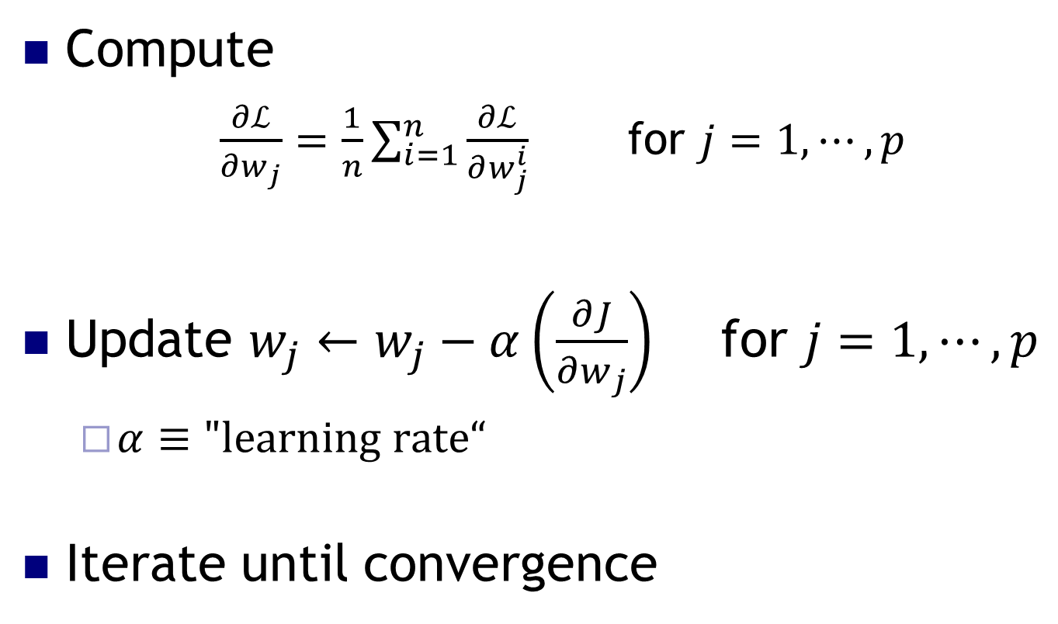
Backpropagation Algorithm
Compute
$\frac{∂ℒ}{∂w_{j}}=\frac{1}{n}\sum_{i=1}^{n}{\frac{∂ℒ}{∂w_{j}^{i}}}$ for $j=1,⋯, p$
Update $w_{j}←w_{j}−α\left(\frac{∂J}{∂w_{j}}\right)$ for $j=1,⋯, p$
$α≡"learning rate“$
Iterate until convergence

Slide 29
Backpropagation Algorithm
Backbone of deep learning
Opportunities for parallelism
Painful to implement yourself

Slide 30
Implementing Neural Nets with TensorFlow

Slide 31





Frameworks for Implementing Neural Networks

Slide 32

Today: TensorFlow/Keras
Use TF to describe computations as a graph
TF schedules computations on devices - CPU, GPU...
Performs automatic differentiation

Slide 33
Project 1: General Model
f
f
f
f
f
INPUT
HIDDEN LAYER
SOFTMAX OUTPUT LAYER
OUTPUT

Slide 34
Quick break…
https://www.youtube.com/watch?v=6KeG_i8CWE8

Slide 35
Deep Learning with ConvNets
Based on:
https://adeshpande3.github.io/adeshpande3.github.io/A-Beginner's-Guide-To-Understanding-Convolutional-Neural-Networks/

Slide 36
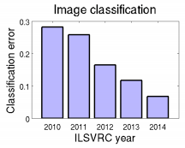
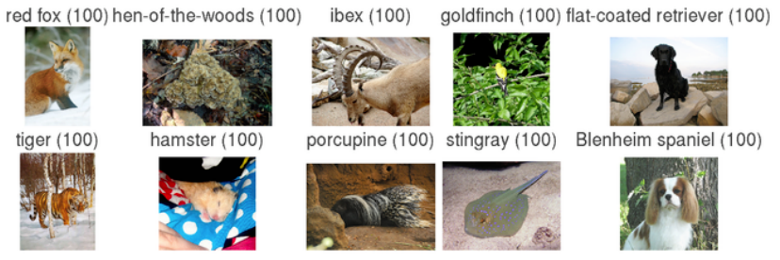
ImageNet Classification Challenge (annual)
More info: http://arxiv.org/abs/1409.0575
1000 object classes, Approximately 1.2 million training, 50k validation, and 100k test images.
Big improvements: 28.2% error rate to 6.7% error rate - human level! How? CNNs!

Slide 37



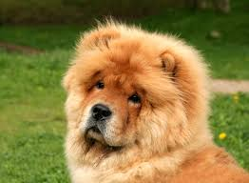
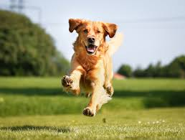

Supervised Learning
Dog=1
Cat=0
Cat=0
Dog=1
Dog=1
Now tell me: cat or dog?

Slide 38
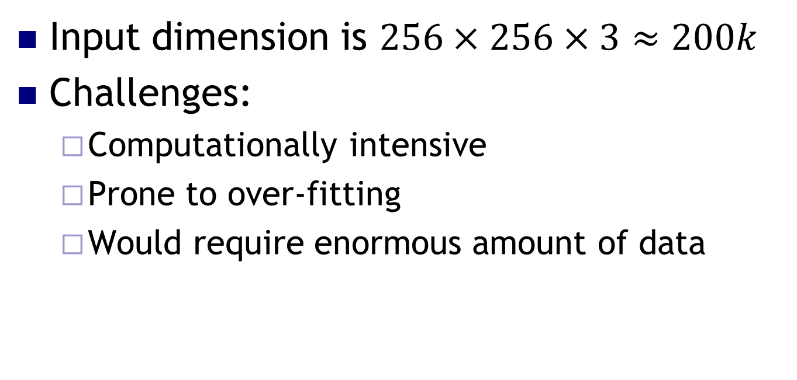
Deep Learning for Image Processing
Input dimension is $256×256×3≈200k$
Challenges:
Computationally intensive
Prone to over-fitting
Would require enormous amount of data

Slide 39
Convolution
...
INPUT MATRIX
FILTER
OUTPUT
MATRIX

Slide 40
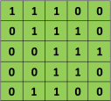

Convolution
Image
Filter

Slide 41
Convolution
Image
Filter

Slide 42
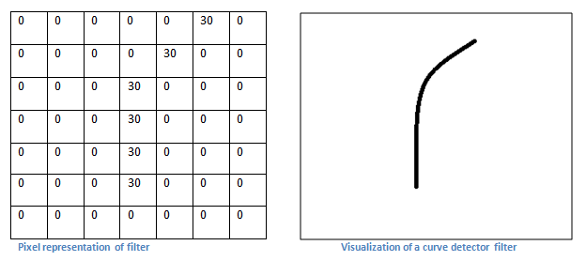
Convolution – The intuition

Slide 43
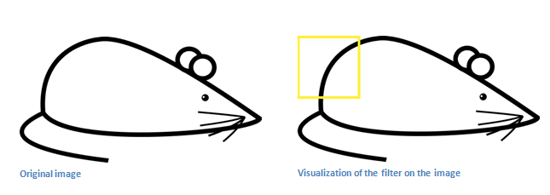
Convolution – the intuition
Recall the curve detector
Output matrix will have a large value here!

Slide 44

Convolution – the intuition
Conversely, the output matrix will have a
zero value here!

Slide 45
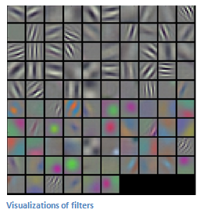
Convolution
Different filters (each acting as a feature detector) produce a feature map
Shallow layers detect low-level features
Deeper layers learn more complicated features

Slide 46
Pooling layers in CNN, deep structures
Maybe a filter learns to detect eyes
Precise location of eye is maybe unimportant
Use a pooling layer to downsample
CONVOLUTION
OUTPUT
2x2 MAX
POOL
POOLING
OUTPUT

Slide 47
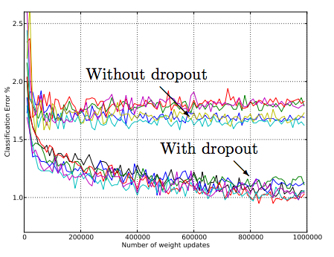
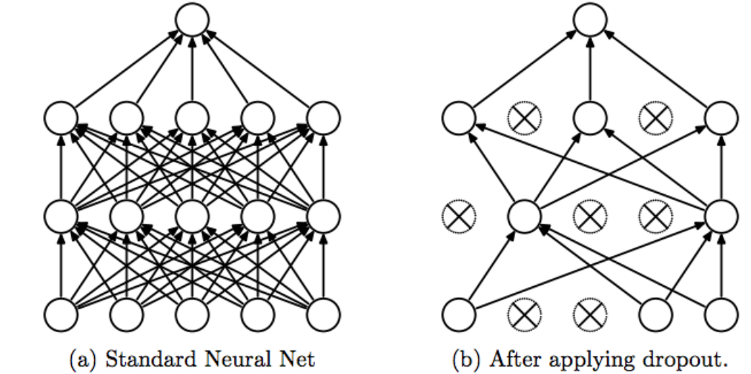
Dropout - cheap regularization for ANN
http://jmlr.org/papers/volume15/srivastava14a/srivastava14a.pdf

Slide 48
Basic ingredients of ConvNets
Lots of layers... more usually perform better!
Most commonly used:
Fully Connected Layers
Convolution
Pooling

Slide 49
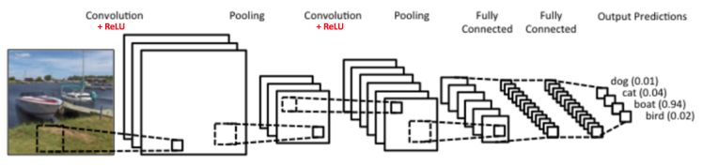
Early ConvNet: “LeNet-5”
http://deeplearning.net/tutorial/lenet.html

Slide 50
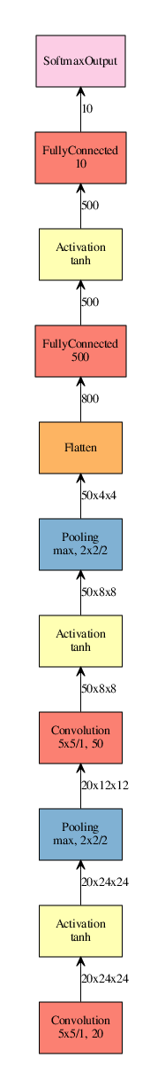
“LeNet”
1998:
“AlexNet”
2012:
“GoogLeNet”
2014:
“Inception v3”
2015:
Source: http://josephpcohen.com/w/visualizing-cnn-architectures-side-by-side-with-mxnet/

Slide 51
Project 3 – Functional Map of the World (fMoW)
Classify satellite images
Will use convolutional neural networks!

Slide 52
Project 3 – fMoW
Changing the filter sizes, kernel size
Adding or removing layers
Varying the amount of dropout
Varying the batch size
Different optimization algorithm
Etc.

Slide 53
Quick break…
https://www.youtube.com/watch?v=iRqypM7jb5Y

Slide 54
Natural Language Processing with Neural Networks

Slide 55
What is Natural Language Processing (NLP)?
Ability of computers to understand human language
Abundant quantities of data
Wide range of use cases
Sentiment analysis
Speech recognition
Text generation
Etc.

Slide 56
First Attempts
Taxonomy
Hard-coded rules
One-hot encoding

Slide 57
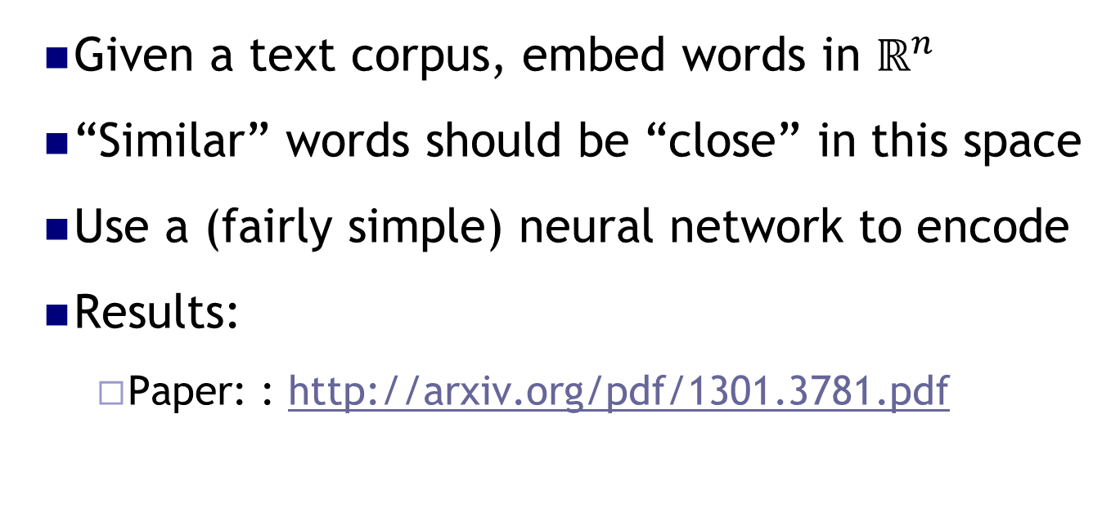
Big Breakthrough: Word2Vec
Given a text corpus, embed words in $ℝ^{n}$
“Similar” words should be “close” in this space
Use a (fairly simple) neural network to encode
Results:
Paper: : http://arxiv.org/pdf/1301.3781.pdf

Slide 58
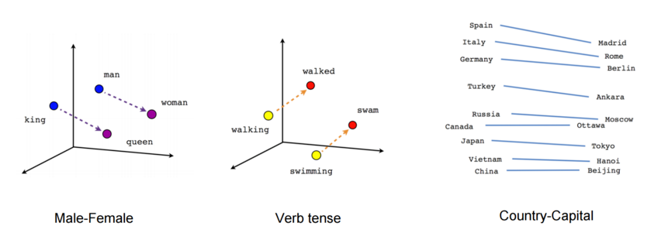
PARIS - FRANCE + ITALY = ROME
JAPAN - SUSHI + GERMANY = BRATWURST
BIG - BIGGER + COLD = COLDER

Slide 59
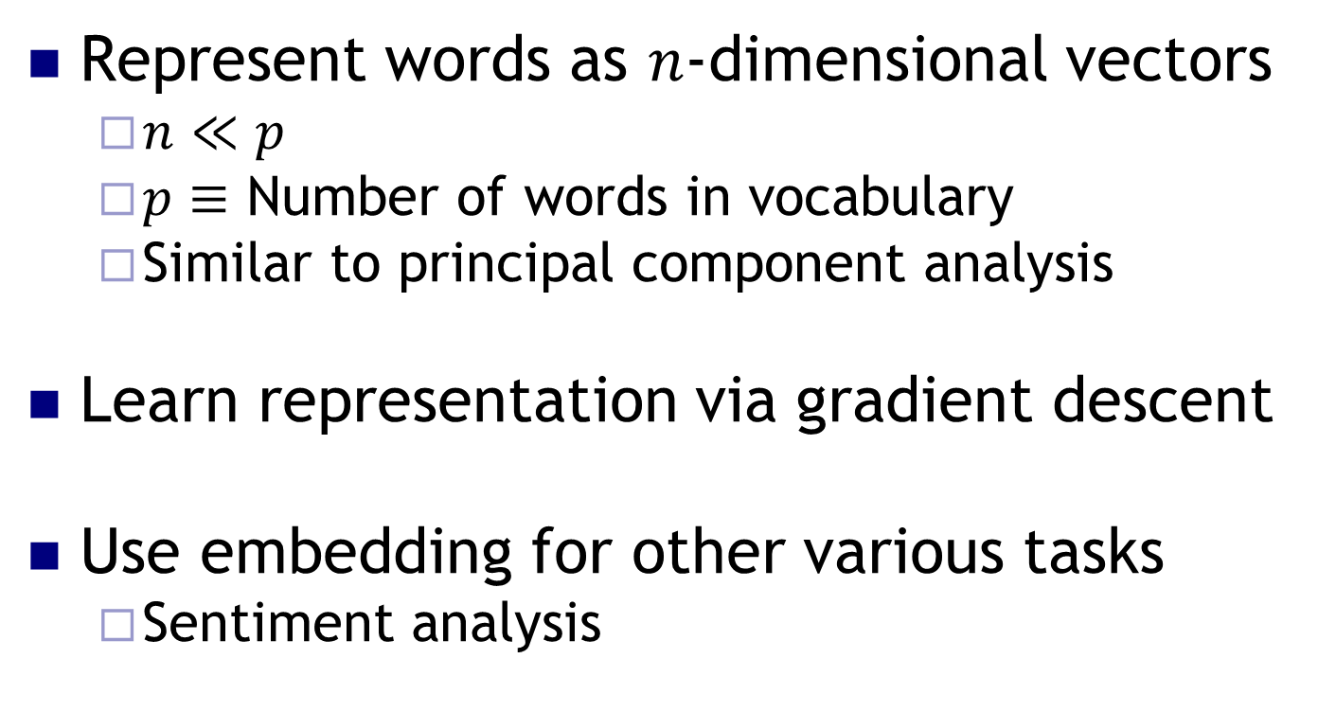
Word Embedding
Represent words as $n$-dimensional vectors
$n≪p$
$p≡$ Number of words in vocabulary
Similar to principal component analysis
Learn representation via gradient descent
Use embedding for other various tasks
Sentiment analysis

Slide 60
Sentiment Analysis
Understand emotion from text
Wide number of use cases:
Product reviews
Market analysis
Etc.

Slide 61

Project 3: IMDB Sentiment Analysis
$50,000$ reviews of polarizing movies
Goal: classify review as positive or negative

Slide 62
Project 3: Extensions
Change embedding size
Optimization algorithm
Vocabulary size
Etc.

Slide 63
Final Thoughts

Slide 64
Hyper-parameter Tuning
Enormous hyper-parameter space
Where to start?
Paper: https://arxiv.org/pdf/1206.5533v2.pdf

Slide 65
Hyper-parameter Priority
Not much consensus in the field
Often problem dependent
Difficult to know beforehand
General thoughts:
Learning rate
Number of layers
Number of hidden units

Slide 66
Hyper-parameter Search
Grid search vs. random search?
Almost always random search
Why?
Explore more values
Coarse to fine search

Slide 67
Additional Resources
Online courses:
Andrew Ng: Coursera – five classes on neural networks
Geoffrey Hinton: Coursera
Fast AI
Kaggle
Code and winners’ write-ups

Slide 68
Additional Resources
Books/Papers/Videos:
http://www.deeplearningbook.org/
http://deeplearning.net/reading-list/
https://ift6266h13.wordpress.com/home/resources/

Slide 69
Key Takeaways
Neural networks are not magical
Wide range of applications for unstructured data
Tons of resources available for further learning
Rapidly changing field

Slide 70
Thank you!

