Slide 1
Whole-electricity system modelling (WeSIM)
Marko Aunedi & Tim Green
Imperial College London
24 November 2022

Slide 2
Whole-system approach to valuing flexible options - time and location effects
Whole-system modelling critical for capturing Time and Location interactions

Slide 3
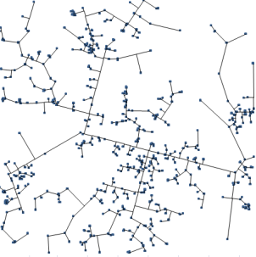
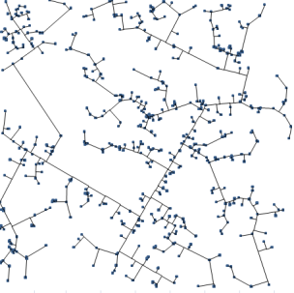
Whole – electricity System Model (WeSIM)
Interconnected GB system
Future development scenarios (GB & EU):
Generation mix evolution (RES etc.)
Demand (electrification etc.)
WeSIM:
Generation, Transmission and Distribution Investment and Operation Model
GB + EU Grid Model: Transmission + Distribution
CO₂ constraints
Investment in G/T/D & storage infrastructure
Generation & storage output, RES curtailment & CO2 emissions
Overall investment and operation cost
~10 representative DNs
Key results
Outturn carbon intensity
System value of flexibility

Slide 4
Key WeSIM features
MILP model that makes optimal investment and operational decisions that minimise total (annualised) system cost:
Generation CAPEX
Transmission CAPEX
Distribution CAPEX
OPEX
Quantifies cost implications across different segments of electricity system
Considering system adequacy constraints
Simultaneously & endogenously ensures least-cost solution whilst ensuring that system-level CO₂ constraint is met
Advanced treatment of system inertia and frequency regulation requirements
Highly suitable for evaluating flexible options (storage, DSR, interconnection, flex. generation…)
Implemented in FICO Xpress with Excel inputs
Peer-reviewed formulation*
* Pudjianto D, Aunedi M, Djapic P, Strbac G, 2014, “Whole-Systems Assessment of the Value of Energy Storage in Low-Carbon Electricity Systems”, IEEE Transactions on Smart Grid, Vol:5, Pages:1098-1109, 2013.

Slide 5
Distribution network modelling (representative networks) – informed by separate LRE model
Urban
Semi-urban/rural
Rural
Capture both voltage and thermal-driven reinforcement and calibrated to represent entire GB distribution network
Ability to assess the benefits of smart network technologies (e.g. DSR or distributed storage) and alternative network reinforcement strategies

Slide 6
Recent extensions to WeSIM
Inclusion of H₂ technologies both on demand side (electrolysis) and generation side (H₂ gas turbines of fuel cells) as well as H₂ transport, storage and production (SMR and ATR)
Addition of carbon offsetting technologies such as DACCS and BECCS, which allows the model to optimise the technology mix with net negative carbon targets
Addition of long-duration (seasonal) energy storage options
Possibility to differentiate between CCS technology variants with different capture rates (e.g. 90% vs. 95% v. 99%), using different cost and efficiency parameters.
An explicit representation of Vehicle-to-Grid (V2G) capabilities of electrified vehicle fleets.

Slide 7
Representation of hydrogen value chain
WeSIM explicitly considers the whole hydrogen supply chain including:
Production (electrolysis, methane reforming)
Storage (e.g. in underground caverns)
Consumption (hydrogen power generation with gas turbines of fuel cells)
Model also allows to consider options for hydrogen imports and to represent hydrogen demand that is external to power system (e.g. for industry or heating)

Slide 8
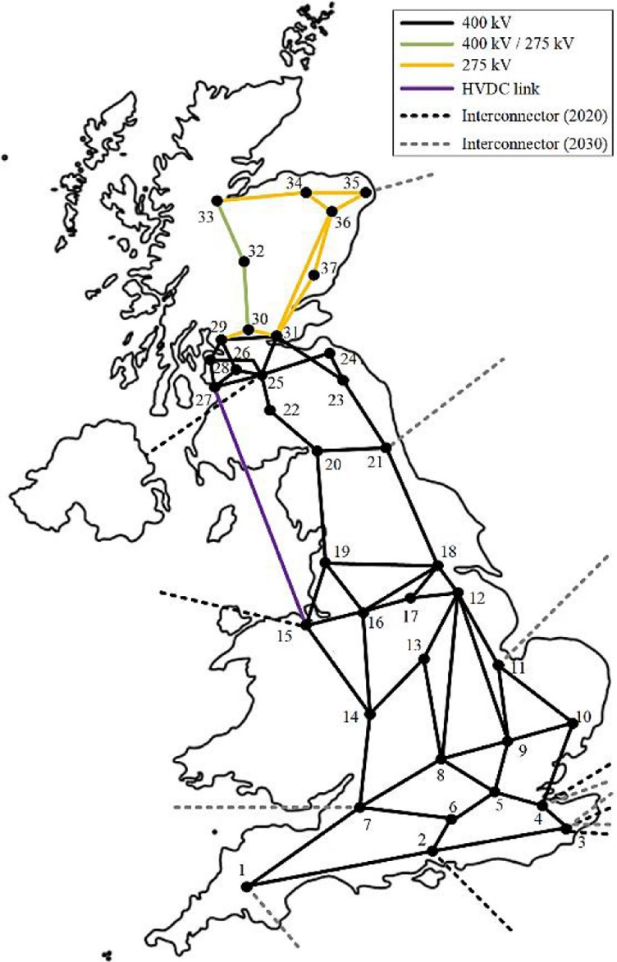
WeSIM extensions in this project
Extending GB transmission network granularity to 37 nodes
Based on reduced representation of transmission grid (from OATS/Strathclyde) and NG data

Slide 9
Selected Applications

Slide 10
Key examples of application in energy policy space (BEIS, CCC, Ofgem, Carbon Trust, industry…)
Cost implications of energy/power system decarbonisation
System Integration Cost of low-C generation
System value of flexibility (energy storage / DSR at different scales)
Value of baseload low-carbon generation
Cost and carbon implication of transport electrification (incl. V2G, fast charging and EV fleets)
Impact assessment of heat electrification (HP and hybrid HP)
Implications of inertia, adequacy and reserve/response constraints in low-carbon systems
Exploring different heat decarbonisation pathways (net zero)
Ongoing:
Value of exporting UK offshore wind (relaxing the neutrality constraint)
Implications of rolling out locally-driven energy system design

Slide 11
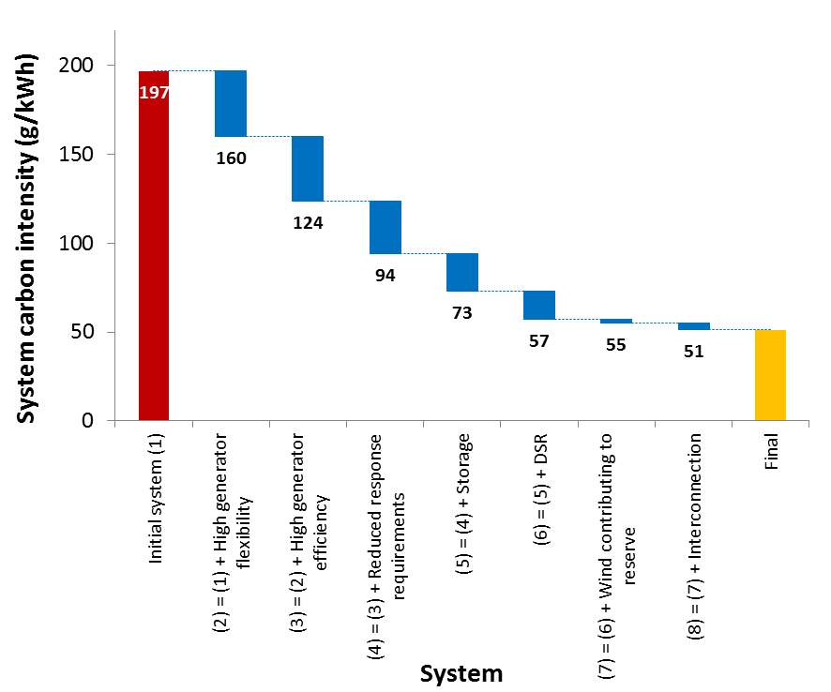
Effect of flexibility on system carbon performance

Slide 12
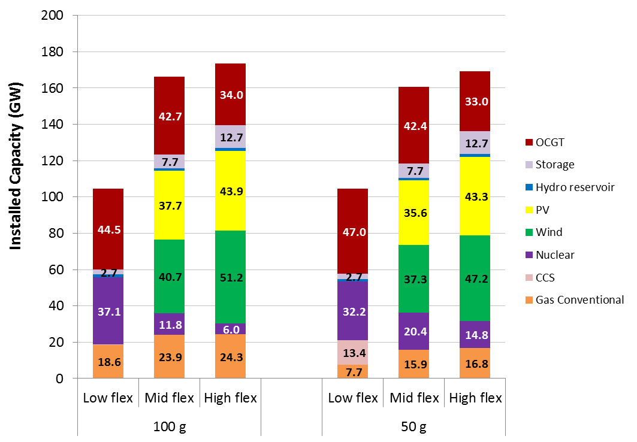
Impact of flexibility on least-cost low-carbon generation mix
Flexibility is a core enabler of cost-effective decarbonisation

Slide 13
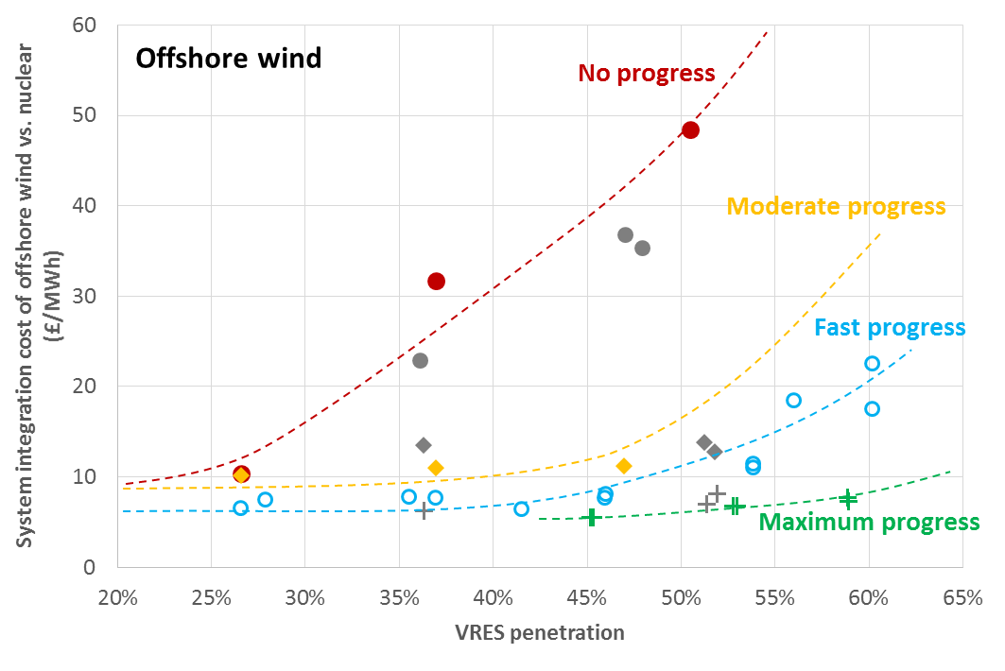
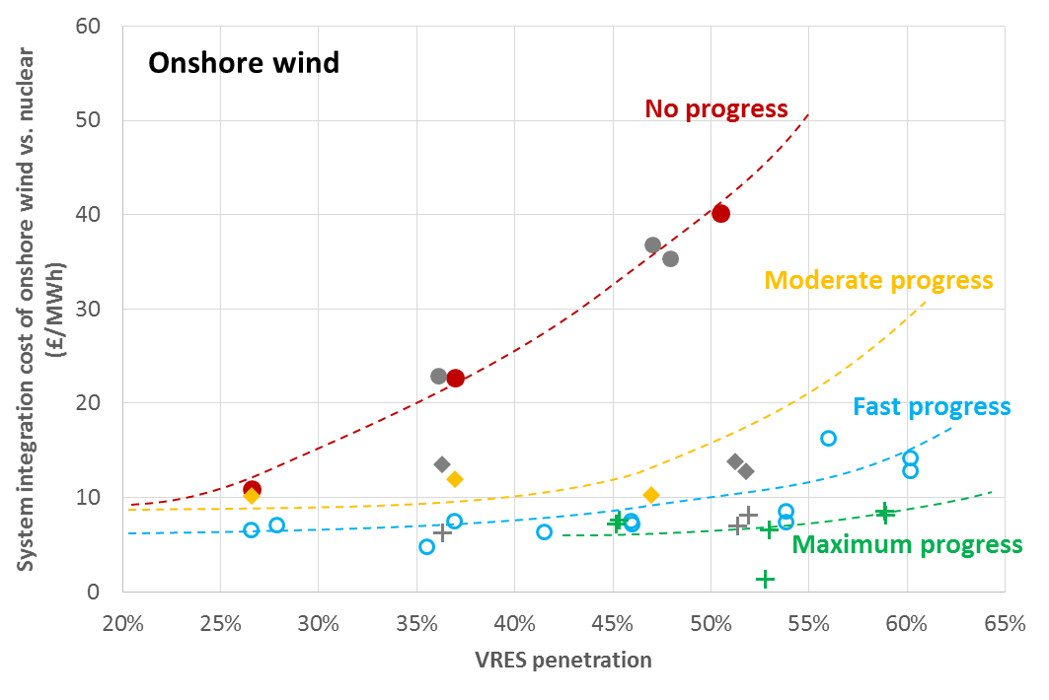
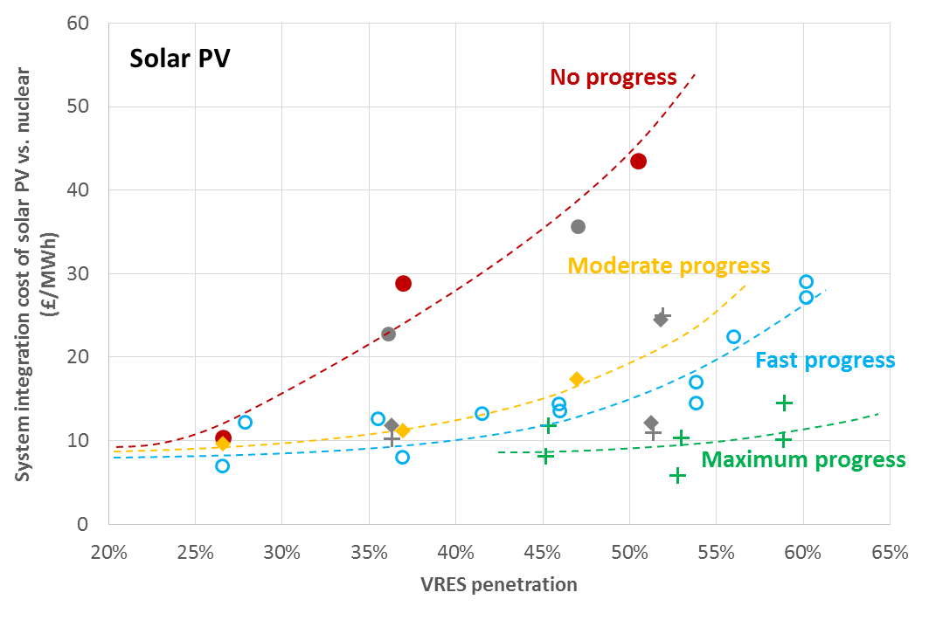
System integration cost of RES

Slide 14
Least-worst regret analysis of flexible options
Based on optimal deployment of flexibility across all 12 scenarios four key Pathways (short-term deployment strategies) are formulated
These decisions are fixed across all scenarios and the model rerun to quantify the increase in cost i.e. regret for each scenario
Pathway | DSR in 2020 | Storage in 2020 | Flexible CCGT in 2020 | Additional interconnection in 2025
Only DSR | 2-5 | - | - | -
Only Storage | - | 1.2-3 | - | -
Balanced | 1-5 | 0.5-3 | 1 | -
Do Nothing | - | - | - | -
 | S1 | S2 | S3 | S4 | S5 | S6 | S7 | S8 | S9 | S10 | S11 | S12 |  | Worst regret
Only DSR | 0.0 | 0.1 | 1.7 | 0.0 | 0.5 | 1.6 | 0.0 | 0.0 | 1.0 | 0.0 | 0.4 | 0.2 |  | 1.7
Only Storage | 2.6 | 3.1 | 1.6 | 2.2 | 0.3 | 1.8 | 6.4 | 6.1 | 1.6 | 5.8 | 0.0 | 0.0 |  | 6.4
Balanced | 0.0 | 0.2 | 1.4 | 0.1 | 0.2 | 1.3 | 0.1 | 0.0 | 0.7 | 0.1 | 0.0 | 0.0 |  | 1.4
Do Nothing | 4.5 | 4.3 | 1.8 | 4.4 | 0.8 | 1.6 | 9.0 | 8.5 | 1.7 | 8.9 | 1.6 | 1.4 |  | 9.0

Slide 15
What range of electricity costs might be expected in a net-zero GB system?
Variations in total system cost expressed as unit cost of electricity broken down into components
Cost covers investment into generation, storage and network assets and their operation, but no metering, billing, tax or supplier margins
Equivalent unit cost in 2020 GB system estimated at 10.1 p/kWh*
Central case unit cost is 8.2 p/kWh; range observed across other cases is 7.8-8.8 p/kWh
Source: Aunedi, M., Wills, K., Green, T. and Strbac, G., “GB electricity generation capacity mix for net-zero carbon emissions”, Energy Futures Lab White Paper, June 2021, https://www.imperial.ac.uk/energy-futures-lab/reports/white-papers/net-zero-gb-electricity/

Slide 16
Whole-electricity system modelling (WeSIM)
Marko Aunedi & Tim Green
Imperial College London
24 November 2022

