Slide 1

AEGIS MOBILE
SwiftUI through
a React lens
Part 01 / Sign-in architecture
A code-grounded guide for the first iOS slice
30 SEPTEMBER 2026
Notes:
Original Aegis learning-series cover artwork: docs/learning/assets/aegis-glass-cover.png. This is an educational deck, not a product screenshot. Project sources: README.md; docs/cahier-conception/02-scope.md; docs/cahier-conception/09-contrats-rest.md.

Slide 2
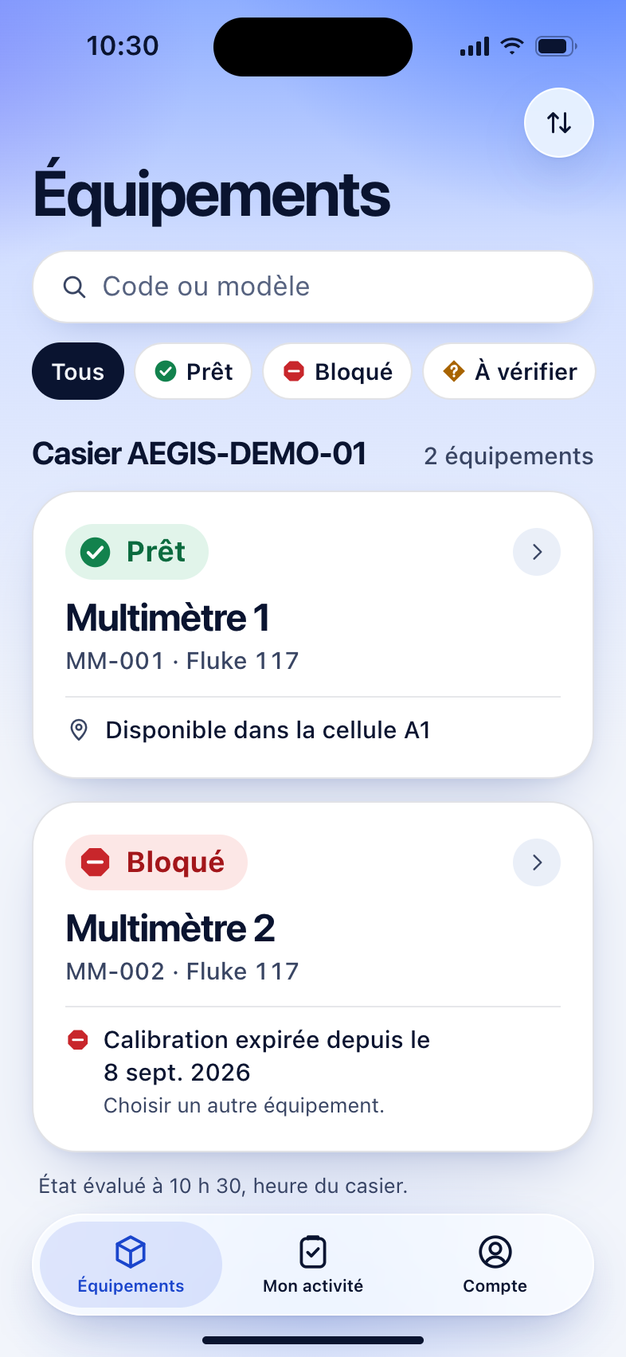
AEGIS MOBILE / LEARNING SERIES
What exists today
0
Swift source files in apps/ios/
The Spring API already implements sign-in and /auth/me. The iOS image at right is approved concept art, not a running app.
APPROVED VISUAL DIRECTION / CONCEPT ONLY
AEGIS / 30 SEP 2026
02
Notes:
Repository inspection on 2026-09-30: apps/ios contains only .gitkeep. Existing API scope is documented in services/api/README.md and implemented in services/api/src/main/java/ca/aegis/control/identity/AuthController.java. Mockup source: docs/design/asset-lifecycle/prototype/renders/ios/a/light/02-catalogue.png; approval: docs/design/asset-lifecycle/direction-validee.md. User has since requested real registration to be scoped first; this deck teaches the existing sign-in contract only.

Slide 3
AEGIS MOBILE / LEARNING SERIES
React ideas, SwiftUI names
Familiar idea
SwiftUI tool
Function component
struct View + body
useState
@State for local UI state
props
stored view properties
shared observable state
@Observable model (iOS 17+)
effect on appearance
.task for async work
The mapping helps you learn. SwiftUI owns rendering and state lifetimes differently from React.
AEGIS / 30 SEP 2026
03
Notes:
Apple primary sources: https://developer.apple.com/documentation/swiftui/model-data and https://developer.apple.com/documentation/SwiftUI/Managing-model-data-in-your-app . Observation with @Observable requires iOS 17 or later. This is a conceptual mapping, not an exact equivalence. Deployment target for Aegis iOS has not yet been fixed.

Slide 4
AEGIS MOBILE / LEARNING SERIES
The iOS trust boundary
PostgreSQL
private
iPhone
SwiftUI
HTTPS
Aegis Control
Spring API
Broker + locker
MQTT
The phone asks. The backend decides. The locker executes authorised commands.
AEGIS / 30 SEP 2026
04
Notes:
Aegis authority and trust boundary: README.md; docs/cahier-conception/02-scope.md §§7-8; docs/cahier-conception/09-contrats-rest.md §§1-2. iOS never accesses PostgreSQL or MQTT directly. Diagram is editable native PowerPoint text and connectors.

Slide 5
AEGIS MOBILE / LEARNING SERIES
The first HTTP contract
POST /api/v1/auth/login
200 response
{
"email": "technician@aegis.demo",
"password": "<entered by user>"
}
{
"accessToken": "<opaque>",
"expiresIn": 3600,
"user": { "role": "TECHNICIAN" }
}
Then GET /api/v1/auth/me with Authorization: Bearer <token>.
The app reads the profile from the server; it never derives roles by decoding the JWT.
AEGIS / 30 SEP 2026
05
Notes:
Existing contract: docs/cahier-conception/09-contrats-rest.md §§4.1-4.4, 10.2-10.3. Existing code: services/api/src/main/java/ca/aegis/control/identity/AuthController.java, LoginRequest.java, LoginResponse.java, UserProfile.java. The JSON is intentionally abbreviated for teaching; actual response also contains tokenType, expiresAt, and a full UserProfile. The placeholder is not a real password or token.

Slide 6
AEGIS MOBILE / LEARNING SERIES
Swift models mirror the wire format
// Illustrative Swift; not in the repository yet
struct LoginRequest: Encodable {
let email: String
let password: String
}
struct UserProfile: Decodable {
let id: UUID
let displayName: String
let email: String
let role: String
let maximumAccessLevel: String
}
Why Codable?
It maps the documented JSON fields to Swift values. Keep the token as an opaque string and keep business decisions on the server.
Contract change? Update the server DTO, the REST document, the client model and tests together.
AEGIS / 30 SEP 2026
06
Notes:
Illustrative teaching code, not compiled. Contract source: docs/cahier-conception/09-contrats-rest.md §§3-4 and 10.2. Actual Java DTOs are LoginRequest.java, LoginResponse.java and UserProfile.java. Swift JSONDecoder defaults map these camelCase names. If role handling controls a workflow, handle unknown enum values conservatively rather than assuming success.

Slide 7
AEGIS MOBILE / LEARNING SERIES
One API client owns networking
// Illustrative Swift; validate(...) is app-defined
func login(_ input: LoginRequest) async throws -> LoginResponse {
let url = baseURL.appending(path: "api/v1/auth/login")
var request = URLRequest(url: url)
request.httpMethod = "POST"
request.httpBody = try encoder.encode(input)
request.setValue("application/json", forHTTPHeaderField: "Content-Type")
let (data, response) = try await session.data(for: request)
try validate(response, data)
return try decoder.decode(LoginResponse.self, from: data)
}
Inject URLSession and the base URL. Test 200, 401, 429 and transport failure.
AEGIS / 30 SEP 2026
07
Notes:
Illustrative teaching code; URL composition and APIError parsing need implementation and tests. Apple primary source: https://developer.apple.com/documentation/foundation/urlsession/data%28for%3A%29 . Aegis status codes: docs/cahier-conception/09-contrats-rest.md §10.2 and §21. Prefer HTTPS outside isolated local development; do not bypass certificate verification to make an iPhone reach the API.

Slide 8
AEGIS MOBILE / LEARNING SERIES
Session state across app launches
SIGN IN
POST /auth/login
Save accessToken in Keychain
REOPEN
Read Keychain token
GET /auth/me to refresh profile
401
Token invalid or expired
Delete local token; show sign-in
SIGN OUT
User chooses logout
Delete local token
No refresh token in P0. Losing the network does not cancel an operation already authorised by Spring.
AEGIS / 30 SEP 2026
08
Notes:
Aegis current decision: docs/cahier-conception/09-contrats-rest.md §§4.1-4.2 and 15.4. Keychain requirement is explicit there. Apple primary source: https://developer.apple.com/documentation/security/keychain-services/ . Do not use UserDefaults for tokens. The local sign-out does not revoke a copied JWT before its expiry. Do not invent a refresh-token route.

Slide 9
AEGIS MOBILE / LEARNING SERIES
Sign-in UI as explicit states
01
Idle
Form accepts email and password
02
Submitting
Disable duplicate action; show progress
03
Rejected
Show a stable error, retain entered email
04
Authenticated
Show technician navigation after the server profile
Use native text controls, Dynamic Type and VoiceOver labels. Glass belongs around the flow, never over critical text.
AEGIS / 30 SEP 2026
09
Notes:
The state design is a proposed implementation pattern, not existing iOS code. Aegis sign-in screen guidance: docs/design/asset-lifecycle/sections.md §3 and docs/design/asset-lifecycle/direction-validee.md. Error codes in docs/cahier-conception/09-contrats-rest.md §10.2. Native SwiftUI views and model data: https://developer.apple.com/documentation/swiftui/model-data . Aegis visual references are concept art only. Current signup desire remains a separate product decision awaiting scope and contract design.

Slide 10
AEGIS MOBILE / LEARNING SERIES
The first iOS slice
Build
Verify
One SwiftUI login view, an injected API client, Codable DTOs and a small Keychain adapter.
A real iPhone signs in, relaunches into /auth/me, rejects a wrong-role account and recovers from 401 or network loss.
Next lesson
Catalogue + personal readiness. The app displays the backend decision; it never calculates READY locally.
AEGIS / 30 SEP 2026
10
Notes:
Acceptance exercise proposed for the first iOS client slice. Existing backend routes: services/api/README.md. Planned catalogue contract: docs/cahier-conception/09-contrats-rest.md §11. Apple sources: https://developer.apple.com/documentation/foundation/urlsession/data%28for%3A%29 , https://developer.apple.com/documentation/security/keychain-services/ . No iOS source exists in the repo on 2026-09-30. Current registration request must be scoped separately before client implementation. Do not claim these checks have run.

