Slide 1
Auto Color Adjust Method

Slide 2






Method - Histogram Specification
Histogram Specification is to map one image histogram to the target image histogram
Main Step of the program:
Step 1: Find histogram of input image , and find its cumulative , the histogram equalization mapping function:
Step 2: Specify the desired histogram , and find its cumulative , the histogram equalization mapping function:
Step 3: Relate the two mapping above to build a lookup table for the over all mapping. Specifically, for each input level ,
find an output level so that best matches :
and then we setup a lookup entry

Slide 3
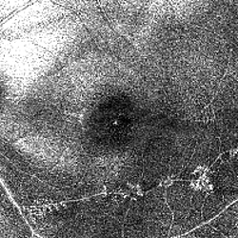
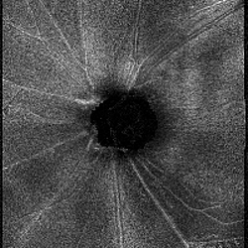
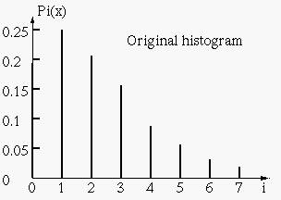
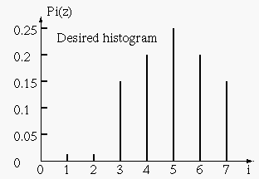
2. Example to show the procedure
(After going over some cases, decide to use the image with lower mean intensity as the desired histogram image.)

Slide 4

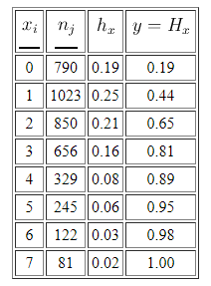
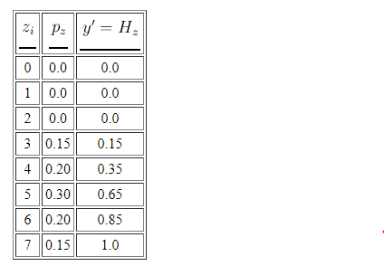

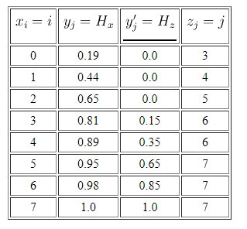

Step 1: Equalize to get mapping
Step 2: Equalize to get mapping
Step 3: Obtain overall mapping,
Get the color intensity mapping table.

Slide 5
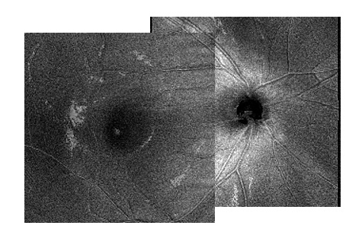
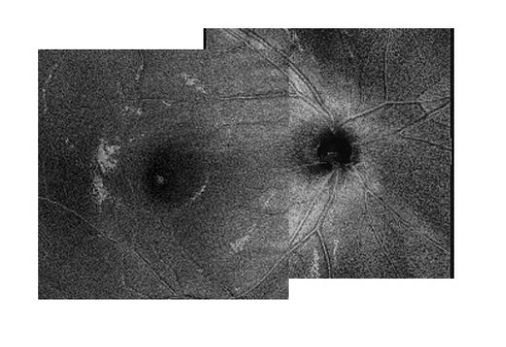
Results:
Before adjusting
After adjusting

Slide 6
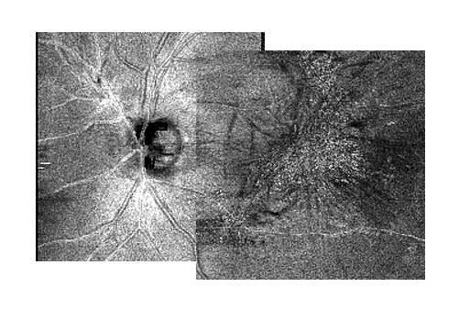
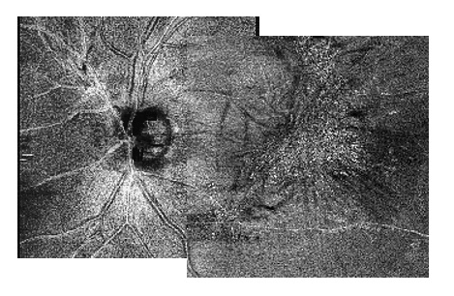
Before adjusting
After adjusting

Slide 7
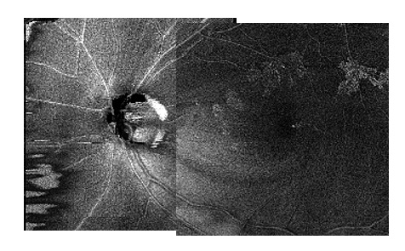
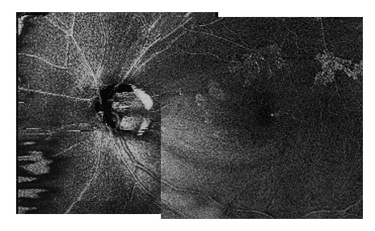
Before adjusting
After adjusting

Slide 8
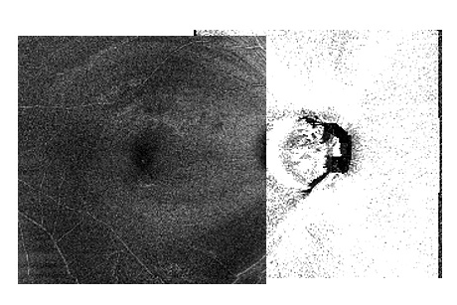
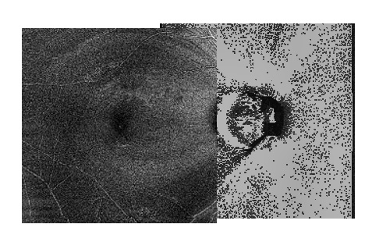
For such cases, still cannot convert well.
Before adjusting
After adjusting

