Slide 1
Topic 2 Introduction to Magento
Application of Open Sources in E-Commerce | uef | Nov 2023
Mr. Lê Ngọc Hiếu – hieu.ln@ou.edu.vn

Slide 2
Learning Outcomes
By the end of this topic, you should be able to
Describe and explain some characteristics of Magento
Prepare Environment for Magento in Windows
Install Magento in Windows

Slide 3
Content
1. What is Open Sources and Why Open-Sources in E-Commerce?
2. Business Models and Open Sources in E-Commerce
3. Open-Source Applications in E-Commerce
4. Developing Application using Open-Source in E-Commerce

Slide 4
Quick start on-premises installation
https://experienceleague.adobe.com/docs/commerce-operations/installation-guide/overview.html?lang=en

Slide 5
Adobe Account Register
https://commercemarketplace.adobe.com/customer/account/login/

Slide 6
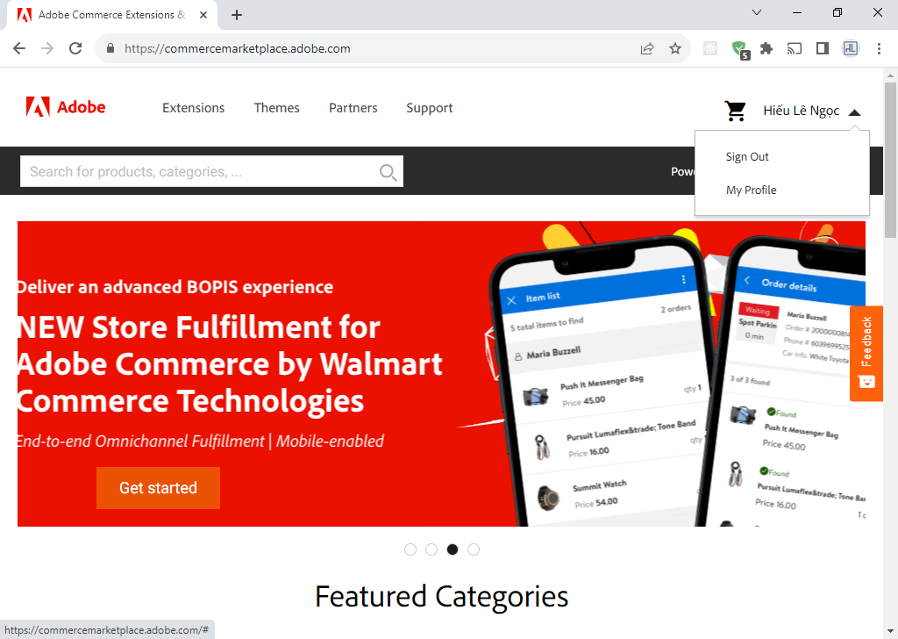
Create Market Place Account

Slide 7
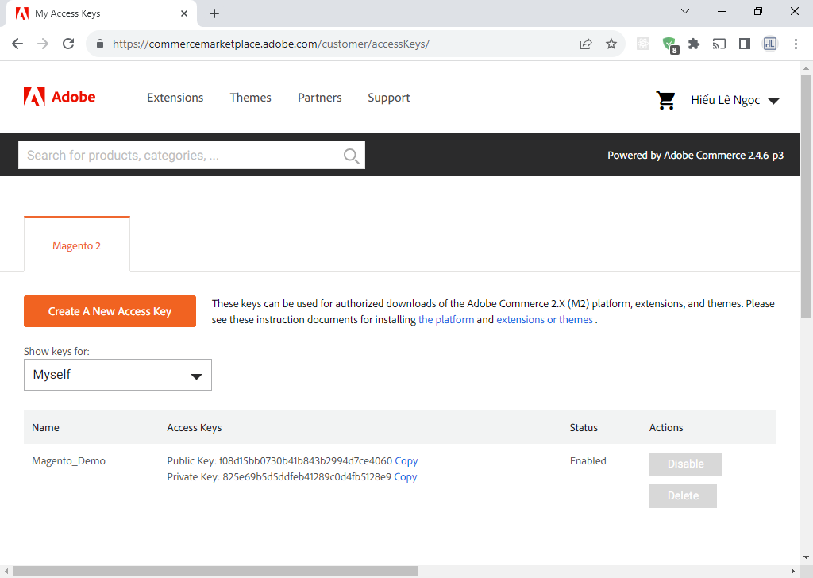
Create App & Access Key

Slide 8

Install XAMPP https://www.apachefriends.org/
APACHE & PHP 8.1
Composer
MySQL:
Username: root
Pass: …
Create Magento Database in MySQL

Slide 9
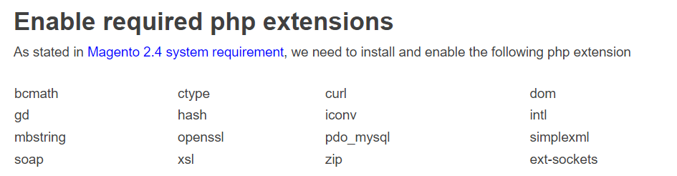
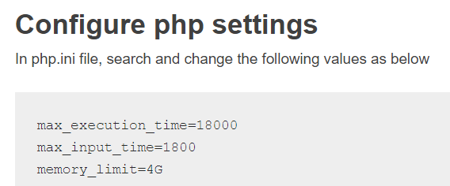
Configure php.ini
Copy C:\xampp\php\libsodium.dll
to C:\xampp\apache\bin\
Restart Apache means stop and start Apache.

Slide 10
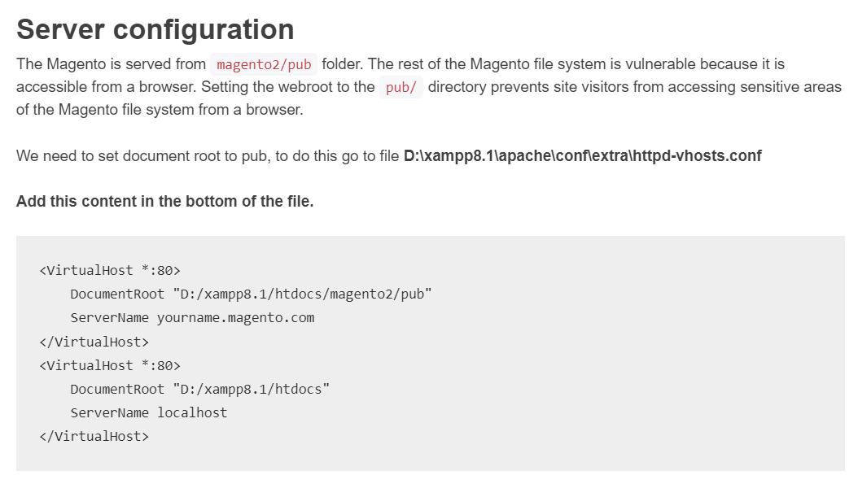

Slide 11
Update host file of Windows
C:\Windows\System32\drivers\etc\

Slide 12
Install elasticsearch on windows OS
ElsaticSearch 8.11.1 (Latest)
Change password
bin/elasticsearch-setup-passwords interactive
bin/elasticsearch-reset-password –username=elastic
ElasticSearch 7.17 (No need Pass)

Slide 13
Install Magento 2.4.4 or Magento 2.4.5 or Magento 2.4.6 on Windows- Step By Step Guide
https://www.thecoachsmb.com/100-working-step-by-step-guide-to-install-magento-2-4-4-on-windows

Slide 14
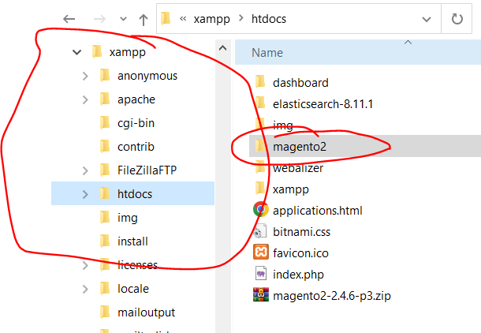
Download Magento 2 from Repo
composer create-project --repository-url=https://repo.magento.com/ magento/project-community-edition=2.4.6 magento246
Now enter Username and password to start downloading
Username: Your public Key
Password: Your private key.

Slide 15
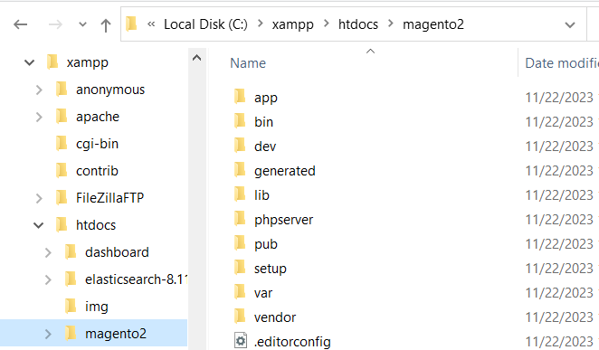
Install Magento 2
php bin/magento setup:install --base-url="http://test1.magento.com/" --db-host="localhost" --db-name="magento246" --db-user="root" --db-password="123456" --admin-firstname="admin" --admin-lastname="admin" --admin-email="user@example.com" --admin-user="admin" --admin-password="Admin@123456" --language="en_US" --currency="USD" --use-rewrites="1" --backend-frontname="admin" --search-engine=elasticsearch7 --elasticsearch-host="localhost" --elasticsearch-port=9200 --elasticsearch-enable-auth=1 --elasticsearch-username=elastic --elasticsearch-password=123456

Slide 16
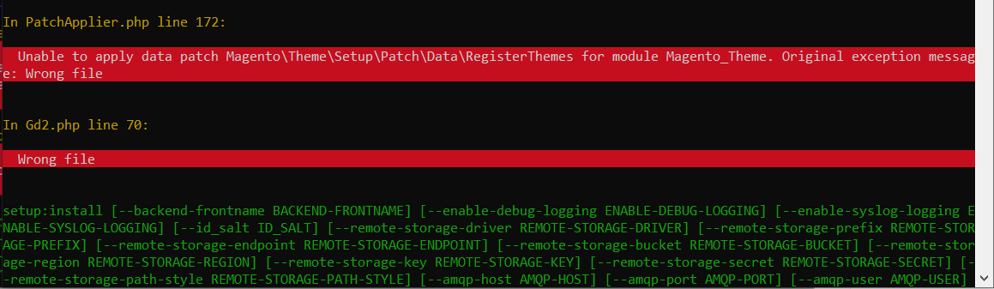
Fix gd2.php
Here Image Adapter try opens to image files (‘open function in Gd2.php line 72). validateURLScheme function return false always because it checking ‘URL’ format but local files not valid for this format, so it returns false.
Find validateURLScheme function in vendor\magento\framework\Image\Adapter\Gd2.php file. at line 92. Replace function with this:
private function validateURLScheme(string $filename) : bool
{
$allowed_schemes = ['ftp', 'ftps', 'http', 'https'];
$url = parse_url($filename);
if ($url && isset($url['scheme']) && !in_array($url['scheme'], $allowed_schemes) && !file_exists($filename)) {
return false;
}
return true;
}

Slide 17
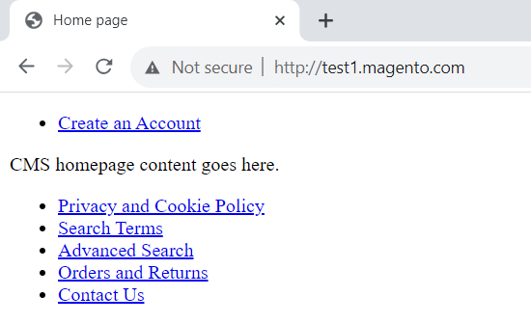
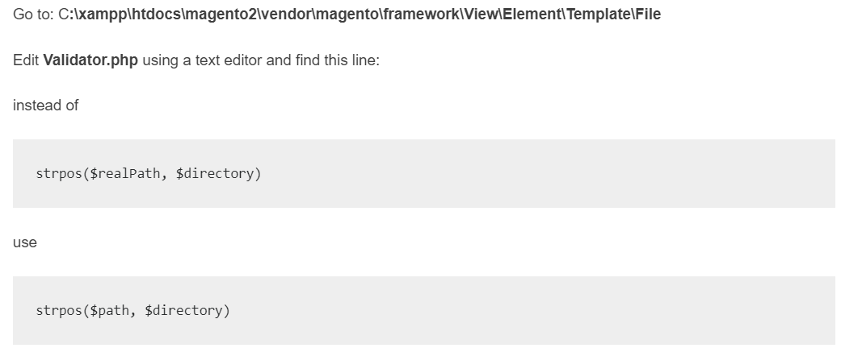
Fix template

Slide 18
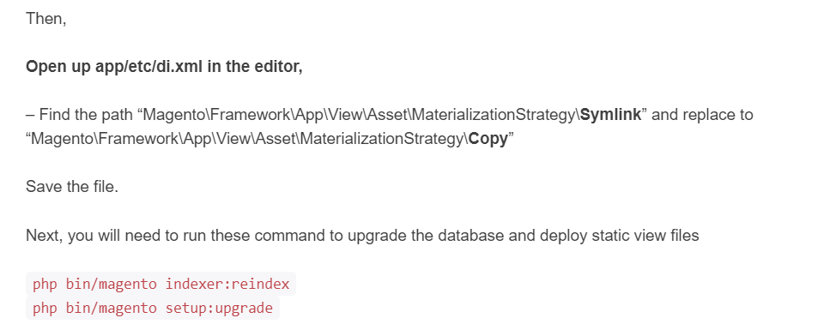
Fix template

Slide 19
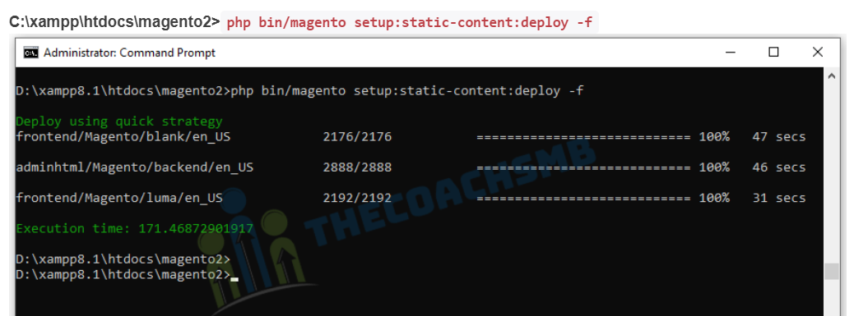

Fix template

Slide 20
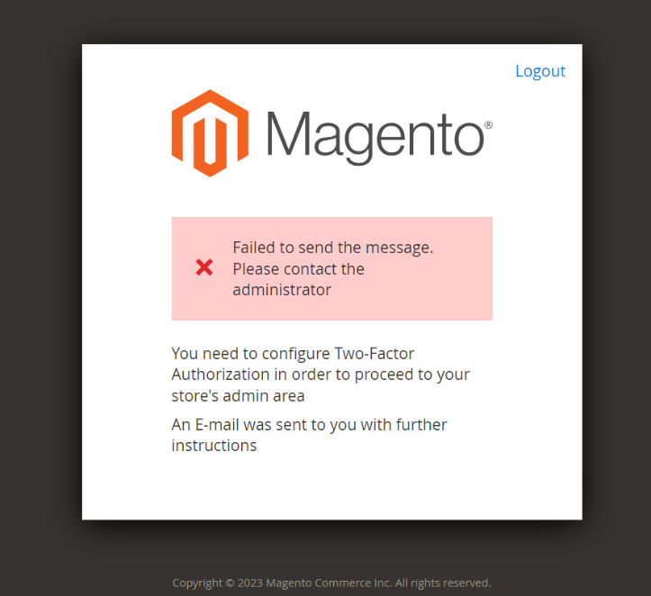
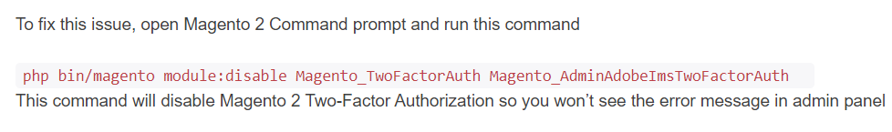
Disable Authentication
Test1.magento.com/admin

Slide 21
Sample Data
php bin/magento sampledata:deploy && php bin/magento indexer:reindex && php bin/magento se:up && php bin/magento se:s:d -f && php bin/magento c:f
Now enter Username and password to start downloading
Username: Your public Key
Password: Your private key.

