Slide 1

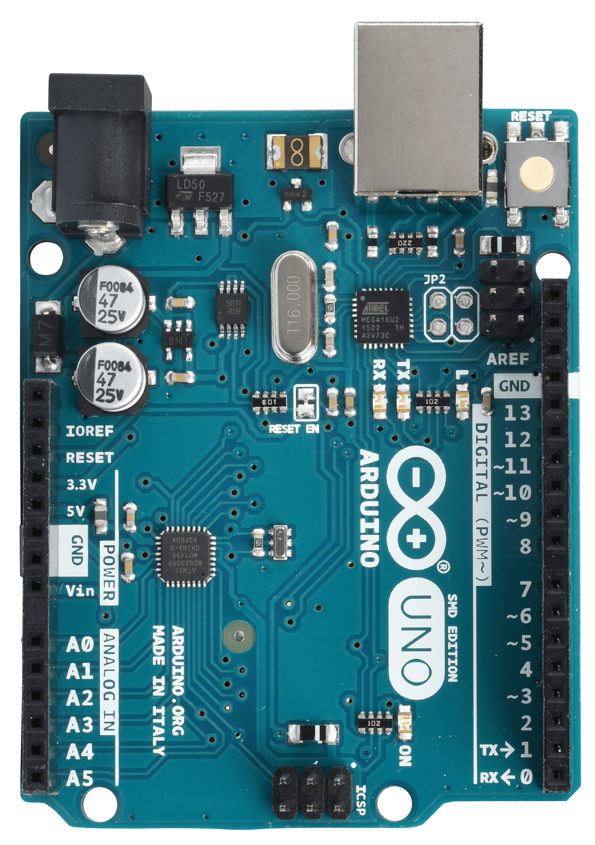
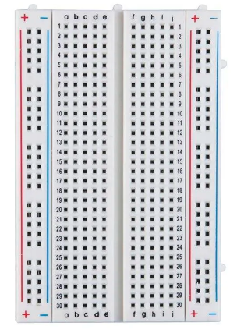
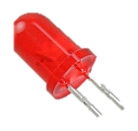
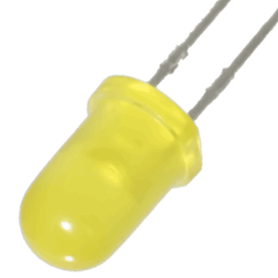
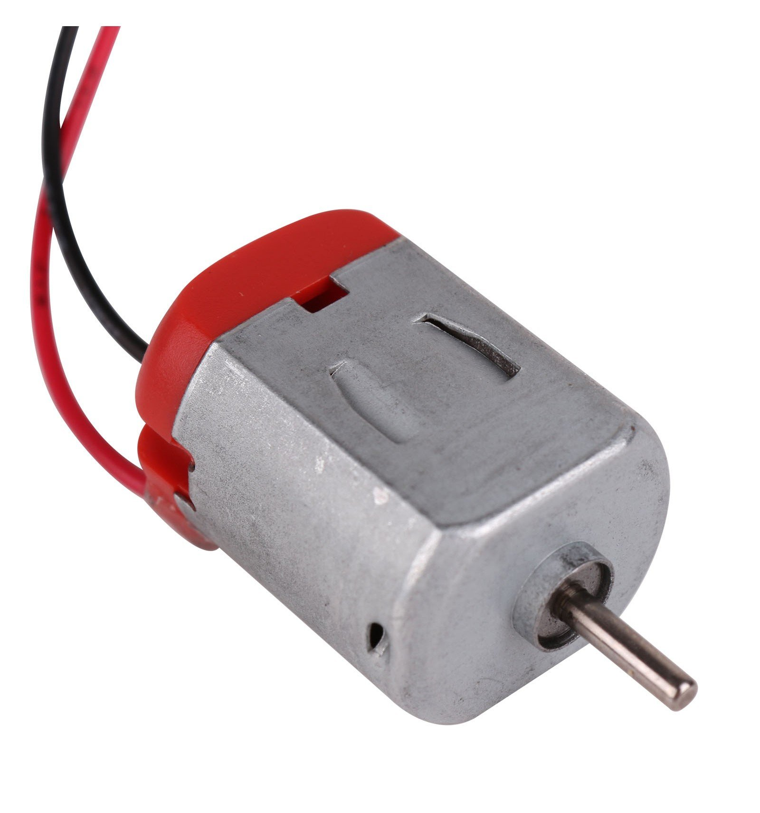
5V rail
External power rail (5V)
trig
echo
motor PWM
‘dead’ indicator
‘stop’ indicator
gate1 motor 1
gate2 motor 1
gate2 motor 2
gate1 motor 2

