Slide 1
The mort artsy figures in my thesis

Slide 2
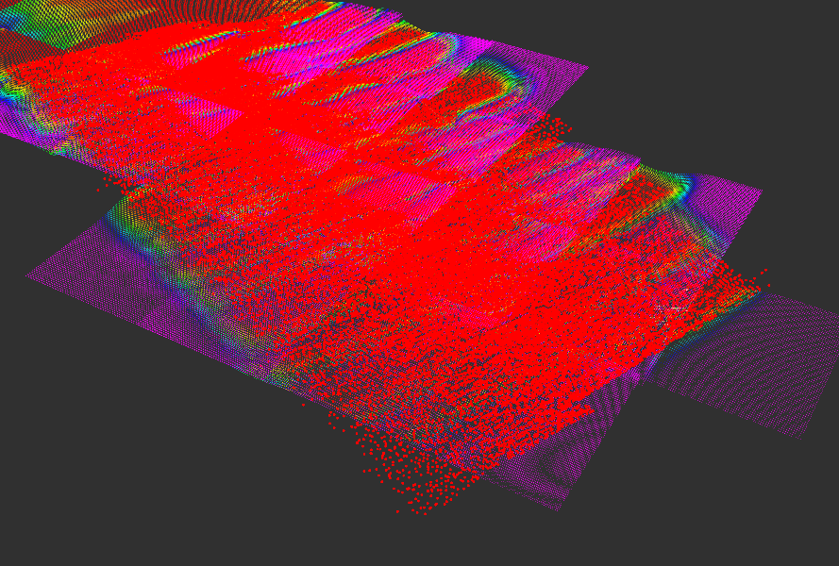
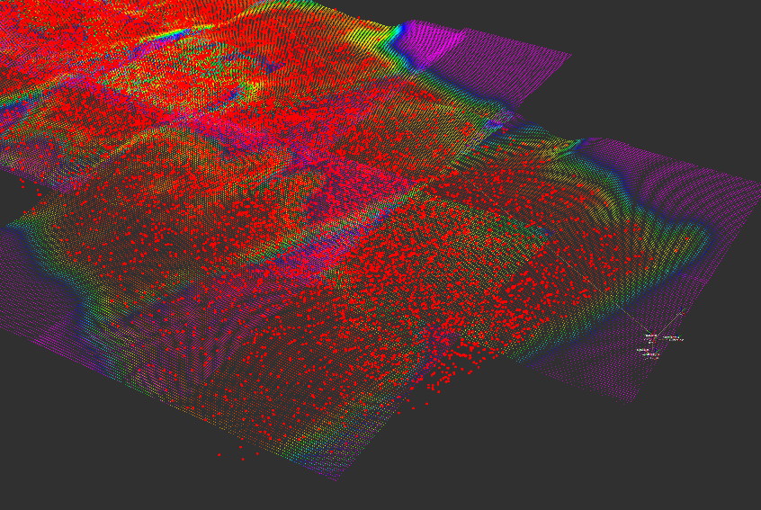
thousands of
datapoints (red)
fewer
datapoints
GPR solution
(color patches)
new GPR solution
fewer
datapoints
new GPR solution

Slide 3
Add Data
Blockulator
Raw Pings
Stream In
Remove
Outliers
Downsample
Data
Add to
Training Tile
Calculate Uncertainties
Compute GPR
GPR
Inference
Add to
Bathymetry Map
fewer
datapoints
new GPR solution

Slide 4
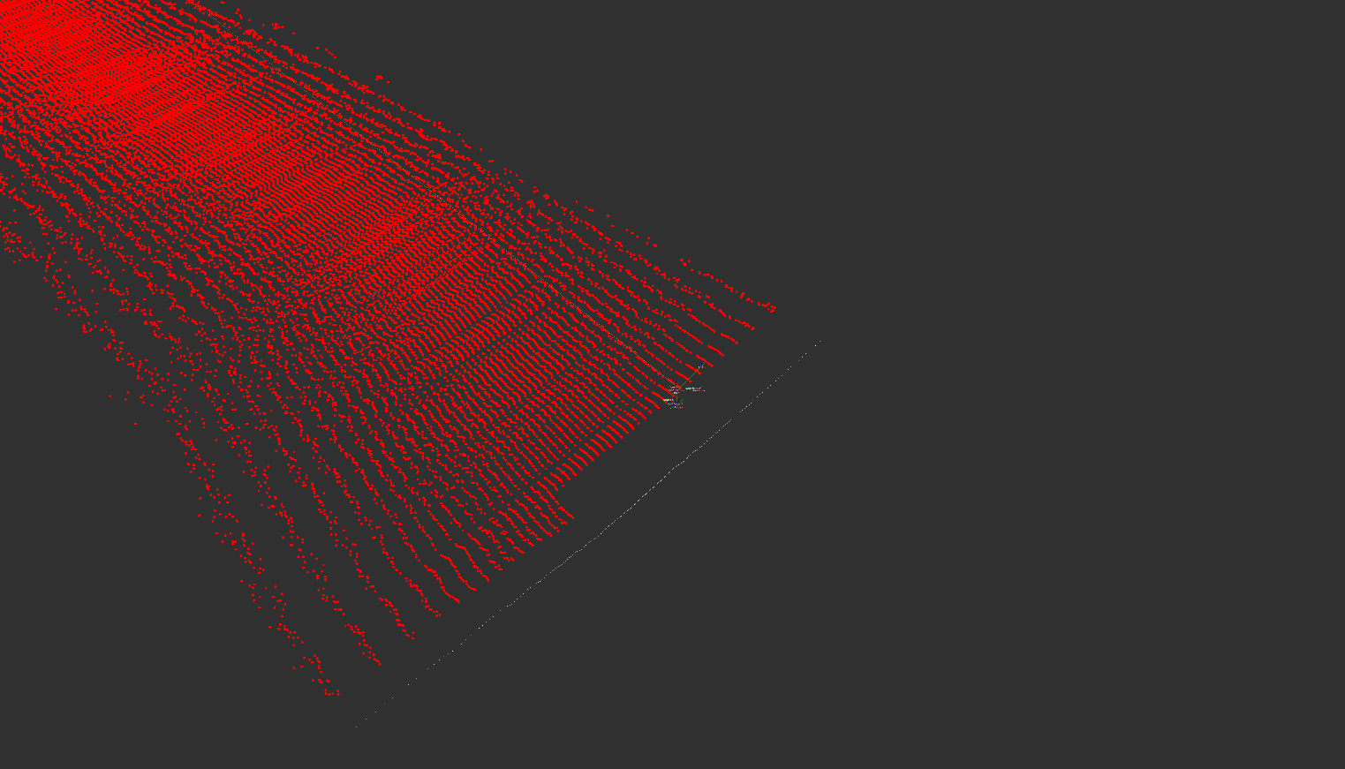
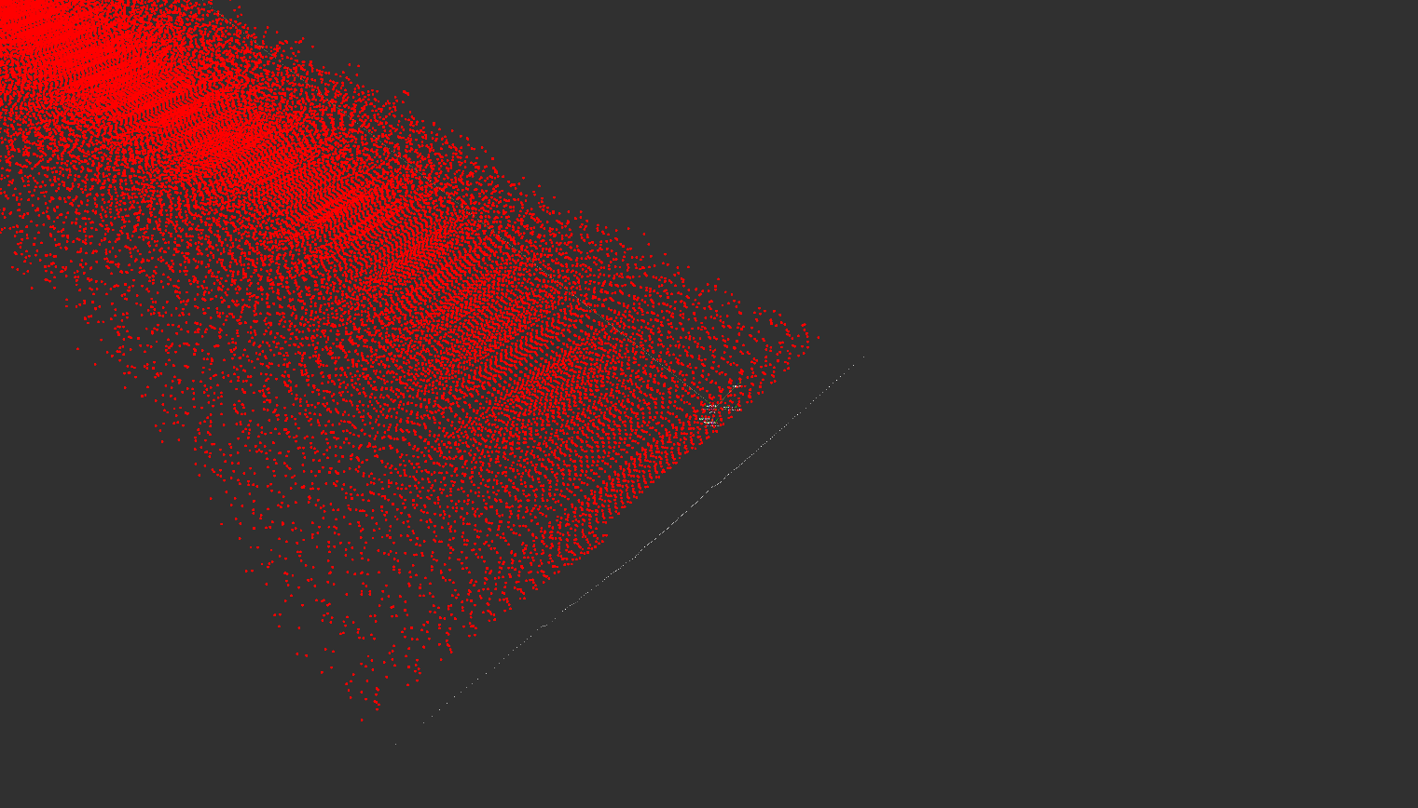
fewer
datapoints
new GPR solution

