Slide 1
How far have we come?
Gaussian Process Regression for Seafloor Mapping

Slide 2

Where it began
Massively Parallel Gaussian Process Regression
real-time updatable GPR solution
exact solution (uses all data)
number of computational speed-ups
runs on a GPU

Slide 3

Where it began
Massively Parallel Gaussian Process Regression
requires heavy-duty GPU
constant sonar uncertainty
not as fast as it could be

Slide 4

What Phil targeted
Massively Parallel Gaussian Process Regression
determine the best downsample method
- 6 methods tested
- want fast and accurate
variable sonar uncertainty across ping
- better reflection of reality

Slide 5
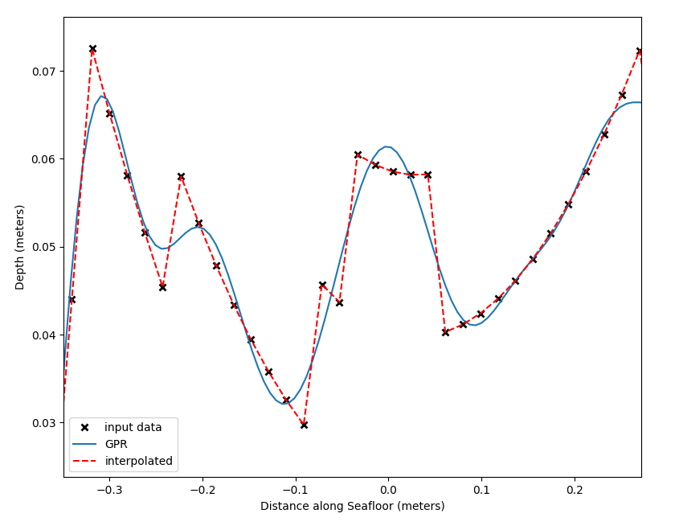
An Example GPR Fit

Slide 6
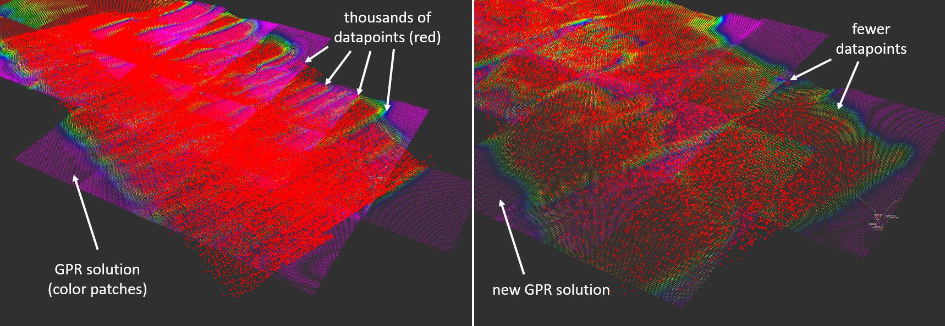
Regression
GPR on a Swath
Fitting a ‘trendline’ to data
All datapoints (exact solution)
10% of datapoints (approximate solution)

Slide 7
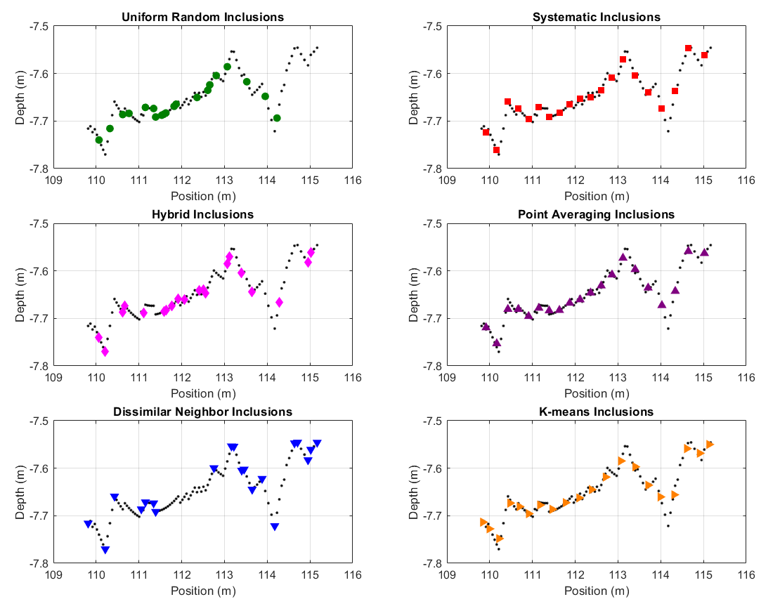
6
Methods
100 pts → 20 pts

Slide 8
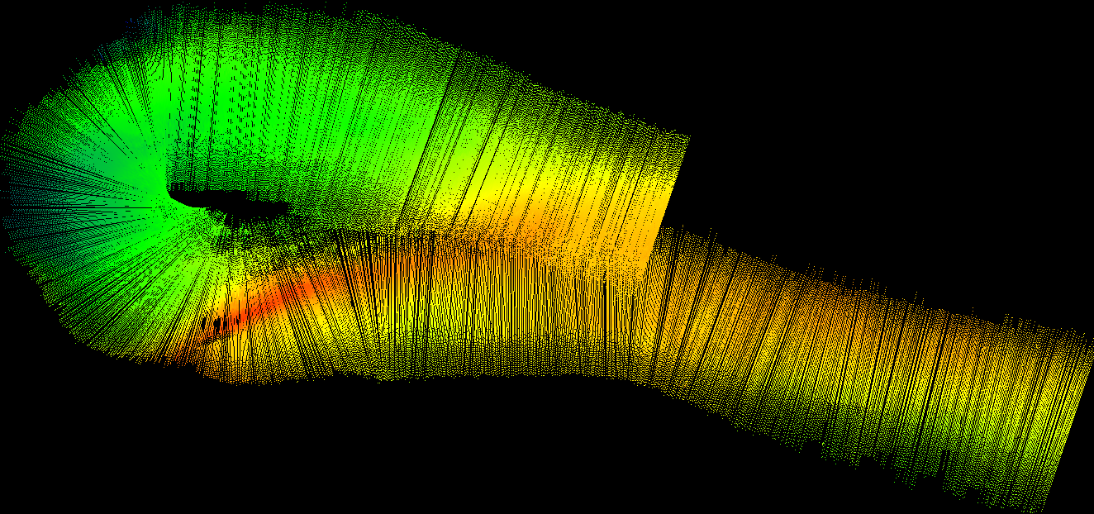
Exact
100%

Slide 9
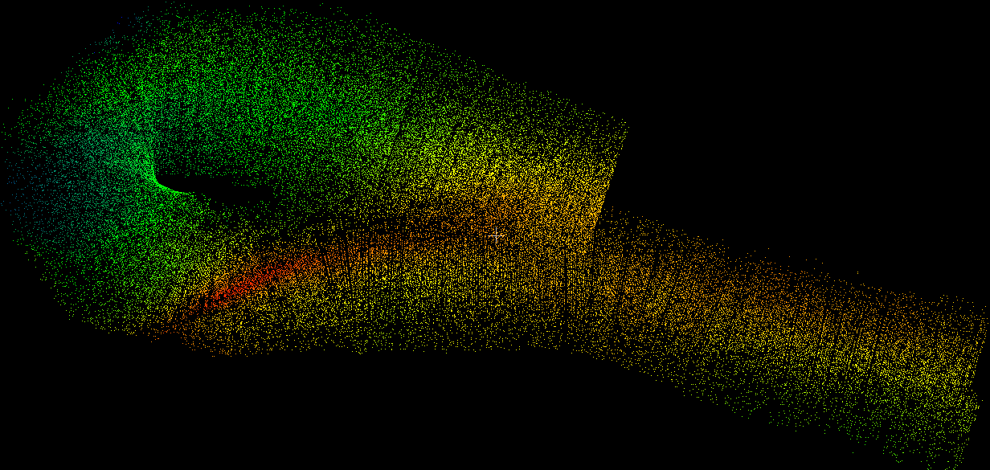
Random
20%

Slide 10
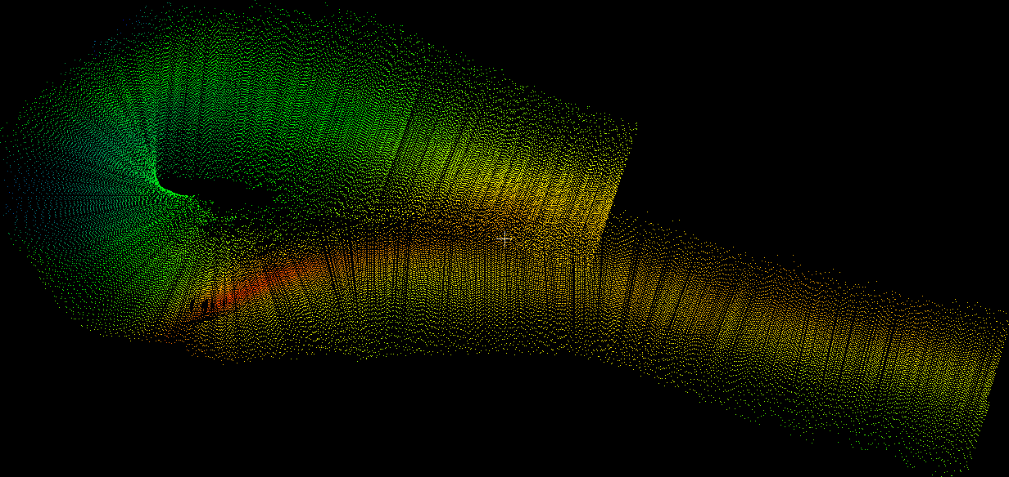
Systematic
every 5th pt
20%

Slide 11
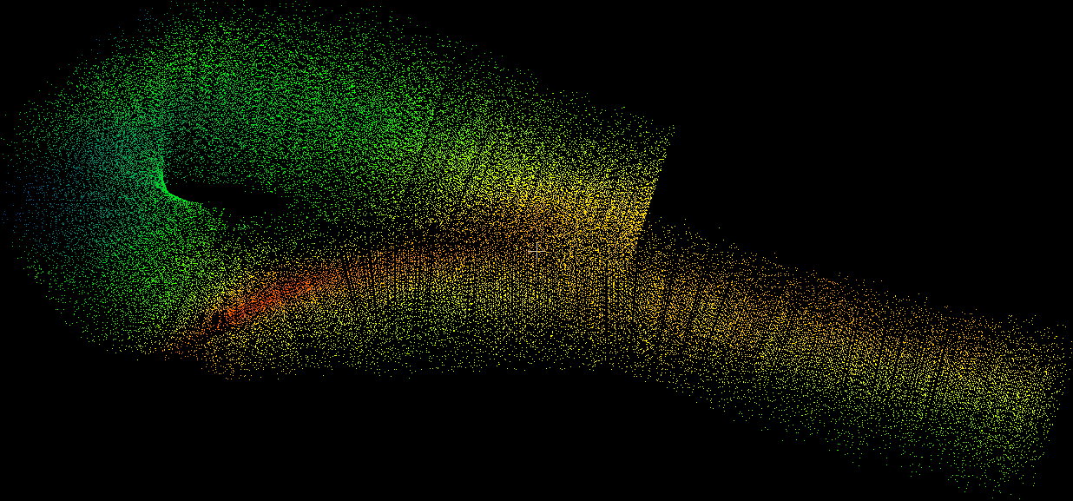
Hybrid
20%

Slide 12
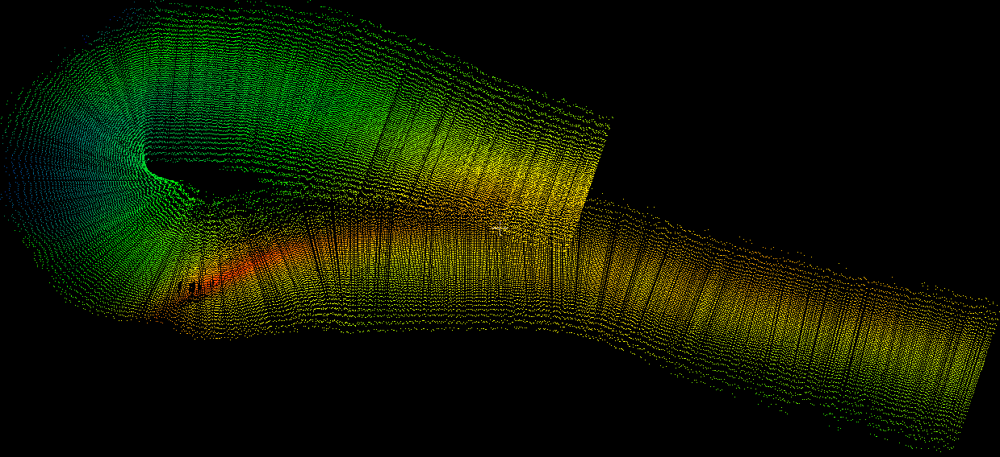
Average
20%

Slide 13
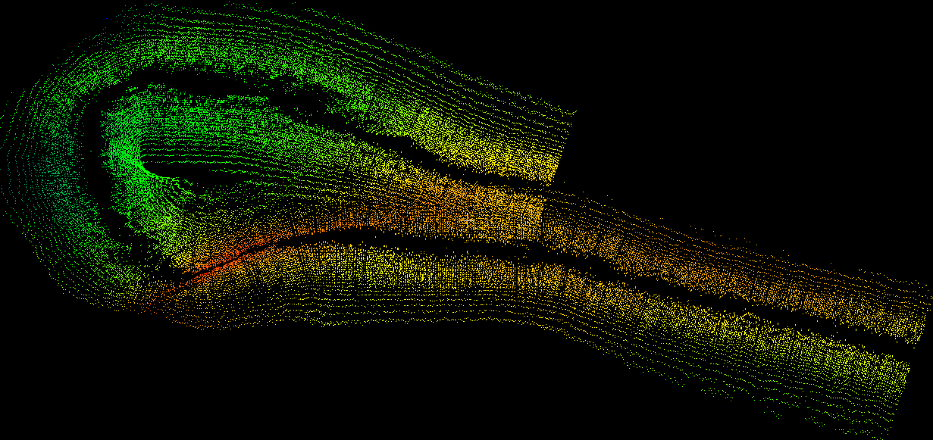
Dissimilar Neighbor
20%

Slide 14

Kmeans
20%

Slide 15

$$y=f(x)$$
y is dependent variable, “target”
x is independent variable, “input”

Slide 16

$$y=f(x)$$
y is dependent variable, “target”
noise in our data!
x is independent variable, “input”

Slide 17

$$y=f\left(x\right)+ϵ$$
y is dependent variable, “target”
noise in our data!
x is independent variable, “input”

Slide 18
$$y=f\left(x\right)+ϵ$$

Slide 19
$$y=f\left(x\right)+ϵ$$
Fitting a ‘trendline’ to data…

Slide 20
$$y=f\left(x\right)+ϵ$$
Fitting a ‘trendline’ to data…
to make predictions where we don’t have data!

Slide 21

$$y=f\left(x\right)+ϵ$$
Fitting a ‘trendline’ to data…
to make predictions where we don’t have data!

Slide 22
$$y=f\left(x\right)+ϵ$$
Trendline gives us predictions of y at any x!

Slide 23
$$y=f\left(x\right)+ϵ$$
Trendline gives us predictions of y at any x!
line = many discrete points

Slide 24
$$y=f\left(x\right)+ϵ$$
What is y when x is 25?

Slide 25
$$y=f\left(x\right)+ϵ$$
What is y when x is 25?

Slide 26
$$y=f\left(x\right)+ϵ$$
What is y when x is 25?
y = 25

Slide 27
$$y=f\left(x\right)+ϵ$$
Make predictions for any unknown point!

Slide 28
$$y=f\left(x\right)+ϵ$$

Slide 29
what was this?
$$y=f\left(x\right)+ϵ$$

Slide 30

what was this?
$$y=f\left(x\right)+ϵ$$
$$y=x$$

Slide 31

what was this?
$$y=f\left(x\right)+ϵ$$
Linear Model
$$y=Ax+b$$
$$y=x$$

Slide 32

what was this?
$$y=f\left(x\right)+ϵ$$
Linear Model
$$y=Ax+b$$
$$y=1x+0$$
$$y=x$$

Slide 33

$$y=Ax+b$$
what are A,b?

Slide 34

$$y=Ax+b$$
$$y=3x+7$$

Slide 35

$$y=Ax+b$$
$$y=−0.5x+2$$

Slide 36

Linear Model
tune A,b
$$y=Ax+b$$

Slide 37

Linear Model
$$y=Ax+b$$
tune A,b

Slide 38
Linear Model
$$y=Ax+b$$
tune A,b

Slide 39


Polynomial Model
Linear Model
$$y=Ax^{2}+Bx+c$$
$$y=Ax+b$$
$$y=0.25x^{2}+0x−4$$
tune A,b
tune A,B,c

Slide 40

Linear Model
$$y= ???$$
$$y=Ax+b$$
tune A,b

Slide 41


Linear + Cos(x)
Linear Model
$$y=A\cos{(x)}+bx$$
$$y=Ax+b$$
$$y=2 cos⁡(x)+1x$$
tune A,b
tune A,b

Slide 42

Linear Model
Polynomial Model
Linear + Cos(x)
$$y=Ax+b$$
$$y=Ax^{2}+Bx+c$$
$$y=A\cos{(x)}+bx$$
tune A,b
tune A,B,c
tune A,b
And so many more models!!

Slide 43
Linear Model
Polynomial Model
Linear + Cos(x)
$$y=Ax+b$$
$$y=Ax^{2}+Bx+c$$
$$y=A\cos{(x)}+bx$$
tune A,b
tune A,B,c
tune A,b
parameters to tune!

Slide 44
Linear Model
Polynomial Model
Linear + Cos(x)
$$y=Ax+b$$
$$y=Ax^{2}+Bx+c$$
$$y=A\cos{(x)}+bx$$
tune A,b
tune A,B,c
tune A,b
PARAMETRIC MODELS

Slide 45
Linear Model
Polynomial Model
Linear + Cos(x)
$$y=Ax+b$$
$$y=Ax^{2}+Bx+c$$
$$y=A\cos{(x)}+bx$$
PARAMETRIC MODELS
Tune parameters to get a ‘best fit’ (can never be perfect due to noise)

Slide 46
Linear Model
$$y=Ax+b$$
Tune parameters to get a ‘best fit’ (can never be perfect due to noise)

Slide 47

Linear Model
$$y=Ax+b$$
$$y=1.2x+0$$
$$R^{2}=0.73$$
Tune parameters to get a ‘best fit’ (can never be perfect due to noise)

Slide 48

Linear Model
$$y=Ax+b$$
$$y=1.2x−2$$
$$R^{2}=0.84$$
Tune parameters to get a ‘best fit’ (can never be perfect due to noise)

Slide 49

Linear Model
$$y=Ax+b$$
$$y=1x+0$$
$$R^{2}=0.94$$
Tune parameters to get a ‘best fit’ (can never be perfect due to noise)

