Slide 1
How far have we come?
Gaussian Process Regression for Seafloor Mapping

Slide 2

Where it began
Massively Parallel Gaussian Process Regression
real-time updatable GPR solution
exact solution (uses all data)
number of computational speed-ups
runs on a GPU

Slide 3

Where it began
Massively Parallel Gaussian Process Regression
requires heavy-duty GPU
constant sonar uncertainty
not as fast as it could be

Slide 4

What Phil targeted
Massively Parallel Gaussian Process Regression
determine the best downsample method
- 6 methods tested
- want fast and accurate
variable sonar uncertainty across ping
- better reflection of reality

Slide 5



What’s the big deal?
GPR scales O(N³)
and N is in the millions
as we use fewer points…
…the algo
speeds up…
…and accuracy goes down.

Slide 6
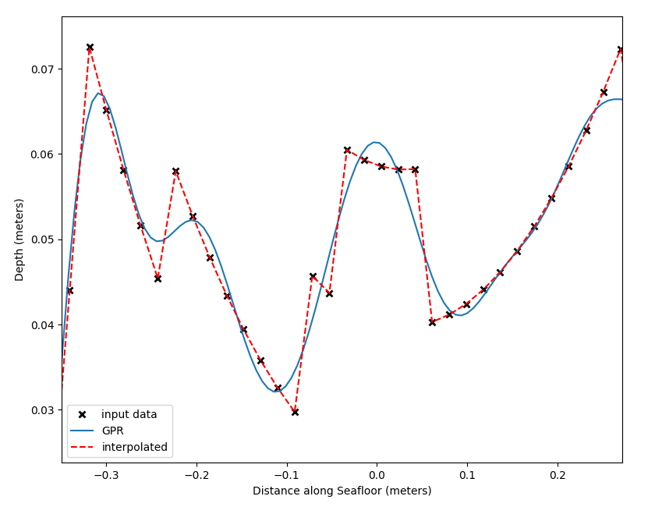
GPR on a 2D ping

Slide 7
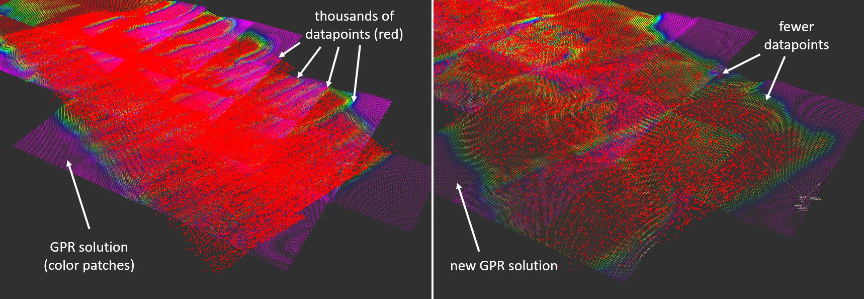
Regression
GPR on a 2.5D swath
Fitting a ‘trendline’ to data
All datapoints (exact solution)
10% of datapoints (approximate solution)

Slide 8
The Process
What does it take to run a different method?
- write downsample algo in c++/ROS
- run algo to get rosbag
- extract bathymetry (shown previously)
- isolate training patch and train hyperparameters
- run algo with trained hyperparameters
50x

Slide 9
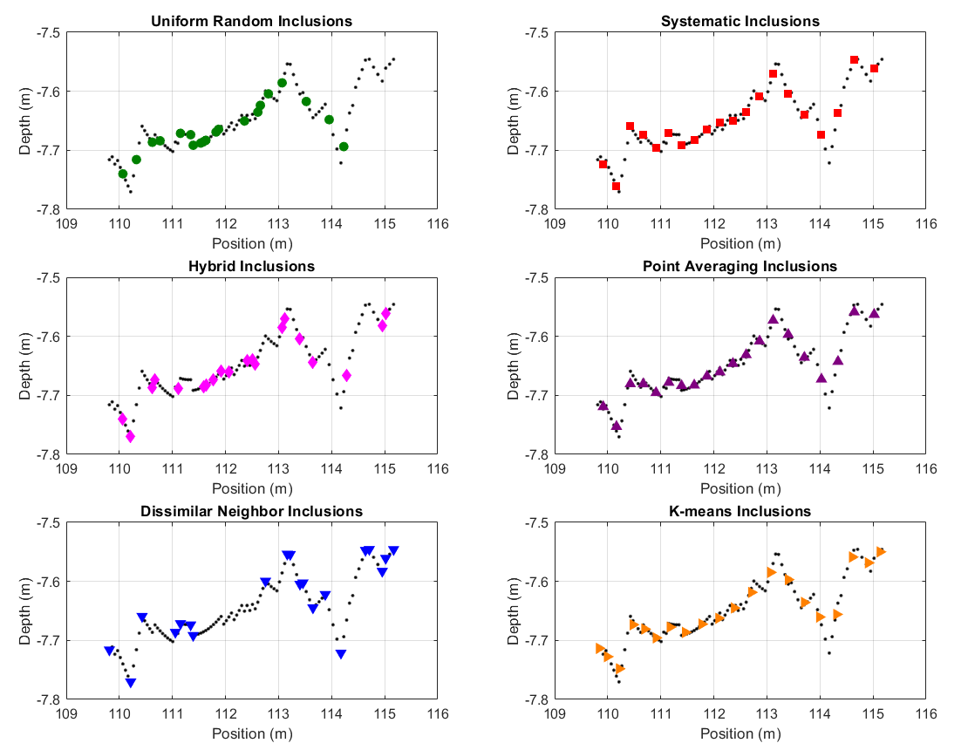
6
Methods
100 pts → 20 pts

Slide 10
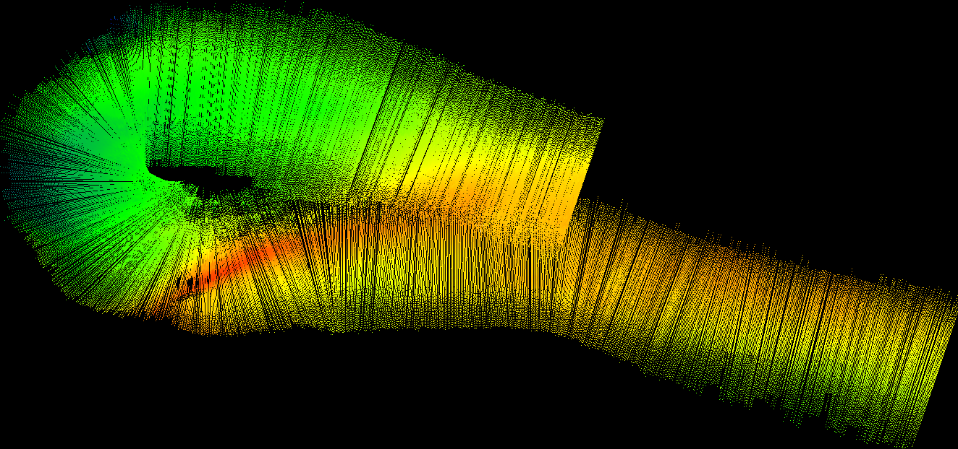
Exact
100%

Slide 11
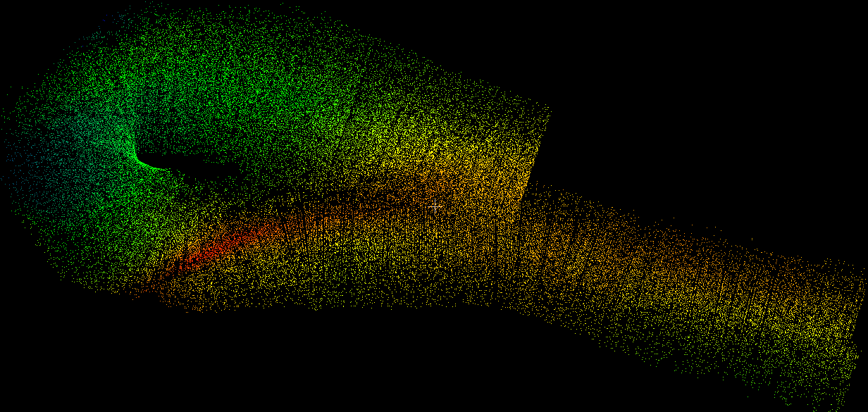
Random
20%

Slide 12
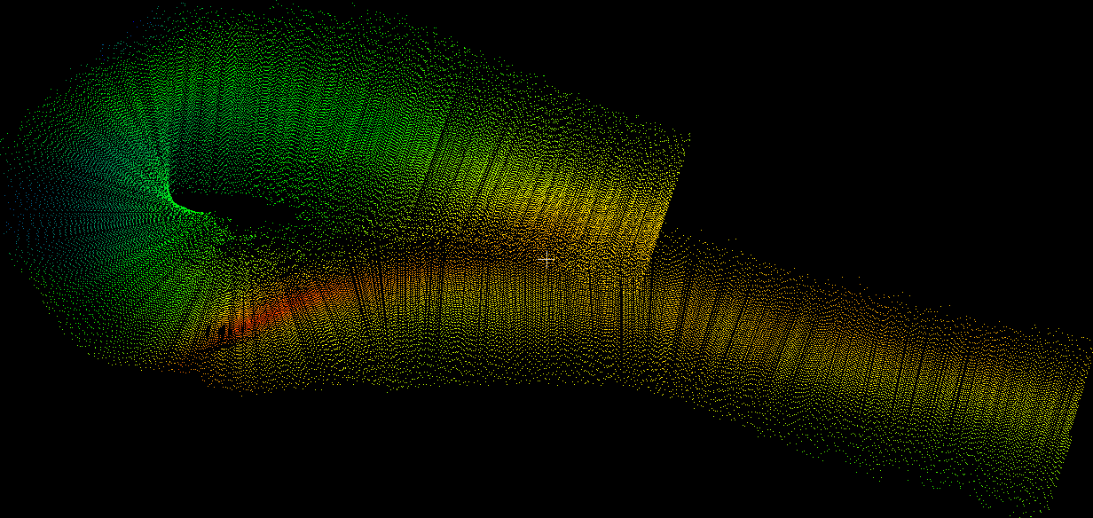
Systematic
every 5th pt
20%

Slide 13
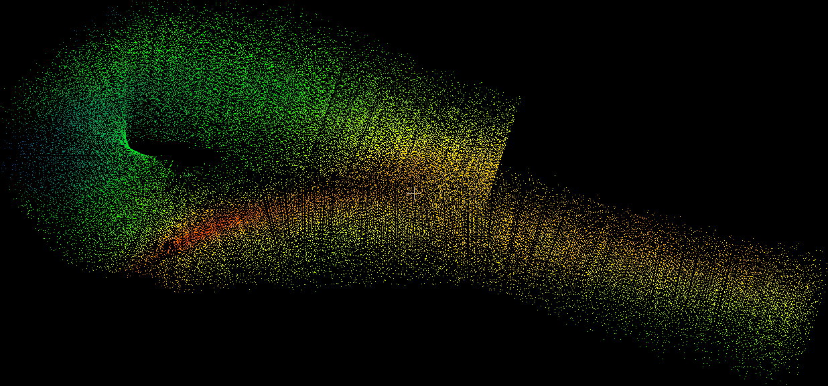
Hybrid
20%

Slide 14
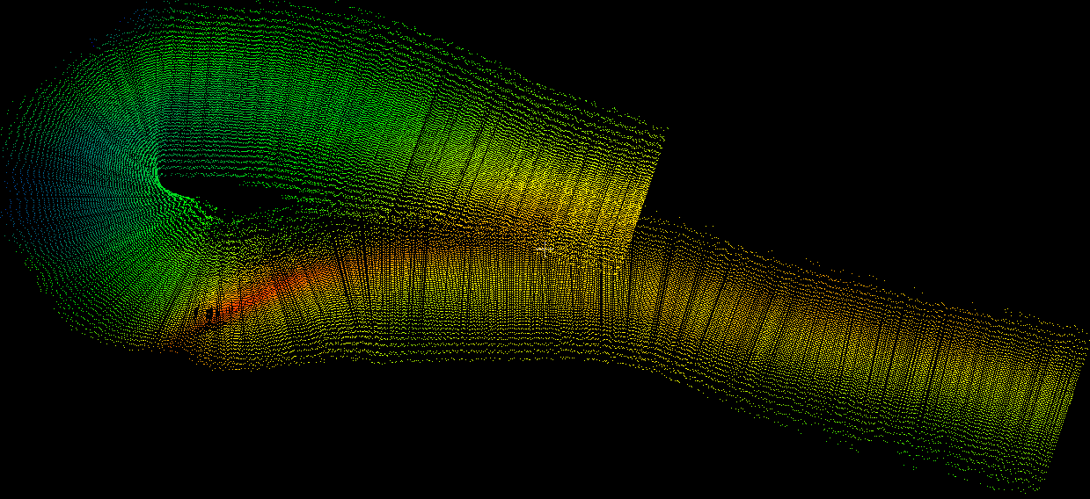
Average
20%

Slide 15
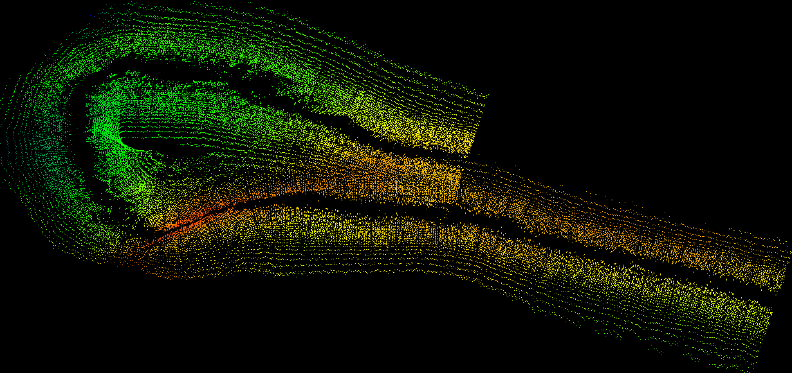
Dissimilar Neighbor
20%

Slide 16

Kmeans
20%

Slide 17
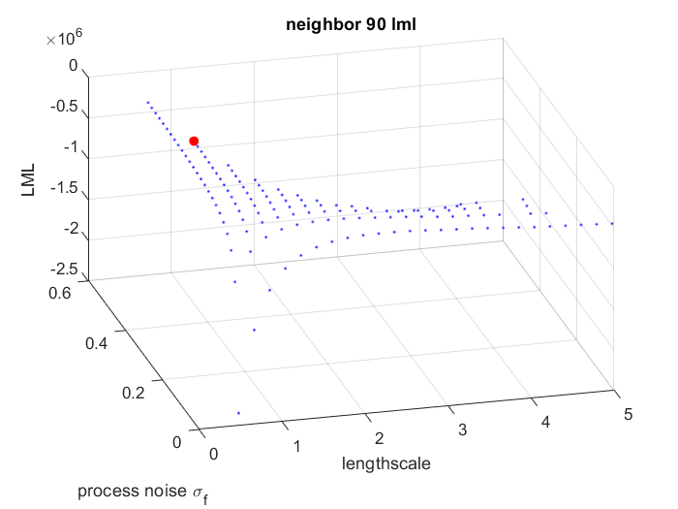
Training Hyperparameters
Want to maximize LML
bad solution zone!
The ‘max’ is dangerous
Choose a more reasonable pt

Slide 18
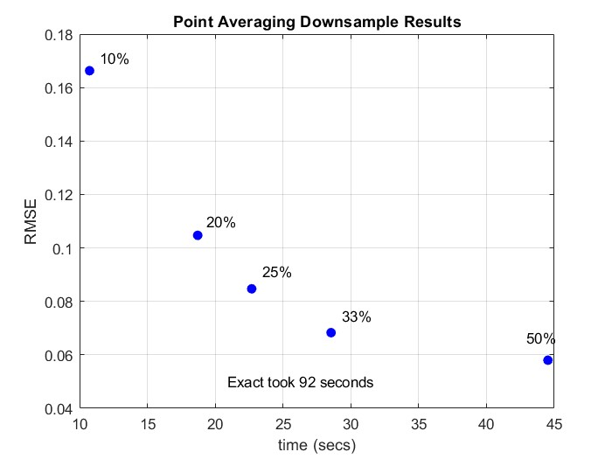
Results!!!
What are good metrics to show for accuracy?
What are good metrics to show for time?

Slide 19

$$y=f(x)$$
y is dependent variable, “target”
x is independent variable, “input”

Slide 20
Questions
What errors to present?
What time metric to present?
Other open advice from committee

Slide 21

$$y=f(x)$$
y is dependent variable, “target”
noise in our data!
x is independent variable, “input”

Slide 22

$$y=f\left(x\right)+ϵ$$
y is dependent variable, “target”
noise in our data!
x is independent variable, “input”

Slide 23

$$y=f\left(x\right)+ϵ$$
Fitting a ‘trendline’ to data…
to make predictions where we don’t have data!

