Slide 1
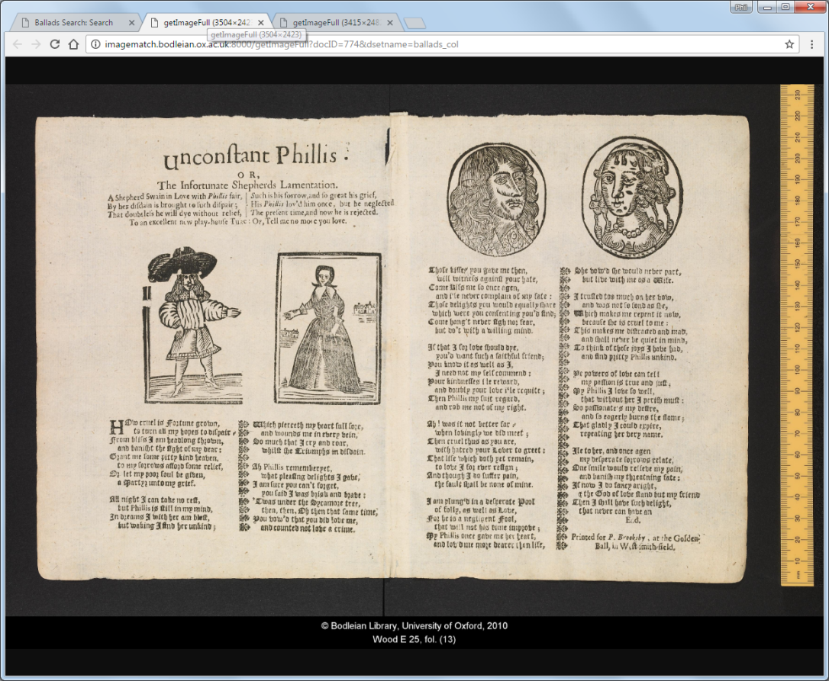
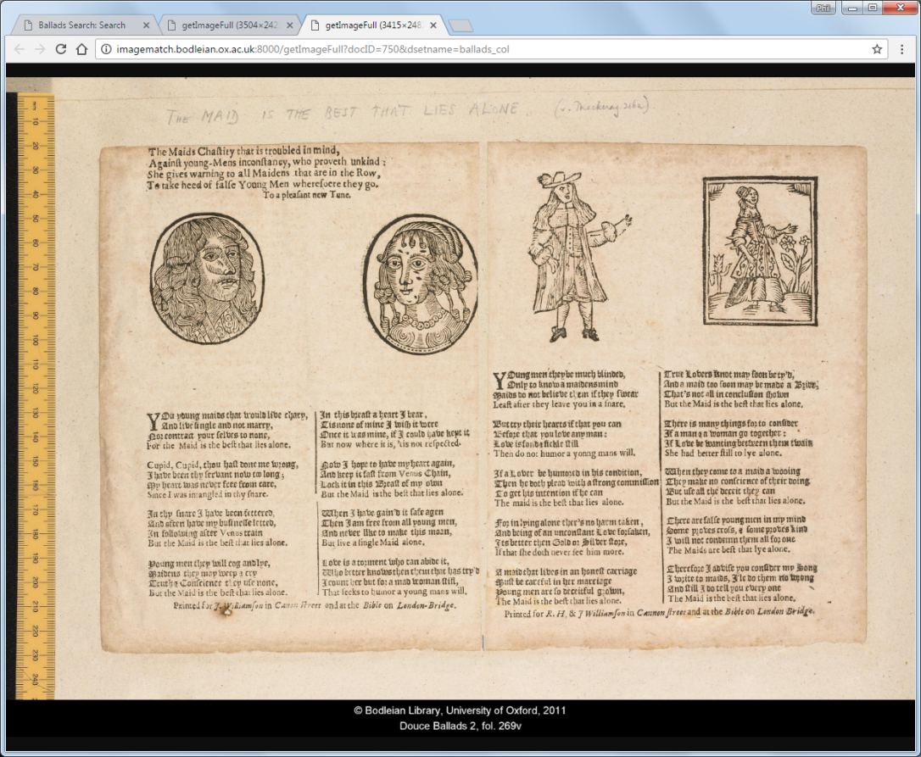
MS. Wood E 25(13)
Douce Ballads 2(269b)

