Slide 1


Selenium WebDriver Basic
Setup Selemiun, Setup NUnit,
Basic Operations and Waits
QA
Automation
SoftUni Team
Technical Trainers
Software University
http://softuni.bg

Slide 2

Table of Contents
NUnit setup
Asserts
Selenium WebDriver setup
IWebDriver
IWebElement
Element Locators
Waits
XPath

Slide 3
Have a Question?
sli.do #QA-Auto

Slide 4

NUnit 3.0
Setup and First Test

Slide 5
NUnit
Initially ported from Junit
NUnit version 3.0, has been completely rewritten
NUnit is Open Source software
Support for a wide range of .NET platforms

Slide 6

Nunit vs MSTest
NUnit allows for parameterized tests
Readable Assert method
NUnit has frequent version updates MS-Test has only one per VS version.
Expected exception message assertion
Can be done using attribute in NUnit
Must be done using Try-Catch in MS-Test

Slide 7
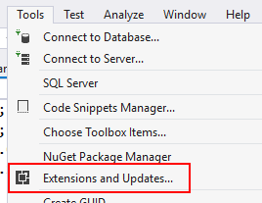
Problem: NUnit Test
Add NUnit 3.0 extension to Visual Studio
Create console application project
Add BankAcount class
Create NUnit Project
Write test against BankAcount

Slide 8


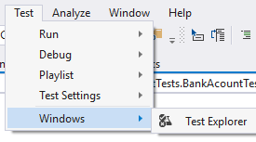
Solution: NUnit Test
Add NUnit 3.0 Adapter
Add NUnit Template
Show Test Explorer
Build Project - F6

Slide 9
Solution: NUnit Test (2)
Write your first test
Class attributes mean this is a class with tests
[TestFixture]
public class BankAcountTests
{
[Test]
public void AcountInitializeWithPositiveValue()
{
BankAcount acount = new BankAcount(2000m);
Assert.AreEqual(2000m, acount.Amount);
}
}
Test Method
Assert class come with NUnit

Slide 10
Asserts
Condition Asserts
Comparison Asserts
Exception Asserts
Assert.IsTrue(bool condition, string message);
Assert.AreEqual(expected value, actual value);
Assert.Throws(
Type expectedExceptionType, TestDelegate code);

Slide 11
Asserts (2)
String Assert
Collection Assert
File Assert
StringAssert.Contains
(string expected, string actual);
CollectionAssert.Contains
(IEnumerable expected, object actual);
FileAssert.AreEqual
(FileInfo expected, FileInfo actual);

Slide 12
Selenium WebDriver
Setup and First Test

Slide 13
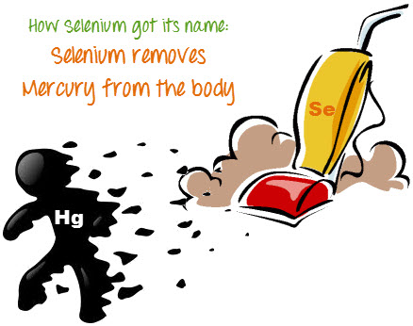
Why Selenium WebDriver?
To use a certain programming language in designing your test case.
To test applications that are rich in AJAX-based functionalities.
To execute tests on the HtmlUnit browser.
To create customized test results.
Since Selenium is a well-known antidote for Mercury poisoning

Slide 14
IDE vs RC vs WebDriver
Selenium IDE
Firefox add-on that you can create relatively simple test cases.
Selenium Remote Control
Use programming languages in creating complex tests.
Also known as Selenium 1
WebDriver
Communicate directly to the browser, thereby controlling it from the OS level.

Slide 15
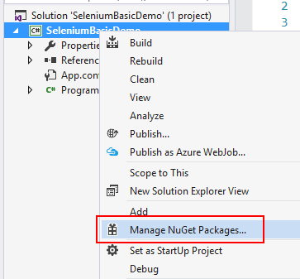
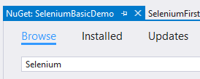
Problem: Enter SoftUni
Create console application
Setup Selenium WebDriver
Execute enter in SoftUni

Slide 16
Solution: Enter SoftUni
Install Selenium Web Driver
Install Selenium Web Driver
Check your solution here: https://judge.softuni.bg/Contests/522/CSharp-Overview

Slide 17

Solution: Enter SoftUni
Install Selenium Web Driver
Add using OpenQA
IWebDriver driver = new ChromeDriver();
driver.Url = "http://softuni.bg";
driver.Quit();
using OpenQA.Selenium;
using OpenQA.Selenium.Chrome;

Slide 18
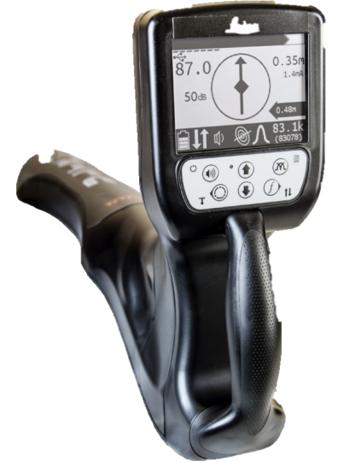

IWebElement
Element Locators

Slide 19
IWebElement
Each browser need defferent driver
IWebElement interface represent HTML elements
IWebDriver driver = new ChromeDriver();
IWebElement element = driver.FindElement(By.Id("coolestWidgetEvah"));
List<IWebElement> list = driver.FindElements(By.TagName("input")).ToList();

Slide 20
Locating Elements
Elements can be located by the same properties as in the IDE
By ID
By class name
By tag name
IWebElement element = driver.FindElement(By.Id("coolestWidgetEvah"));
IList<IWebElement> cheeses = driver.FindElements(By.ClassName("cheese"));
IWebElement frame = driver.FindElement(By.TagName("iframe"));

Slide 21
Locating Elements (2)
By Name
By Link Text
By CSS Selector
IWebElement cheese = driver.FindElement(By.Name("cheese"));
IWebElement cheese = driver.FindElement(By.LinkText("cheese"));
IWebElement cheese =
driver.FindElement(By.CssSelector("#food"));

Slide 22
Locating Elements (3)
By Xpath
Internet Explorer have special rules for XPath
Chain of locators
IList<IWebElement> inputs = driver.FindElements(By.XPath("//input"));
IWebElement cheese = this.driver.
FindElement(By.ClassName(“firstElementTable")).
FindElement(By.Id(“secondElement"));

Slide 23
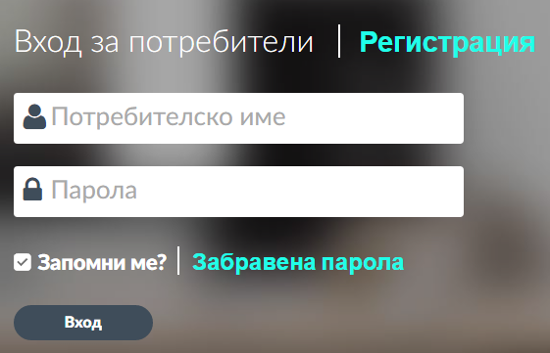

Problem: Login SoftUni
Create NUnit project and install Selenium WebDriver
Write a test for login in SoftUni
Assert logo is visible

Slide 24
Solution: Enter SoftUni
IWebDriver driver = new ChromeDriver();
driver.Url = "http://softuni.bg";
WebDriverWait wait = new WebDriverWait
(driver, TimeSpan.FromSeconds(60));
IWebElement loginButton = wait.Until<IWebElement>
((w) => { return w.FindElement(By.LinkText("Вход")); });
loginButton.Click();
Wait for elements if you have rich AJAX

Slide 25
Solution: Enter SoftUni
IWebElement userName = driver.FindElement(By.Name("username"));
userName.Clear();
userName.SendKeys("DJBuro");
//TODO: make the same for password
IWebElement login = driver.FindElement(By.Xpath
("/html/body/div/div[2]/div[2]/div[2]/div[1]/form/input[2]"));
login.Click();
IWebElement logo = driver.FindElement(By.Xpath
("//*[@id=\"page-header\"]/div[1]/div/div/div[1]/a/img[2]"));
Assert.IsNotNull(logo);
Assert.AreEqual(50, logo.Size.Width);

Slide 26

Waits
Explicit Wait vs Implicit Wait

Slide 27
Explicit Wait
Explicit wait – use it for dynamic pages where you don’t care about the execution time (Functional Testing)
WebDriverWait wait = new WebDriverWait
(driver, TimeSpan.FromSeconds(60));
IWebElement loginButton = wait.Until<IWebElement>
((w) => {
return w.FindElement(By.LinkText("Вход"));
});

Slide 28
Implicit Wait
Implicit Wait – assert action executed in exact interval (Performance Testing)
Thread.Sleep() – don’t use it!
driver.Manage().Timeouts().
ImplicitlyWait(TimeSpan.FromSeconds(10));
Thread.Sleep(2000)

Slide 29
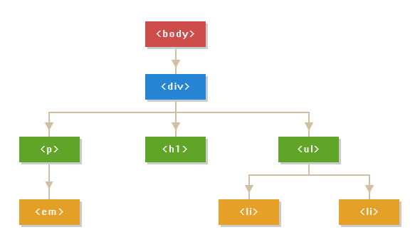
Element Present in DOM
An element not being present at all in the DOM.
An element being present in the DOM but not visible.
An element being present in the DOM but not enabled. (i.e. clickable)

Slide 30

Selenium Support Classes

Slide 31

Selenium Support Classes
Install Selemium.Support
ExpectedConditions
WebDriverWait wait = new WebDriverWait
(driver, TimeSpan.FromSeconds(10));
IWebElement element = wait.Until(ExpectedConditions
.ElementToBeClickable(By.Id("someid")));

Slide 32
SelectElement
HTML drop down
Select Element
<select>
<option value="volvo">Volvo</option>
<option value="saab">Saab</option>
</select>
SelectElement selectElement = new SelectElement
(driver.FindElement(By.XPath("/html/body/select")));
selectElement.SelectByText("Saab");

Slide 33

Problem: Register New Account in DemoQA
Open DemoQA
Open registration form
Fill the form with valid data
Assert Registration is successful

Slide 34
Solution: Register New Account in DemoQA
//TODO: Navigate to registration page
IWebElement firstName = driver.FindElement(By
.Id("name_3_firstname"));
Type(firstName, "Ventsislav");
IWebElement matrialStatus = driver.FindElement(By
.XPath("//*[@id=\"pie_register\"]/li[2]/div/div/input[1]"));
matrialStatus.Click();
List<IWebElement> hobbys = driver.FindElements(By
.Name("checkbox_5[]")).ToList();
hobbys[0].Click();
hobbys[1].Click();

Slide 35
Solution: Register New Account in DemoQA
IWebElement countryDropDown = driver.FindElement(By
.Id("dropdown_7"));
SelectElement country = new SelectElement(countryDropDown);
country.SelectByText("Bulgaria");
//TODO: Do same to other drop downs on page
//TODO: Send keys to other inputs
IWebElement picButton = driver.FindElement(By
.Id("profile_pic_10"));
uploadPicButton.Click();
driver.SwitchTo().ActiveElement().SendKeys
(@"C:\Users\Buro\Desktop\big-logo.png");

Slide 36
Solution: Register New Account in DemoQA
//TODO: Send keys to other inputs
IWebElement registrationMessage = driver.FindElement(By.ClassName("piereg_message"));
Assert.IsTrue(registrateButton.Displayed);
Assert.AreEqual("Thank you for your registration",
registrationMessage.Text);
driver.Quit();
public void Type(IWebElement element, string text)
{
element.Clear();
element.SendKeys(text);
}

Slide 37
Selenium Support Classes
XPath Syntax

Slide 38
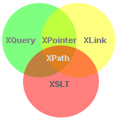
Xpath
What is XPath?
XPath is a syntax for defining parts of an XML document
XPath uses path expressions to navigate in XML documents
XPath contains a library of standard functions
XPath is a major element in XSLT
XPath is a W3C recommendation

Slide 39
Xpath Syntax
Driver | Tag and Attribute
bookstore | /bookstore/book[last()]
/bookstore | /bookstore/book[last()-1]
bookstore/book | /bookstore/book[position()<3]
//book | //title[@lang]
bookstore//book | //title[@lang='en']
//@lang | /bookstore/book[price>35.00]
/bookstore/book[1] | /bookstore/book[price>35.00]/title
//book/title | //book/price | /bookstore/*
//* | //title | //price
https://www.w3schools.com/xml/xpath_intro.asp

Slide 40
Xpath Axes
Location path can be absolute or relative
AxisNamez | Expression
ancestor | Selects all ancestors (parent, grandparent, etc.)
descendant | Selects all descendants (children, grandchildren, etc.)
following-sibling | Selects all siblings after the current node
preceding-sibling | Selects all siblings before the current node
child | Selects all children of the current node
parent | Selects the parent of the current node
attribute | Selects all attributes of the current node
https://www.w3schools.com/xml/xpath_axes.asp

Slide 41






SoftUni Diamond Partners

Slide 42






SoftUni Diamond Partners

Slide 44

License
This course (slides, examples, demos, videos, homework, etc.) is licensed under the "Creative Commons Attribution-NonCommercial-ShareAlike 4.0 International" license

Slide 45





Trainings @ Software University (SoftUni)
Software University – High-Quality Education, Profession and Job for Software Developers
softuni.bg
Software University Foundation
http://softuni.foundation/
Software University @ Facebook
facebook.com/SoftwareUniversity
Software University Forums
forum.softuni.bg

