Slide 1
Bank Account
An Introduction
To Programming
Using
Visual Basic
Exercises for Beginners
01
Write a program to maintain a person’s savings and checking accounts. The program should keep track of and display the balances in both accounts, and maintain a list of transactions (deposits, withdrawals, fund transfers, and check clearing) separately for each account. The two lists of transactions should be stored in text files.
The program should use 2 classes: Transaction and Account. The class Transaction should have properties for transaction name, amount, date, and whether it is a credit (deposit) or debit (withdrawal/check). The class Account, which will have both checking and savings account as instances, should use an array of Transaction objects. In addition, it should have properties for name (Checking or Savings) and balance. It should have methods to carry out a transaction (if possible) and to load the set of transactions from a text file. The events InsufficientFunds and TransactionCommitted should be raised at appropriate times.

Slide 2
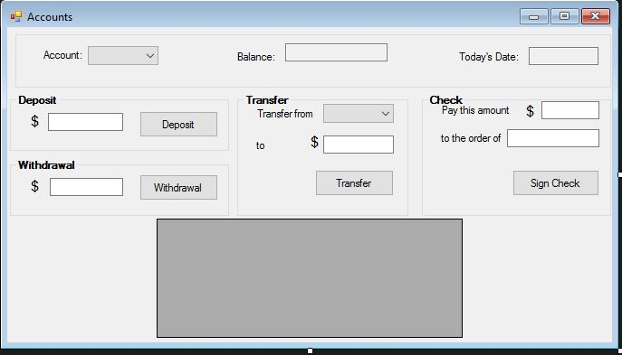
Two drop down combo boxes should each contain items Checking and Savings. Each of the four group boxes correspond to a type of transaction. When Savings is selected in Account combo box, the Check group box should disappear.
The user makes a transaction by entering data into the text boxes of a group box and pressing the associated button. The items appearing in the DataGridView control should correspond to the type of account that has been selected. The caption of the second label in the Transfer group box should toggle between “to Checking” and “to Savings”, depending on the item selected in the “Transfer from” combo box. If a transaction cannot be carried out, a message should be displayed. Two text files should be maintained (on for each account type) and should be updated each time a transaction is carried out.

