Slide 1
Baseball
An Introduction
To Programming
Using
Visual Basic
Exercises for Beginners
01
File ALE.txt contains information shown in Table 1.
Write a program that produces a text file (I’ll call it ALE2.txt), which should contain information shown in the Table 2, in which the baseball teams are in descending order by the percentage of games won.

Slide 2
TABLE 1 TABLE 2
Team Won Lost Team Won Lost Pct
-------------------------- --------------------------------------------
Baltimore 93 69 New York 95 67 0.586
Boston 69 93 Baltimore 93 69 0.574
New York 95 67 Tampa Bay 90 72 0.556
Tampa Bay 90 72 Toronto 73 89 0.451
Toronto 73 89 Boston 69 93 0.426

Slide 3
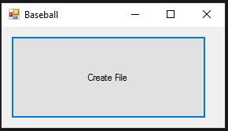
INPUT
No input – input is from a text file ALE.txt
OUTPUT
A text file ALE2.txt
EVENTS
btnGenerate – Generate file ALE2.txt

