Slide 1
Membership List
An Introduction
To Programming
Using
Visual Basic
Exercises for Beginners
01
Write a menu-driven program to manage a membership list. Assume that the names and phone numbers of all members are stored in alphabetical order (by last name, then first name) in the text file "MemberPhones.txt“. Each record consists of two fields - a name field and a phone number field. The names should appear in a list box when the firm is loaded.
When a name is highlighted, both the name and phone number of the person should appear in the text boxes at the bottom of the form.
To delete a person, highlight his or her name and click on the Delete menu item.
To change either a person's name or phone number, make the corrections in the text boxes and click on the menu item "Modify".
To add a new member, type the person's name and phone number into the text boxes and click on the menu item "Add". When the "Exit" menu item is clicked, the new membership list should be written to the file and the program should terminate.

Slide 2
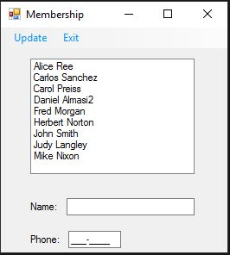
INPUT
No input – input is from a text file MemberPhone.txt
OUTPUT
Updated MemberPhone.txt
EVENTS
SelectedIndexChanged – Display name from list box in text boxes
mnuAdd, mnuDelete, mnuModify – add new name, delete name from list, modify name in the list
mnuExit – save updated list in MemberPhone.txt

