Slide 1
Airplane Seating Chart
An Introduction
To Programming
Using
Visual Basic
Exercises for Beginners
04
An Airplane has 15 rows numbered 1 through 15, with 6 seats labeled A-F in each row. Write a program that keeps track of the seats that have been reserved and the type of meal requested by each passenger. The seating chart should be displayed in a list box with a line for each row. When the ticket agent clicks on the desired row in a list box, the row number and the status of the seats in the row should be displayed in seven read-only text boxes at the bottom of the form. When an agent clicks on one of the text boxes, a second form containing four options labeled Unoccupied, Regular, Low Calorie and Vegetarian should appear. Clicking on the radio button should close the second form and update both text box and the row for that seat in the list box. Unoccupied seats are denoted with a period, and occupied seats are denoted with the first letter of their meal type. At any time, the agent should be able to request the number of seats filled, the number of window seats vacant, and the number of each type of meals ordered.

Slide 2
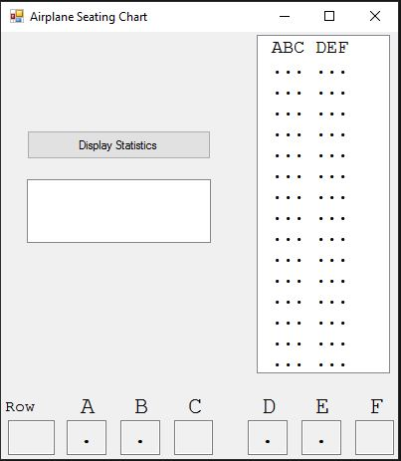
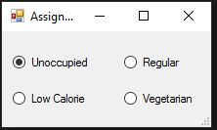
INPUT
Click on a text box representing a seat
OUTPUT
Seat in a list box
Statistics showing available seats
EVENTS
Text box click events
btnStatistics – displays statistics in a list box
Check box click event – second form events

