Slide 1
The Underdog And The World Series
An Introduction
To Programming
Using
Visual Basic
Exercises for Beginners
05
What is the probability that the underdog will win the World Series in baseball? What is the average number of games for a World Series?
Write an ANIMATED program to answer those questions. For example, suppose the underdog is expected to win 40% of the time (so the probability of winning a game is 40%). The probability of a 40% underdog’s winning a World Series is about 29%, and such a series would last average of 5.7 games.
The program should simulate the playing of 10,000 World Series where the underdog’s probability of winning is entered in a text box. The values of the horizontal scroll bars should extend from 0 to 10,000 and should be calculated after each series so that the scroll boxes steadily move across the bars.
NOTE: In order to save the program from being overwhelmed with changing values too often, just change the values after every 10 series. Also, every time the values are changed, execute a Refresh method for each of these text boxes.

Slide 2
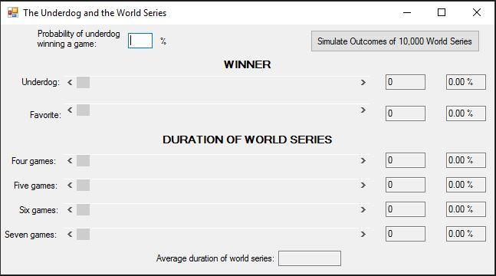
INPUT
Probability of underdog’s win
OUTPUT
Animated scroll bars + calculated values in text boxes
EVENTS
Simulate 10,000 World Series button click event

