Slide 1
Spread Of an Epidemic
An Introduction
To Programming
Using
Visual Basic
Exercises for Beginners
06
A community of 10,000 individuals is exposed to a flu epidemic in which infected individuals are sick for 2 days and then are immune from the illness. When we first start to observe the epidemic (that is on day 0), 200 people have had the illness for 1 day, and 100 people have had it for 2 days. At any time, the rate at which the epidemic is spreading is proportional to the product of the number currently ill and the number of susceptible. Specifically, each day:
#of individuals in the first day of the illness = Cint(0.0001735 * #sick the previous day * #susceptible the previous day
Write a program that displays successive bar graph illustrating the progress of the epidemic. When the show day 0 button is clicked, the bar graph should show the distribution for day 0. Each time the Advance One Day button is clicked, a bat graph showing the distribution for the next day should appear.

Slide 2
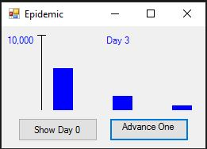
INPUT
none
OUTPUT
Picture box – shows graph
EVENTS
btnDay0 – shows graph for Day 0
btnAdvance – shows graphs for each click (1 click = 1 day)

