Slide 1
Business Travel Expenses
An Introduction
To Programming
Using
Visual Basic
Exercises for Beginners
07
Write a program to print a business travel expenses attachment for an income tax return. The program should request as input the name of the organization visited, the dates and locations of the visit, and the expenses for meals and entertainment, airplane fare, lodging, and taxi.
NOTE: Only 50% of the expenses for meals and entertainment are deductible.

Slide 2
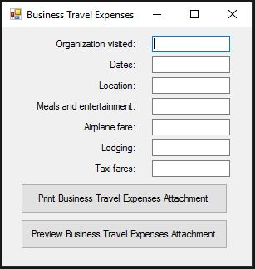
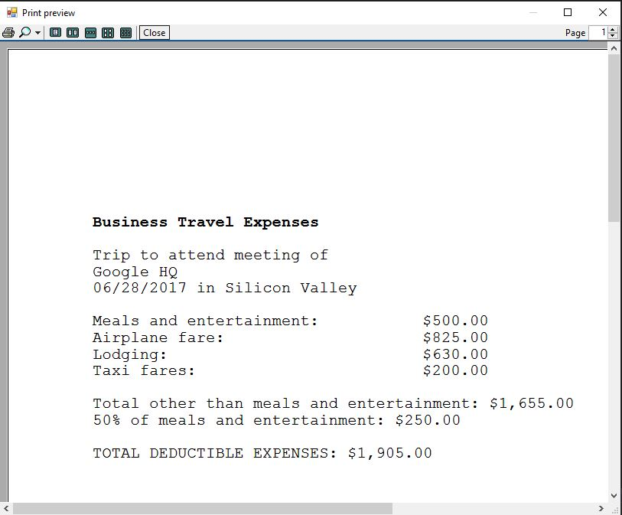
INPUT
Text boxes with trip information
OUTPUT
Printed receipt (and print preview)
EVENTS
btnPrint – Print receipt
btnPreview – Print Preview

