Slide 1
Unit Conversion
An Introduction
To Programming
Using
Visual Basic
Exercises for Beginners
01
Write a program that displays nine different units of measure; request the unit to convert from, the unit to convert to, and the quantity to be converted; and then displays the converted quantity.

Slide 2
The unit conversion to feet is saved in Units.txt file
1 inch = 0.833 foot
1 yard = 3 feet
1 meter = 3.28155 feet
1 fathom = 6 feet
1 rod = 16.5 feet
1 furlong = 660 feet
1 kilometer = 3281.5 feet
1 mile = 5280 feet
Text File Units.txt has following data
inch,.083333
fathom,6
foot,1
furlong,660
kilometer,3281.5
meter,3.2815
mile,5280
rod,16.5
yard,3

Slide 3
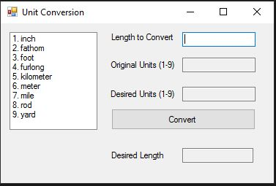
INPUT
txtOriginal – unit to convert from
txt Desired – unit to convert to
txtLength – user enters length to convert
NOTE: Input comes from click on an item in list box
OUTPUT
txtOutput – converted measurement quantity
EVENTS
btnConvert – convert measurement

