Slide 1
ISBN Validator
An Introduction
To Programming
Using
Visual Basic
Exercises for Beginners
02
Write a program that accepts an 10 digit ISBN type number (including hyphens) as input, calculate the sum, and tell if it is a valid ISBN.
Valid ISBN is divisible by 11, unless the last digit is an ‘X’. If that’s the case, then the ‘X’ is replaced with number 10, and the ISBN needs to be divisible by 11 in order to be considered valid.

Slide 2
Let’s refer to the 10 characters of the ISBN as
d1,d2,d3…d10
To determine if ISBN is valid, we use the sum as follows:
10*d1 + 9*d2 + 8*d3 + 7*d4….1*d10
If the ISBN ends with ‘X’ (i.e. 0-32-108599-X) then the ‘X’ is replaced with 10
10*0 + 9*3 + 8*2 +7*1…1*10
If the result can be divided by 11, the ISBN is valid.

Slide 3
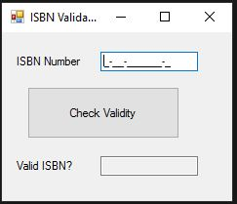
INPUT
mtbISBN – ISBN string, including hyphens (using masked text box)
OUTPUT
txtOutput – Yes/No (determination if ISBN is valid)
EVENTS
btnValidate – Validate ISBN

