Slide 1
Curve Grades
An Introduction
To Programming
Using
Visual Basic
Exercises for Beginners
03
Write a program to calculate the mean and standard deviation of the exam scores, assign letter grades to each exam score, Standard Deviation, and Mean.
The test scores are in a text file Scores.txt

Slide 2
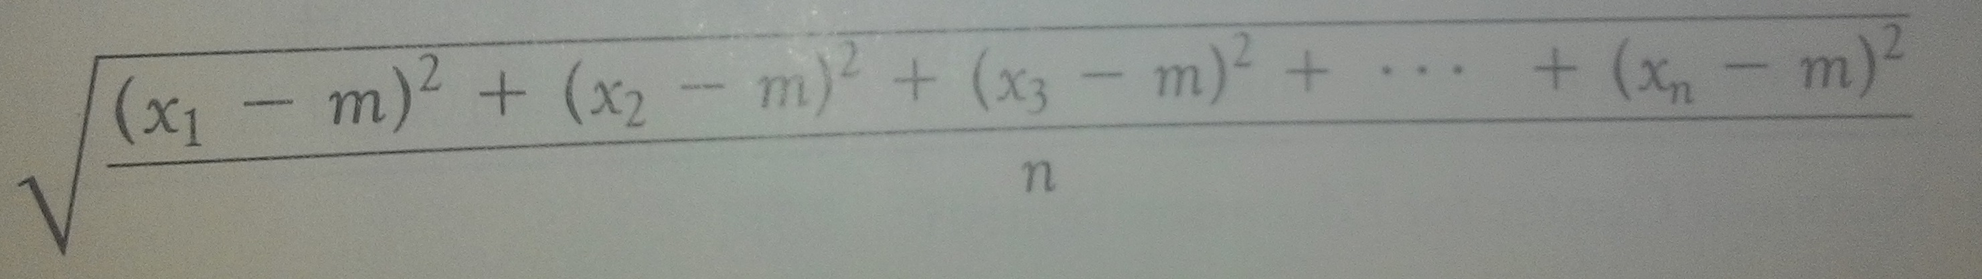
Mean (m) =
X1 + x2 + x3 + …. + xn
n
Standard Deviation (s) =
ES = Exam Score
ES >= m + 1.5s A
M + 0.5s <= ES < m + 1.5s B
M – 0.5s <= ES < m + 0.5s C
M – 1.5s <= ES < m – 0.5s D
ES < m – 1.5s F

Slide 3
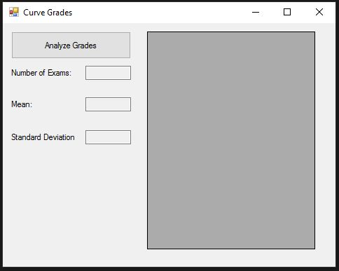
INPUT
TextFile Scores.txt
OUTPUT
Number of Exams - txtNumOfExams
Mean - txtMean
Standard Deviation - txtStDev
Scores + grades – grdScores (gridview)
EVENTS
btnAnalyze – Analyze test scores

