Slide 1
Bachelor Degrees
An Introduction
To Programming
Using
Visual Basic
Exercises for Beginners
04
Write a program that allows the user to display any one of the 3 tables as an option and to quit as a fourth option. Use file Degrees.txt.
First table is ordered alphabetically by the field of study;
Second one is ordered by decreasing percentages;
And last one is ordered by increasing number of degrees

Slide 2
TABLE 1: TABLE 2:
FIELD OF STUDY 1981 2010 FIELD OF STUDY % CHANGE (1981-2010)
-------------------------------------------------- -------------------------------------------------------------
Business 200,521 358,293 Computer and IT 161.8%
Computer and IT 15,121 39,589 Business 78.7%
Education 108,074 101,265 Social Science 71.9%
Engineering 63,642 72,654 Engineering 14.2%
Social science 100,513 172,780 NOTE: percentageChange = ((value2 - value1) / value1) * 100
TABLE 3:
FIELD OF STUDY
--------------------------------------------------
Computer and IT .... 39,589
Engineering ....... 72,654
Education .......... 101,265
Social Science ................. 172,780
Business .................................... 358,293
NOTE: Each dot represents value of 10,000 (of rounded degrees; i.e. 39,589 = 40,000 = 4 dots; 72,654 = 73,000 = 7 dots etc.)

Slide 3
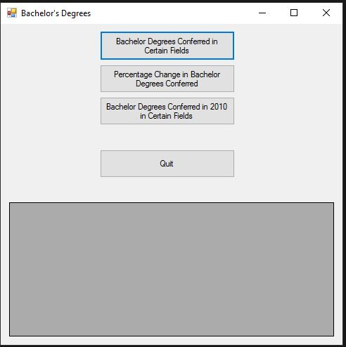
INPUT
No user input – Text file Degrees.txt
OUTPUT
Degrees analyses – grdOutput (gridview)
EVENTS
3 button clicks – Display each 3 analysis of Degrees

