Slide 1
Rudimentary Translator
An Introduction
To Programming
Using
Visual Basic
Exercises for Beginners
05
Write a program that requests an English sentence as input and translates it into French and German. Assume that the only punctuation in the English sentence is a period. If the word is not in the dictionary, it should appear as itself in the translations.
Use file Dictionary.txt

Slide 2
English | French | German
YES | OUI | JA
TABLE | TABLE | TISCH
THE | LA | DEM
IS | EST | IST
YELLOW | JAUNE | GELB
FRIEND | AMI | FREUND
SICK | MALADE | KRANK
MY | MON | MEIN
LARGE | GROS | GROSS
NO | NON | NEIN
HAT | CHAPEAU | HUT
PENCIL | CRAYON | BLEISTIFT
RED | ROUGE | ROT
ON | SUR | AUF
AUTO | AUTO | AUTO
OFTEN | SOUVENT | OFT

Slide 3
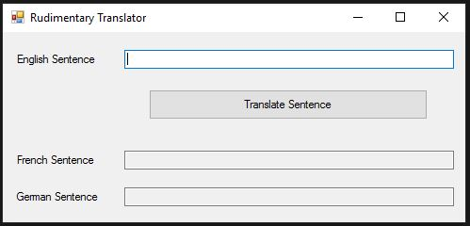
INPUT
English sentence – txtEnglish
OUTPUT
French translation – txtFrench
German translation - txtGerman
EVENTS
Translate English – btnTranslate
NOTE: text file Dictionary.txt contains English, French and German words

