Slide 1
Soccer League
An Introduction
To Programming
Using
Visual Basic
Exercises for Beginners
06
Each team in a six-team soccer league played each other team once.
Place the team names in an array structures that also holds the number of wins.
Place the data from table into two-dimensional array
Place the number of games won by each team in the array structures
Display a listing of the teams giving each team's name and number of games won.
Sort by decreasing order by the number of wins

Slide 2
Jazz Jets Owls Rams Cubs Zips
-----------------------------------------------------------------------------------
Jazz -- Jazz Jazz Rams Cubs Jazz
Jets Jazz -- Jets Jets Cubs Zips
Owls Jazz Jets -- Rams Owls Owls
Rams Rams Jets Rams -- Rams Rams
Cubs Cubs Cubs Owls Rams -- Cubs
Zips Jazz Zips Owls Rams Cubs --

Slide 3
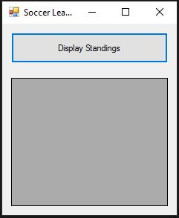
INPUT
No input
OUTPUT
Team + Wins – grdScores (gridview)
EVENTS
btnDisplay – Display each teams wins

