Slide 1
Poker
An Introduction
To Programming
Using
Visual Basic
Exercises for Beginners
07
A poker hand can be stored in a 2-dimensional array.
Dim hand(3, 12) as Integer - declares an array with 52 elements, where the first subscript ranges over the four suits and the second subscript ranges over the 13 denominations. A poker hand is specified by placing 1’s in the elements corresponding to the cards in the hand (see table).
Write a program that requests the five cards as input from the user, creates the related array, and passes the array to procedures to determine the type of hand: Flush (all cards with the same suit), straight (cards have consecutive denominations – ace can come either before 2, or after King), Straight Flush, Four-of-a-kind, Full House (3 cards of one denomination, 2 cards of another denomination), Three-of-a-kind, Two pairs, One pair, or none of the above.

Slide 2
Example of array for poker hand
Ace of Heart
Ace of Diamond
5 Of Spade
9 Of Club
Queen of Heart
A | 2 | 3 | 4 | 5 | 6 | 7 | 8 | 9 | 10 | J | Q | K
0 | 0 | 0 | 0 | 0 | 0 | 0 | 0 | 1 | 0 | 0 | 0 | 0
1 | 0 | 0 | 0 | 0 | 0 | 0 | 0 | 0 | 0 | 0 | 0 | 0
1 | 0 | 0 | 0 | 0 | 0 | 0 | 0 | 0 | 0 | 0 | 1 | 0
0 | 0 | 0 | 0 | 1 | 0 | 0 | 0 | 0 | 0 | 0 | 0 | 0
Club
Diamond
Heart
Spade

Slide 3
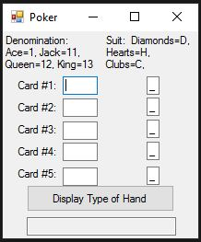
INPUT
Random 5 cards (denomination) in text boxes
Random 5 cards (suits) in text boxes
OUTPUT
Type of Poker hand
EVENTS
btnDisplay – Display Poker hand

