Slide 1
Airline Reservation
An Introduction
To Programming
Using
Visual Basic
Exercises for Beginners
08
Write a reservation system for an airline flight. Assume the airplane has 10 rows with 4 seats in each row. Use a two-dimensional array of strings to maintain a seating chart. In addition, create an array to be used as a waiting list in case the plane is full. The waiting list should be "first come, first served". Allow user three options:
A) Add a passenger to the flight or waiting list:
1. Request passenger's name 2. Display a chart of the seats in the airplane in tabular form 3. If seats are available, let the passenger choose a seat. Add the passenger to the seating chart. 4. If no seats are available, place the passenger on the waiting list.
B) Remove a passenger from the flight
1. Request passenger's name 2. Search the seating chart for the passenger's name and delete it 3. If the waiting list is empty, update the array so the seat is available 4. If the waiting list is not empty, remove the first person from the list and give him the newly vacated seat
C) Quit

Slide 2
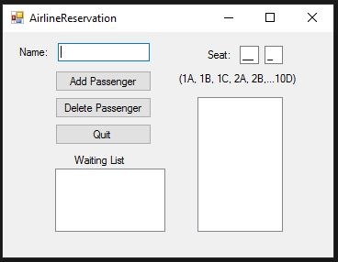
INPUT
txtName – passenger’s name
mtbSeatRow – the seat row (1-10)
mtbSeatColumn – seat column (1-4)
OUTPUT
lstOutput – seating chart
lstWaitingList – list of waiting passengers
EVENTS
btnAdd – Add passenger
btnDelete – Remove passenger
btnQuit – quit program

