Slide 1
Game of Life
An Introduction
To Programming
Using
Visual Basic
Exercises for Beginners
09

Slide 2
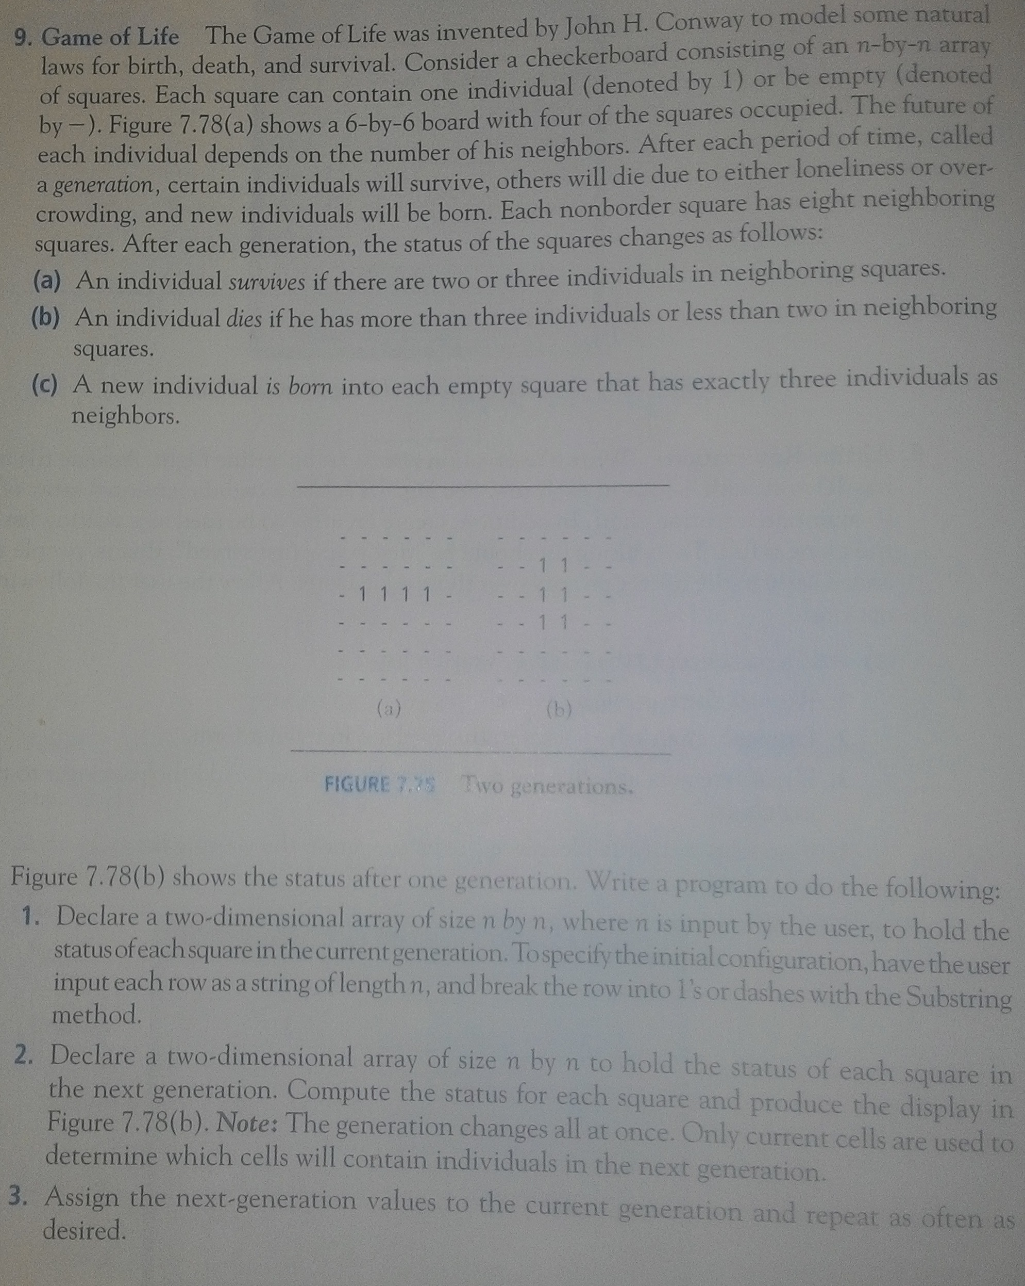
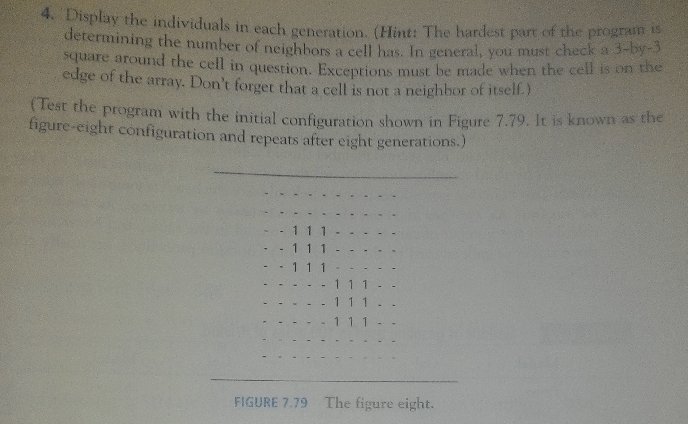

Slide 3
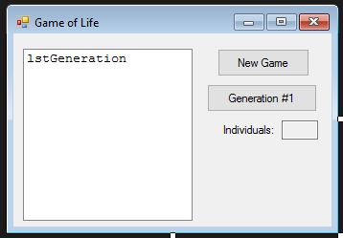
INPUT
Input Box – input variation of the game board
OUTPUT
Generations of population (alive individuals)
EVENTS
btnNew – new game
btnGeneration – advance game by one generation

