Slide 1
Directory Assistance
An Introduction
To Programming
Using
Visual Basic
Exercises for Beginners
10
Write a program that simulates directory assistance. Suppose the names and phone numbers of all employees are contained in Employees.txt. Each line of the text file has three parts - last name, first and middle name, and phone extension. The user should press a buttons for the first three letters of the person's last name followed by the first letter of the first name.
For example, for the name “Smith, Pavol" the user would press ‘6536'.
NOTE: there can be multiple people with different names for whom the same numbers will work, as each button contains 3-4 letters.

Slide 2
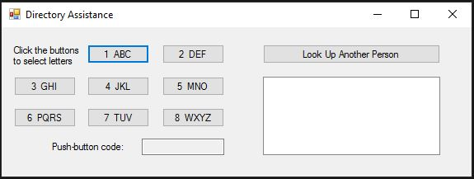
INPUT
Buttons 1-8 (A-Z)
OUTPUT
lstOutput – found name
EVENTS
Click events for buttons. Once 4 clicks, the name is displayed in the list box

