Slide 1
Fuel Economy
An Introduction
To Programming
Using
Visual Basic
Exercises for Beginners
11
A fuel economy test was carried out for 5 cars. Each car was driven 100 miles, and then the model of the car and the number of gallons used were placed in a line of the file Mileage.txt. Write a program to display the models and their average MPG in decreasing order.
The program should utilize an array of structures with upper bound 4, where each structure has 3 members.
The first member should record the name of each model of car.
The second member should record the number of test vehicles for each model (the file contains multiple models of some cars).
The third member should record the total number of gallons used by that model.

Slide 2
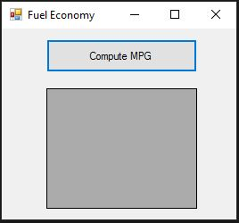
INPUT
Text file – Mileage.txt
OUTPUT
dgvOutput – car type and calculated mileage
EVENTS
btnCompute – calculate mileage

