Slide 1
U.S. Senate
An Introduction
To Programming
Using
Visual Basic
Exercises for Beginners
02
File Senate112.txt contains the members of the 112th Senate, before the 2012 election
File RetiredSen.txt contains members who left senate after 2012 election
File NewSen.txt contains newly elected senators in 2012 election
1. Write a program that uses the 3 files and create new file Senate113.txt that contains records for 113th Senate
2. Write a program that determines the number of senators of each party affiliation (Dem, Rep, Independent)
3. Write a program that determines the number of states whose two senators have the same party affiliation
4. Write a program that asks the user to select a state from a list box and then displays the 2 senators from each state

Slide 2
1. file Senate112.txt contains records for 112th Senate
2. file RetiredSen.txt contains records of Senators who retired or were not re-elected
3. file NewSen.txt contains records of newly elected Senators
We will combine the 3 text files to construct 113th Senate.
We will basically remove the non-reelected Senators from Senate112 file, and then add the newly elected Senators

Slide 3
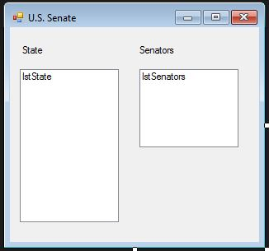
INPUT
No direct input – everything is stored in text files
lstState – contains list of U.S. states
OUTPUT
A text file Senate113.txt
lstSenators – displays names of Senators of state selected from lstState
EVENTS
lstState_SelectedIndexChanged

