Slide 1
File of Names
An Introduction
To Programming
Using
Visual Basic
Exercises for Beginners
03
The file Names.txt contains a list of names in alphabetical order. Write a program that request a name from the user and insert the name into the list in its proper location.
If it is already in the list, the name should not be inserted.

Slide 2
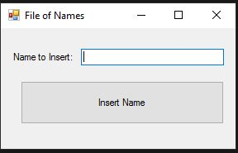
INPUT
Names.txt – text file of names
txtName – name to insert into Names.txt
OUTPUT
An ordered text file Names.txt with name inserted
EVENTS
btnInsert – inserts name into text file

