Slide 1
Telephone Directories
An Introduction
To Programming
Using
Visual Basic
Exercises for Beginners
04
'Write a program to create and maintain telephone directories. Each telephone directory should be contained in a separate text file. In addition, a file named Directories.txt should hold the names of the telephone directories. At any time, names of all the directories should be displayed in a list box. After a directory is selected, it becomes the current phone directory
1. Create new phone directory. The filename should be provided by input dialog box
2. Add a listing (as given in text box) to the end of current phone directory
3. Delete a name (as given in text box) from the current phone directory
4. Display the names and phone numbers in the current phone directory

Slide 2
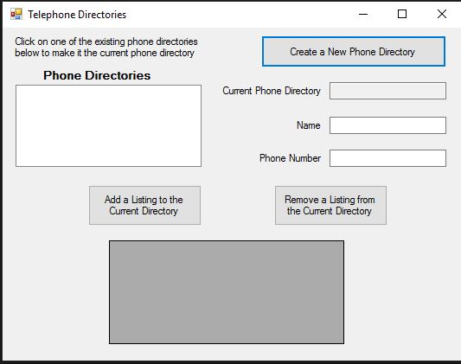
INPUT
txtName – name associated with the phone number
TxtPhone – phone number associated with the name
OUTPUT
dgvOutput – data grid view with Name and Phone columns
EVENTS
btnNewDirectory – Adds new directory to text file
btnAddListing – adds new name and phone to current directory
btnRemove – removes record from current directory

