Slide 1
UPC Barcode
An Introduction
To Programming
Using
Visual Basic
Exercises for Beginners
05
Each item in a store is identified by its UPC which consists of 12 digits. The single digit on the left (d1) identifies the type of product (0 for groceries, 2 for meat etc.). The first set of five digits (d2 - d6) identifies manufacturer. Second five digits (d7 - d11) identifies the product. Last digit (d12) is a check digit.
It is chosen so that (3 x d1 + d2 + 3 x d3 + d4 + 3 x d5 + d6 + 3 x d7 + d8 + 3 x d9 + d10 + 3 x d11 + d12) is a multiple of 10.
Write a program to simulate an automated check out at supermarket. A master file UPC.txt should have a record for each item, and the price of the item. The program should allow the cashier to enter UPCs one at a time and should place the UPCs in a separate text file.
Each UPC should be validated with the sum (*) as soon as it is entered and should be re-entered if the UPC is not a multiple of 10. After all items have been processed, the program should use the two text files to display a receipt in a text box.

Slide 2
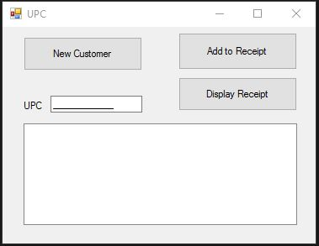
INPUT
Masked Text Box – UPC Code
OUTPUT
lstOutput – the purchase receipt
EVENTS
btnNewCustomer – Prepares form for new customer
btnAddReceipt – Adds single item to a purchase
btnDisplayReceipt – Displays final receipt

