Slide 1
Baseball
An Introduction
To Programming
Using
Visual Basic
Exercises for Beginners
06
The file Baseball.xml contains data about the performance of major league players in 2012 season.
Write a program using the file, that requests team as input from a list box and displays the players from that team whose batting average was above the average of his teammate's batting averages that are listed in the file. The players should be sorted in decreasing order by their batting averages. The output should display each player's name and batting average

Slide 2
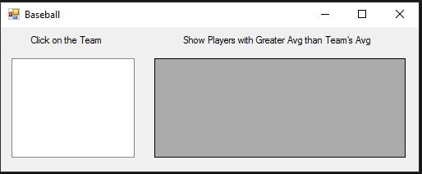
INPUT
XML file – Baseball.xml
OUTPUT
DataGridView - dgvOutput
EVENTS
ListBox Index Changed – displays players with above average scores in Data Grid View

