Slide 1
Voting Machine
An Introduction
To Programming
Using
Visual Basic
Exercises for Beginners
02
Write a program that handles an election. When the program is first run, the label at the top of the page should read as follows: "Nominate candidate" to enter a candidate. or "Start Voting" to end nominations and start the voting. The program should add each candidate to a list box as he or she is nominated.
After the nomination process is complete, club members should be able to approach the computer one at a time and double-click on the candidate of their choice. When the Tally Votes button is clicked on, a second list box showing the number of votes received by each candidate, should appear along side the first list box. Also, the name(s) of the candidate(s) with the highest number of votes should be displayed in a message box.

Slide 2
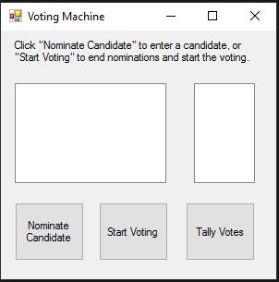
INPUT
Input dialog – enter candidate names
OUTPUT
lstCandidates – displays candidate names
lstVotes – display voting results
EVENTS
btnNominate – enter new candidate
btnVote – vote for candidates
btnTally – add votes

