Slide 1
Inventory Control
An Introduction
To Programming
Using
Visual Basic
Exercises for Beginners
03
Write a menu-driven multiform inventory program for a book store with data saved in a text file. Each record of the text file should consist of five fields – title, author, category (fiction or non-fiction), wholesale price, and number in stock. At any time, the program should display the titles of the books in stock in a list box. The user should have the option of displaying either all titles or just those in one of the 2 categories. The user should be able to add a new book, delete book, or alter any of the fields of a book in stock. The adding and editing processes use the second form frmDetails. At any time, the user should be able to calculate the total value of all books, or the total value of the books in either category. The menu item File contains the two second-level menu items Save and Exit. The menu items Display and Values each contain the three second-level menu items All, Fiction, and Non-Fiction.
Hint: Store the data about the books in an array of structures

Slide 2
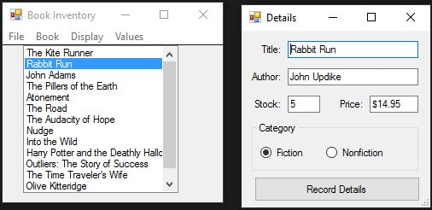
INPUT
Text File. We will read and write to it.
OUTPUT
All books
Book details
EVENTS
Menu driven to add, edit, or delete books, and calculate inventory value

