Slide 1
Calculator
An Introduction
To Programming
Using
Visual Basic
Exercises for Beginners
01
Write a program that allows the user to specify two numbers and then adds, subtracts, or multiplies them when the user clicks on the appropriate button.
The output should give the type of arithmetic performed and the result.
When one of the numbers in an input text box is changed, the output text box should be cleared.

Slide 2
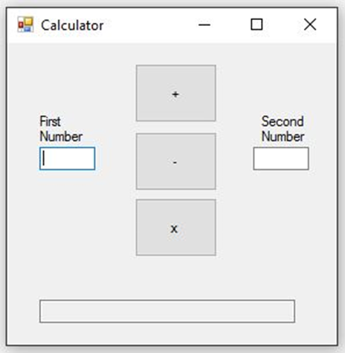
INPUT
First Number - txtFirst
Second Number – txtSecond
OUTPUT
Output Text Box – txtResults
EVENTS
Addition Button – btnPlus
Subtraction Button – btnMinus
Multiplication Button – btnMultiply

