Slide 1
Change For a Dollar
An Introduction
To Programming
Using
Visual Basic
Exercises for Beginners
03
Write a program to make change for an amount of money from 0 through 99 cents input by the user. The output of the program should show the number of coins from each denomination used to make change.

Slide 2
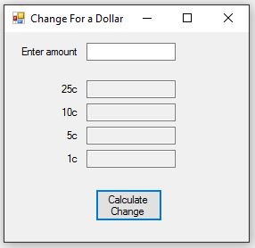
INPUT
Enter Amount – txtAmount
Output (Read Only)
25c – txt25
10c – txt10
5c – txt5
1c – txt1
EVENTS
Calculate Change - btnCalculate

