Slide 1
Unit Price
An Introduction
To Programming
Using
Visual Basic
Exercises for Beginners
06
Write a program that requests the price and weight of an item in pounds and ounces, and then determines the price per ounce.

Slide 2
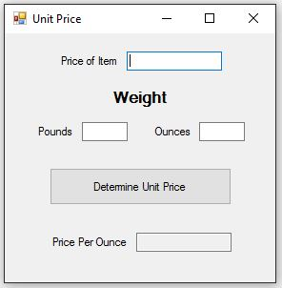
INPUT
Price Of Item – txtPriceOfItem
Pounds – txtPounds
Ounces - txtOunces
Output (Read Only)
Price Per Ounce - txtPricePerOunce
EVENTS
Determine Unit Price - txtDetermine

