Slide 1
Quadratic Equation
An Introduction
To Programming
Using
Visual Basic
Exercises for Beginners
04
Write a program to determine the real roots of the quadratic equation
ax + bx + c = 0 (where a <>0) after requesting the values of a, b, and c.
Before finding the roots, ensure that ‘a’ is a non-zero value
NOTE: the operation has 2, 1, or 0 solutions depending on whether the value of b^2 – 4*a*c is positive, zero, or negative.
In the first two cases, the solutions are given by the quadratic formula
(-b +- Math.Sqrt(b^2 -4 * a * c)) / (2 *a)
Example: a = 1, b = -11, c = 28; Solutions = 7 and 4
2

Slide 2
Ensure a <> 0
Determine number of solutions using b^2 – 4*a*c
If result is negative, there are 0 solutions
If result is 0, there is one solution using formula (-b +- Math.Sqrt(b^2 -4 * a * c)) / (2 *a)
If result is positive, there are two solutions using formula
(-b +- Math.Sqrt(b^2 -4 * a * c)) / (2 *a)
solution 1 uses –b + MathSqrt….
solution 2 uses –b – MathSqrt….

Slide 3
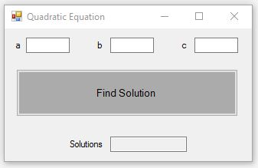
INPUT
Number a - txtA
Number b – txtB
Number c - txtC
OUTPUT
Output Text Box – txtSolutions
EVENTS
Find Solution Button – btnFindSolution

