Slide 1
Restaurant Menu
An Introduction
To Programming
Using
Visual Basic
Exercises for Beginners
05
Write a program to place an order from the restaurant menu. Group the menu and make each group box invisible, and becomes visible only when its corresponding check box is checked. After the button is clicked, the cost of the meal should be displayed.
NOTE: The checked property of the radio button in each group should be set to True. This guarantees that a selection is made in each visible group box.

Slide 2
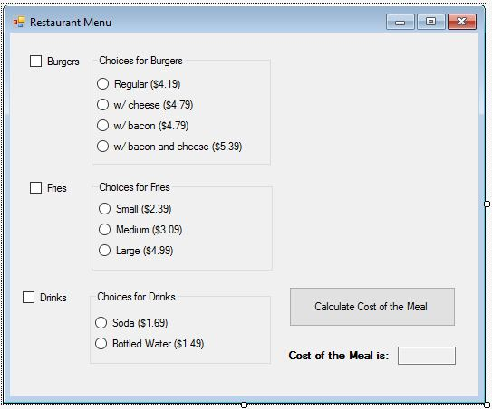
Burgers | Fries | Drinks
Regular ($4.19) | Small ($2.39) | Soda ($1.69)
w/ Cheese ($4.79) | Medium ($3.09) | Bottled Water ($1.49)
w/ Bacon ($4.79) | Large ($4.99)
w/ bacon and cheese ($5.39)
Checkboxes (open corresponding radioButtons)
Burgers – chkBurgers
Fries - chkFries
Drinks - chkDrinks
OUTPUT
Output Text Box – txtCost
EVENTS
checkbox - CheckedChanged
Radio button – CheckedChanged
Calculate button - btnCalculate

