Slide 1
College Admissions
An Introduction
To Programming
Using
Visual Basic
Exercises for Beginners
06
The admissions offices of colleges often rely on point system. Write a program that allows an admissions officer to determine whether an applicant should be admitted.
Program should calculate the total score and then admit an applicant with score of 100 or more

Slide 2
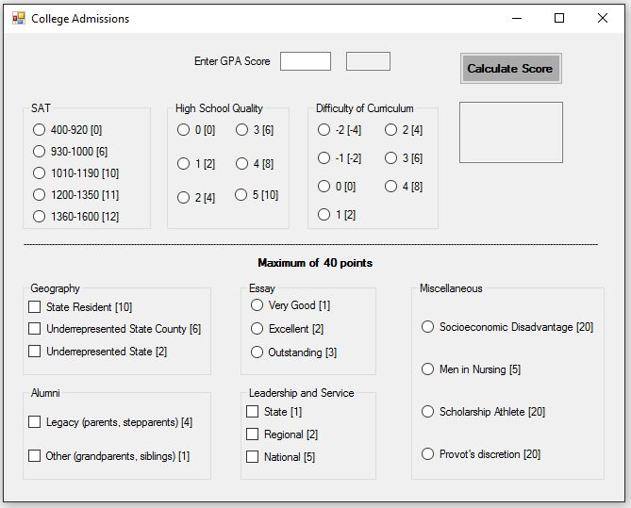
The GPA entered should be between 2.0 and 4.0. The points assigned are 20x the GPA (i.e. GPA 3.5 = 70 points)
Total of 40 points MAX can be earned from responses below the line
The numbers in brackets are points awarded for the response
INPUT
GPA score - txtGPAScore
RadioButtons
CheckBoxes
OUTPUT
Output Text Box – txtOutput (multiline, read-only)
EVENTS
Calculate Score - btnCalculate
RadioButtons - CheckedChange
CheckBoxes – CheckedChange
NOTE:
The points in brackets are stored in Tag property of each radioButton and checkBox

