Slide 1
Grade Point Average
An Introduction
To Programming
Using
Visual Basic
Exercises for Beginners
01
Write a program to calculate a student's GPA. The user should enter the grade (A, B, C, D, or F) and the number of credit hours for a course, and then click on the 'Record This Course' button.
The user should then repeat this process for all the student's courses. After all the courses have been recorder, the user should click on the 'Calculate GPA' button. A function procedure should be used to calculate the quality points for a course.

Slide 2
Grade Rules
A = 4.0
B = 3.0
C = 2.0
D = 1.0
F = 0
Credit Hours:
Max 4
Min 1
MAX Possible Grade: 16 (Student gets A and 4 credit hours -> 4 * 4 = 16)
Actual Course Grade: Student Grade * Credit Hour
Final Grade: (Actual Course Grade / MAX Possible Grade) * 4

Slide 3
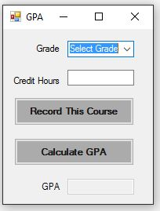
INPUT
Grade - cmbGrades
Credit Hour – txtCreditHour
OUTPUT
GPA - txtGPA
EVENTS
Record Course - btnRecord
Calculate GPA - btnCalculate

