Slide 1
Restaurant Bill
An Introduction
To Programming
Using
Visual Basic
Exercises for Beginners
02
Write a program to compute customer's bill. The vendor sells pizza slices for $1.75, fries for $2.00 and soft drinks for $1.25. The program should request the quantity of each item, ordered in a Sub procedure, calculate the total cost with a Function procedure and use Sub procedure to display an itemized bill.

Slide 2
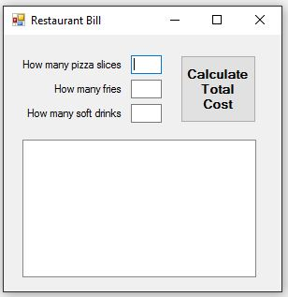
INPUT
Slices of Pizza - txtPizza
Fries – txtFries
Drinks - txtDrinks
OUTPUT
Bill - lstDisplay
EVENTS
Calculate Cost - btnCalculate

