Slide 1
Furniture Order
An Introduction
To Programming
Using
Visual Basic
Exercises for Beginners
03
A furniture manufacturer makes two types of furniture: chairs and sofas. The price per chair is $350 and price per sofa is $925. Sales tax is 5%.
Write a program that creates an invoice for an order. After the data has been entered, the user can display an invoice in a list box by pressing the "Process Order" button. The user can click on the "Clear Order Form" button to clear all text boxes and the list box, and click on the Quit button to exit the program.
The invoice number consists of the capitalized first two letters of the customer's last name, followed by the last four digits of the zip code. The customer name is input with the last name first, followed by a comma, a space, and the first name. However, the name is displayed on the invoice in the proper order (first name, last name). The generation of the invoice number and the reordering of the first and last names should be carried out by Function procedures.

Slide 2
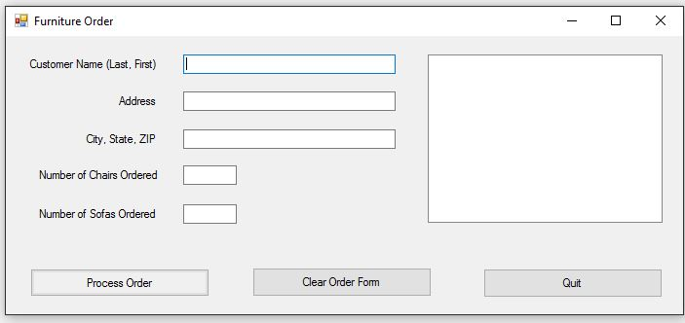
INPUT
Customer Name - txtName
Customer Address – txtAddress
Customer City, State, Zip – txtCity
Chairs Ordered – txtCharis
Sofas Ordered - txtSofas
OUTPUT
Order Details - lstDisplay
EVENTS
Process Order – btnProcess
Clear Form – btnClear
Quit - btnQuit

