Slide 1
Proverbs
An Introduction
To Programming
Using
Visual Basic
Exercises for Beginners
04
Write a program that presents 7 proverbs, one at a time, and asks the user to evaluate them as true or false. The program should then tell the user how many questions were answered correctly and display one of the following evaluations:
Perfect (all correct)
Excellent (5 or 6 correct)
You might consider taking Psychology 101 (less than 5 correct)

Slide 2
Proverb | Truth Value
The squeaky wheel gets the grease | True
Giving is better than receiving | True
Opposites Attract | False
Spare the rod and spoil the child | False
Actions speak louder than words | True
Flattery will get you nowhere | False
Marry in haste, repent at leisure | True

Slide 3
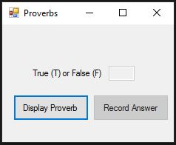
INPUT
Text Box – txtAnswer
OUTPUT
Text Box – txtCorrectAnswer
EVENTS
Display Proverb - btnProverb
Display Answer – btnAnswer

