Slide 1
Stick Game
An Introduction
To Programming
Using
Visual Basic
Exercises for Beginners
05
Write a program that allows the user to challenge the computer to a game of Pick Up Sticks.
Game Rules:
The user chooses the number of matchsticks from 5-50 to place in pile. Then, the computer chooses who will go first.
At each turn, the contestant can remove 1, 2, or 3 matchsticks from the pile. The contestant who removes the last matchstick loses.
The computer should make the user always select from the pile where the number of matchsticks has a remainder of 1 when divided by 4.
For instance, if the user initially chooses a number of matchsticks that has a reminder of 1 when divided by 4, then the computer should have the user go first. Otherwise, the computer should go first and remove the proper number of matchsticks.
NOTE: The remainder when n is divided by 4 is n Mod 4. After writing the program, play a few games and observe that the computer always wins.

Slide 2
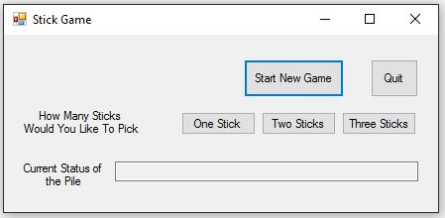
INPUT
Number Of Sticks – Input Box
OUTPUT
Status Of Game – txtPileStatus
EVENTS
Start Game – btnStart
Quit Game – btnQuit
Select 1 Stick – btnOne
Select 2 Sticks – btnTwo
Select 3 Stick – btn Three

